Slide 1


A teacher resource to support 1st – 2nd class pupils to explore and acknowledge the importance of our shared world.
Notes:
Acknowledgements
This resource has been published by GOAL as part of GOAL’s Global Citizenship Education Programme for primary schools 2021 and is funded by Irish Aid.
All artwork for this resource is by GOAL’s design team in Honduras, in partnership with Bear Print Media.
© GOAL 2021
A special thanks to our pilot schools St. Marys National School, Trim, Co. Meath & Scoil Bhríde Shelagh, Dundalk, Co. Louth for taking the time to test the resource in 1st-2nd classes and for providing invaluable feedback.
We would like to acknowledge the collaboration and support of the following individuals/organisations during the resource development process:
GOAL's 2020/21 Teacher Advisory Group: Sarah Callan, Aoife Dowdall, Paula Galvin, Justin McGuire & Trasa Minnock, our colleagues in GOAL Honduras, The Marine Institute of Ireland & Mar Alliance.
Background
GOAL Global is a humanitarian aid agency founded in 1977. GOAL has responded to many of the world’s major humanitarian crises, working with disadvantaged communities in over 60 countries.
Today, GOAL is supporting vulnerable communities in 14 programme countries across Africa, the Middle East, and Latin America. GOAL is currently applying its unique expertise in Emergency Response to the Global Covid-19 crisis.
In addition to emergency response, GOAL also works towards food & nutrition security, resilient health & sustainable livelihoods, and fostering Global Citizenship - recognising that we all share responsibility for a better world.
We all need to work together as we strive to achieve GOAL’s mission: A world without poverty.

Slide 2

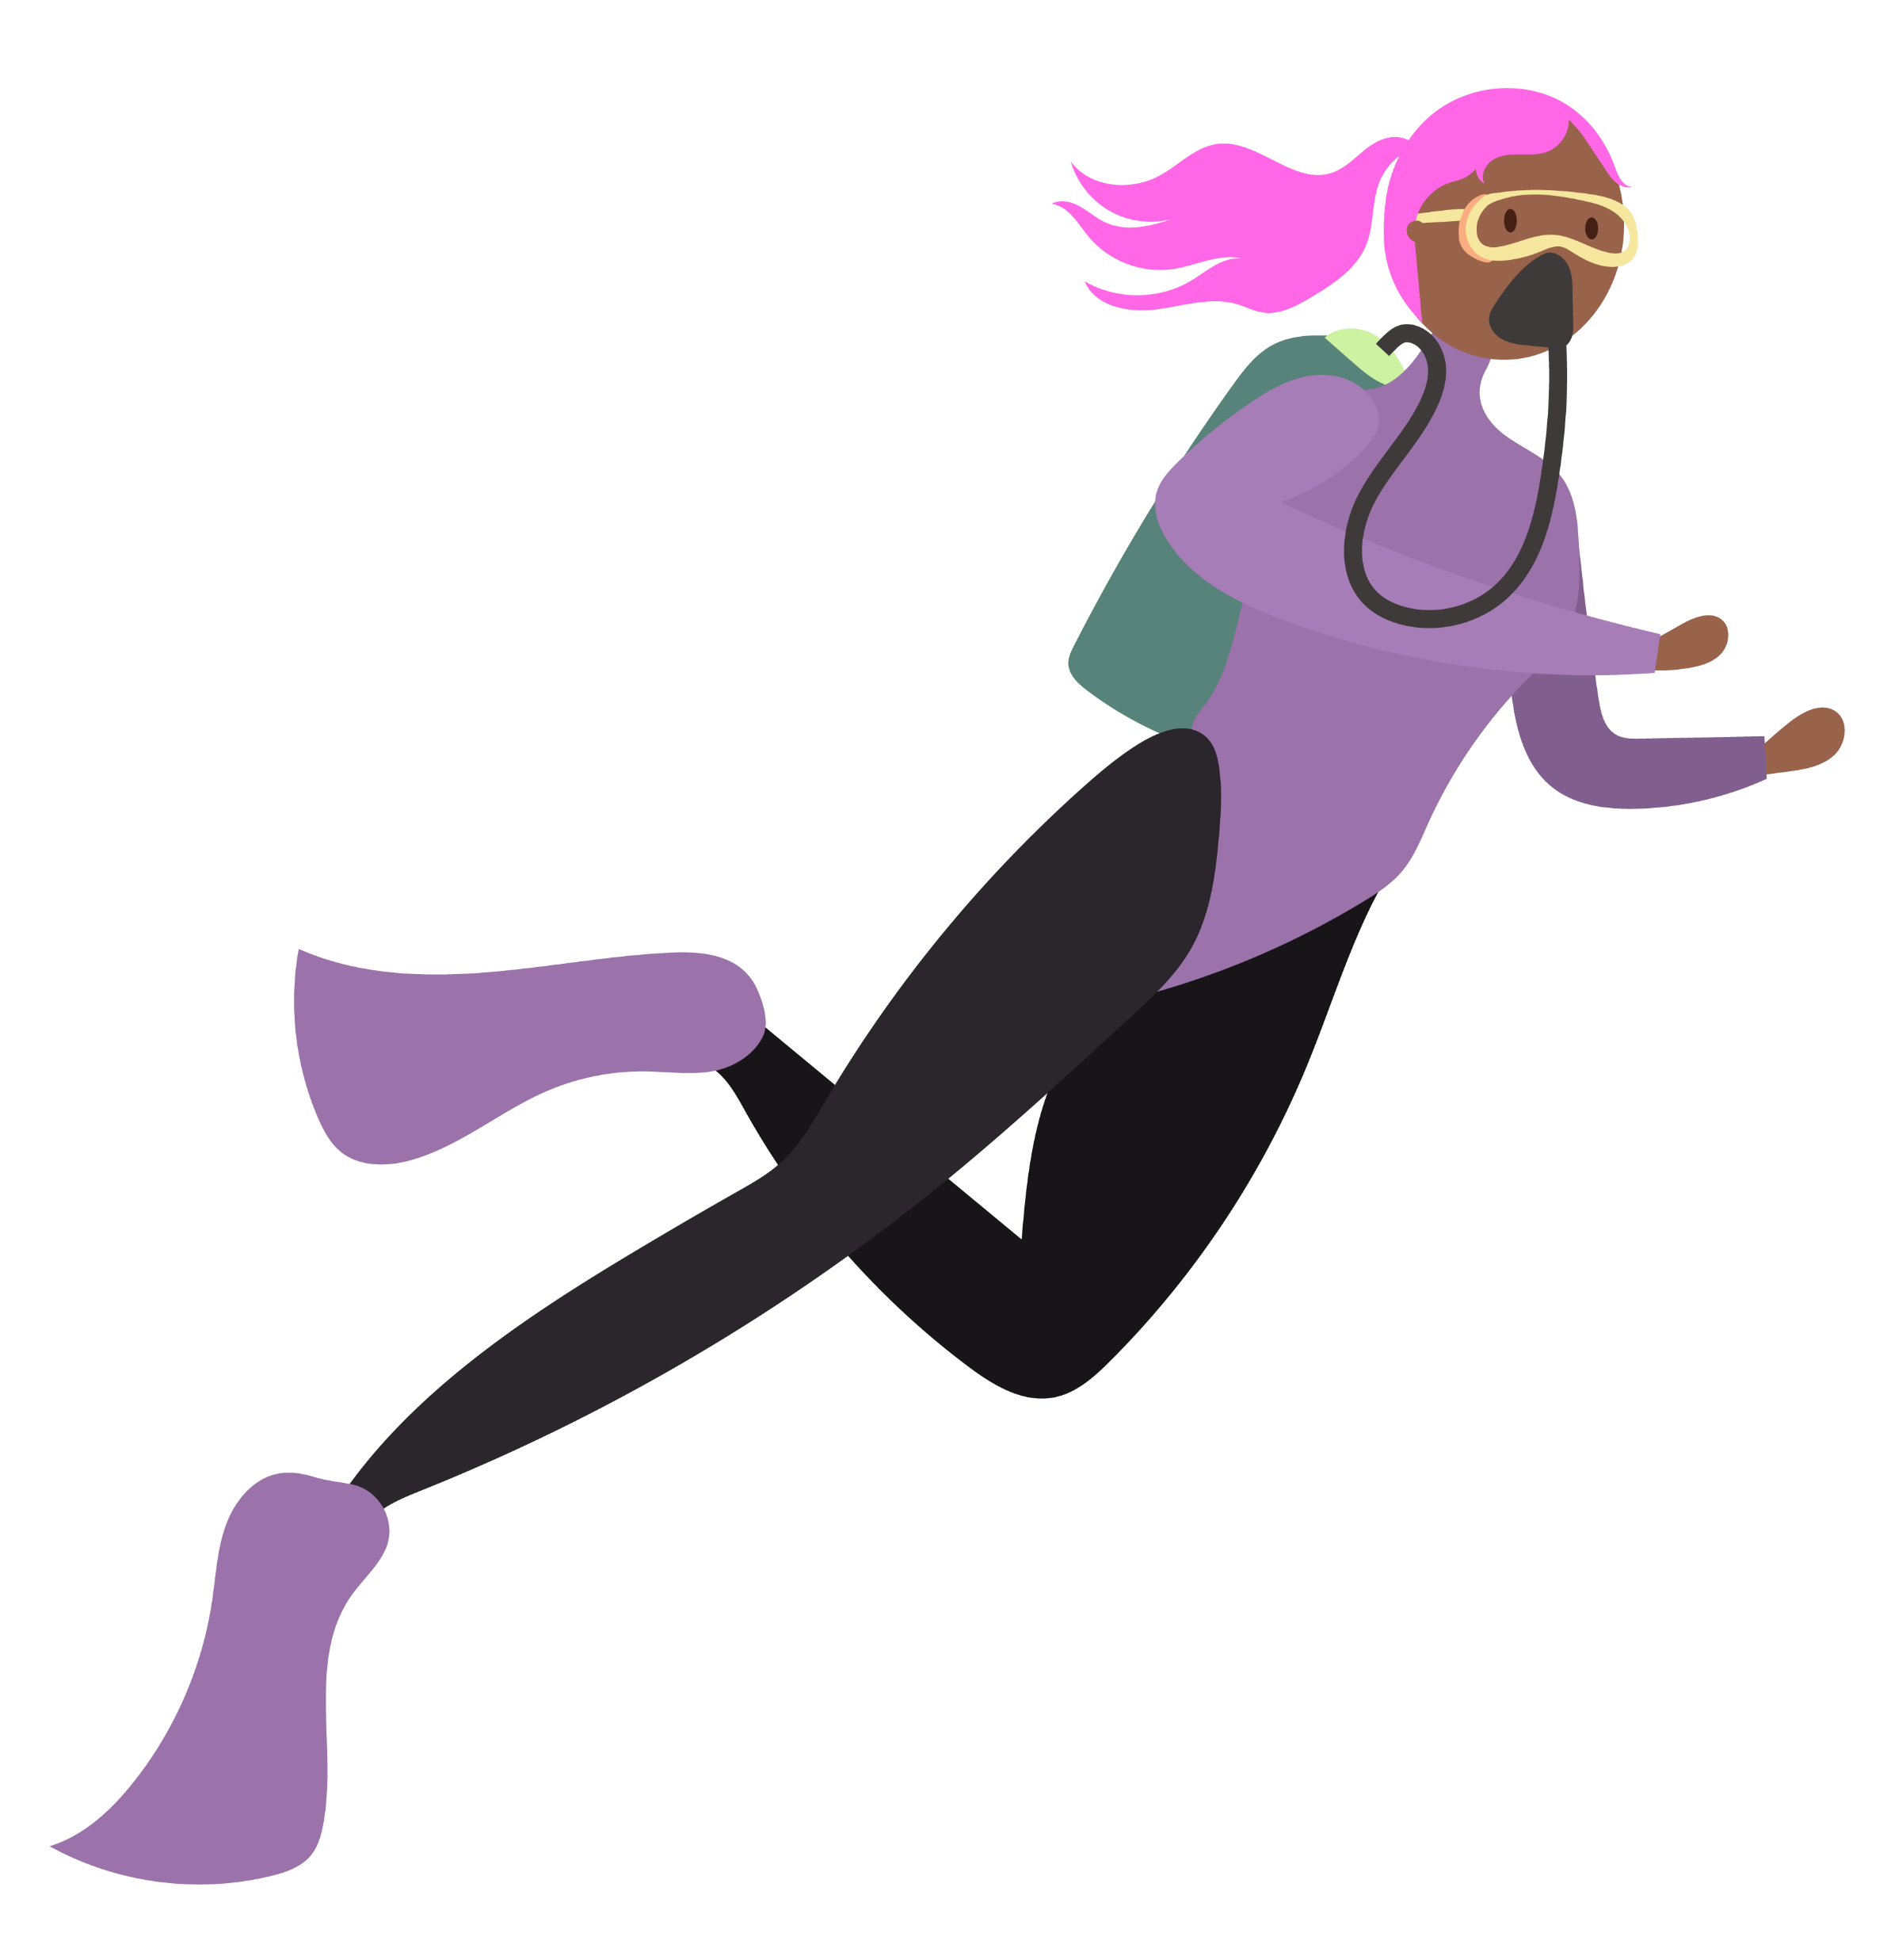
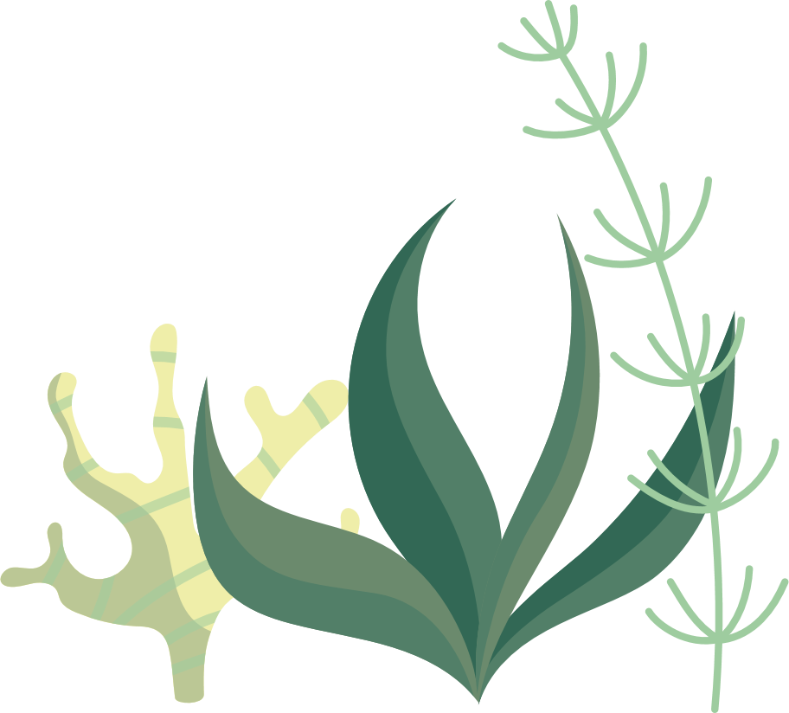
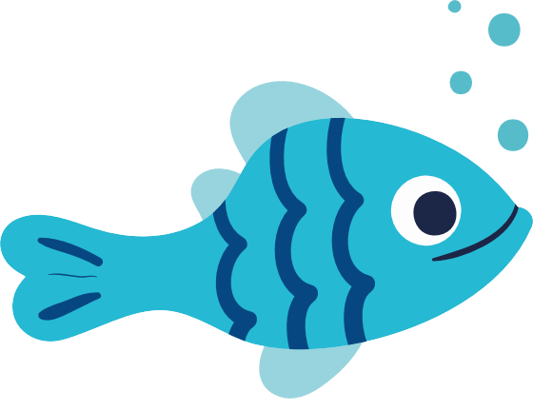
Aim
To enable pupils to explore and reflect upon the importance of healthy waterways in the context of local and global sustainability using drama and other creative and participative educational
methodologies.
Notes:
Notes for teachers
Water Wishes 1st – 2nd class: Aim slide (No animation)

Slide 3
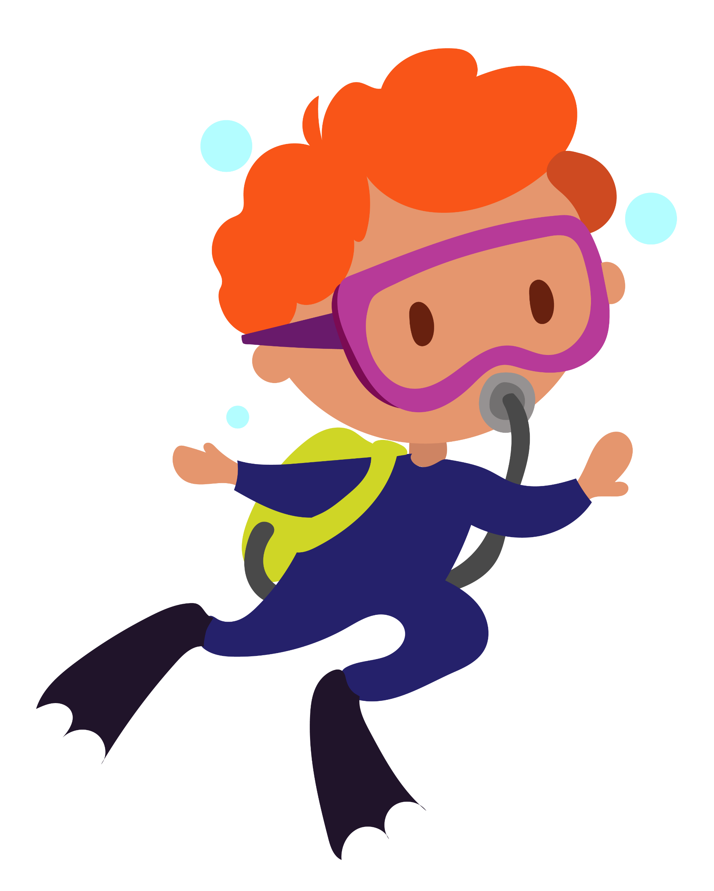
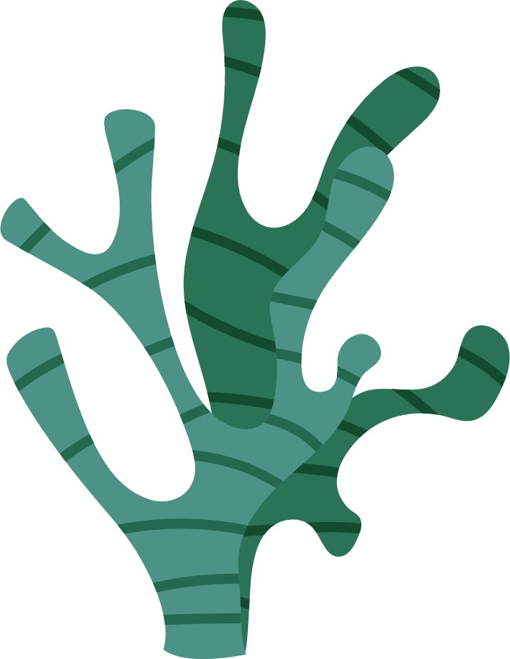
Unit Overview
Powerpoint contents | Section | Slide number
 | Curriculum links | 4 - 5
 | Lesson 1: | 6 - 24
 | Lesson 2: | 25 - 32
 | Lesson 3: | 33 - 44
 | Lesson 4: | 45 - 54
•4 curriculum-linked lessons
•Visually attractive slides for use with 1st – 2nd class
•Multi-media stimuli included in slides – this means internet access will be necessary for some slides
• Step-by-step teacher support in Slide Notes (including ideas to adapt to online learning contexts)
Everything you need to teach
– all in one PowerPoint!
Notes:
Notes for teachers
Water Wishes 1st – 2nd class: Unit Overview slide (No animation)

Slide 4

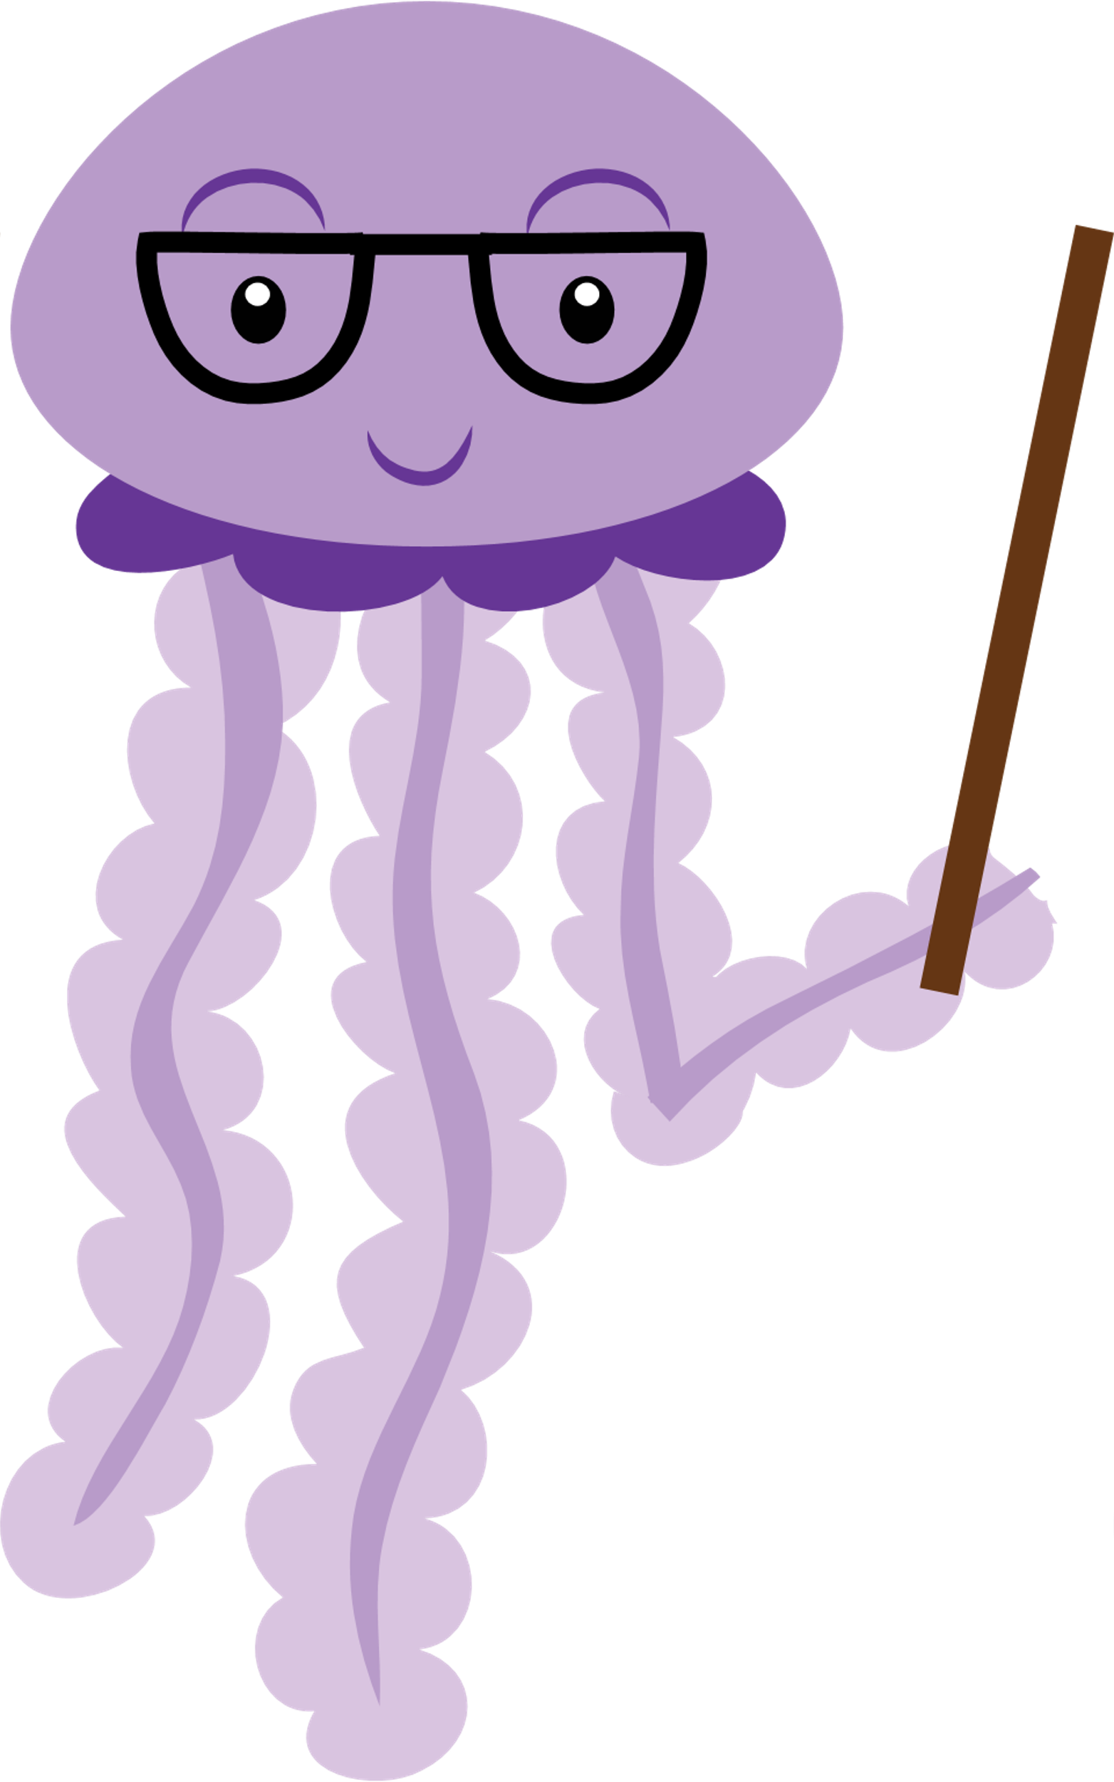
Curriculum links & Unit learning intentions
Notes:
Notes for teachers
Water Wishes: Curriculum links & Unit learning intentions (Title slide) (No animation)

Slide 5
Curriculum Links
Subject
Drama | Drama to explore feelings, knowledge and ideas, leading to understanding Exploring and making drama Cooperating/communicating making drama Reflecting on drama
SESE Geography | Human Environments People and places in other areas Natural Environments The local natural environment Environmental Awareness and Care Caring for my locality
Mathematics | Number Counting and numeration
Physical Education | Games Creating and playing games Understanding and appreciation of games
SESE Science | Living things Plants and animals Environmental awareness and care Caring for my locality
Subject
Visual Arts | Drawing Making drawings Paint and colour Painting
SPHE | Myself and others Relating to others Myself and the wider world Developing citizenship
Languages English Irish | Oral language Communicating Understanding Exploring and using Reading Communicating Exploring and using Writing Exploring and using | Teanga ó Bhéal Cumarsáid Tuiscint Fiosrú agus úsáid Léitheoireacht Tuiscint Fiosrú agus úsáid Scríbhneoireacht Fiosrú agus úsáid
Notes:
Notes for teachers
Curriculum links (no animation)
Unit Learning Intentions:
Lesson 1
In this lesson, we are learning to:
practice breathing as a way of feeling calm
experience what it means to ‘reuse’
discuss the importance of water in our lives
read a map/extract meaning from a map
consider the need to share knowledge & work together
reflect on our learning
Lesson 2
In this lesson, we are learning to:
practice breathing as a way of feeling calm
consider what it means to overfish
discuss the importance of sustainability
listen and respond to a story
collaborate, listen and share knowledge
reflect on their learning
Lesson 3
Learning intentions
In this lesson, we are learning to:
practise breathing as a way of feeling calm
discuss the problems facing our rivers, seas and oceans and solutions to these problems.
work together as a team.
consider the lives and environment of fishing families in Honduras.
use numeracy and literacy to engage in a fishy activity.
reflect on our learning
Lesson 4
Learning intentions
In this lesson, we are learning to:
practice breathing as a way of feeling calm
identify the different United Nations Global Goals
discuss Changemakers working to progress Global Goal 14: Life under water
generate action ideas to protect our waterways
reflect on our learning

Slide 6
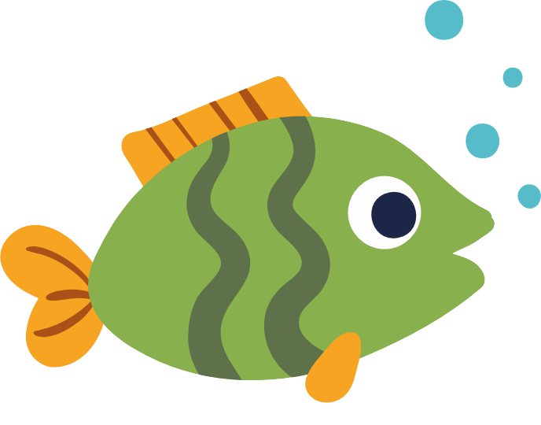
Lesson 1
Notes:
Notes for teachers
Water Wishes 1st – 2nd class: Lesson 1 Title slide (No animation)

Slide 7
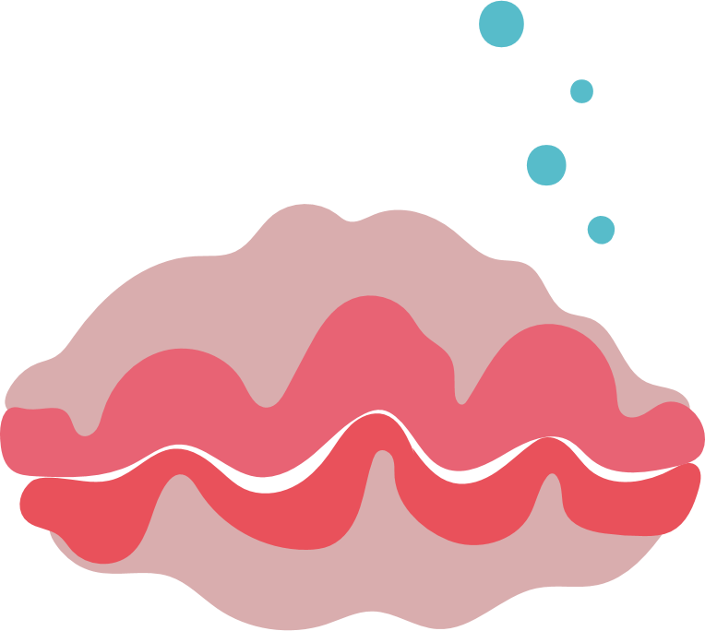
Lesson 1
Learning intentions
In this lesson, we are learning to:
practice breathing as a way of feeling calm
experience what it means to ‘reuse’
discuss the importance of water in our lives
read a map/extract meaning from a map
consider the need to share knowledge & work together
reflect on our learning
Notes:
Lesson 1 Teacher notes
Approximate time of lesson: 45 minutes

Slide 8

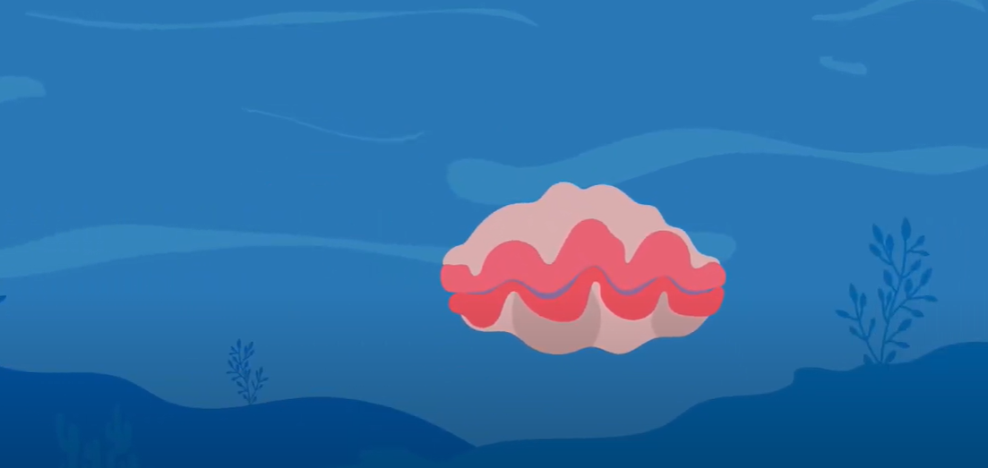
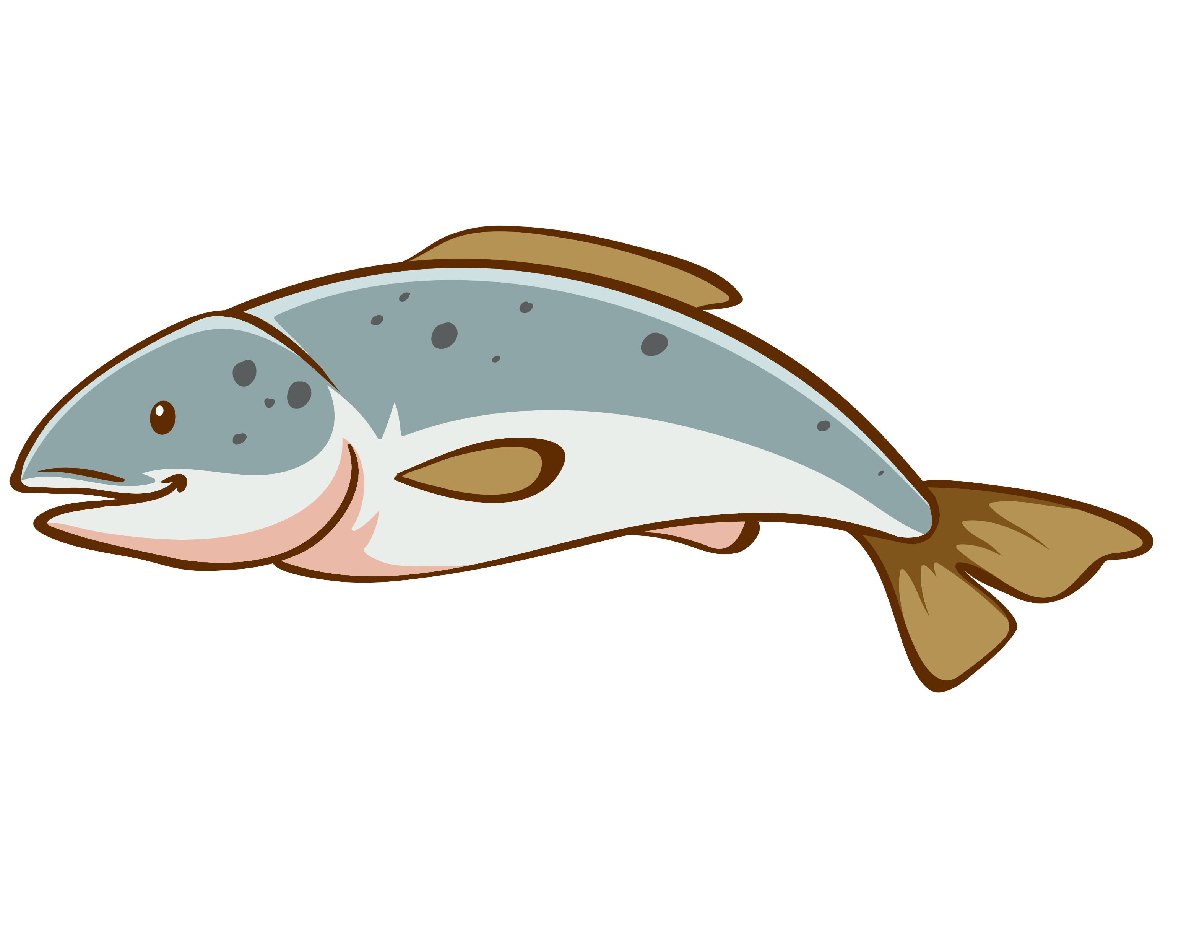
Activity 1 Mindful Giant Clams
Have you ever seen a mindful giant clam?
Notes:
Teacher’s Step-by-step Activity Guide
Activity 1: Mindful Giant Clams
Explain that one way to feel calmer or better is to breathe in and out, slowly and deeply.
Tell the class that they are going to practice breathing as a way of feeling calm. Sometimes it can help to imagine something at the same time as we breathe, to help us slow down our breath.
To guide the breathing activity, you can either play the video or use the script provided (below)
Depending on your class, you might like to demonstrate and invite the class to join in for a second or third practice breath.
Script
This is a Giant Clam.
Clams live on the ocean floor, and once they find a nice home, they stay planted in that spot for the rest of their life with their shells gently opening and closing as the water swirls around them.
So, settle yourselves down like a Giant Clam, with your feet firmly planted on the ground and bring your hands together, to make the shell of a clam.
Remember that no matter how rough the water gets, or how many thoughts we have, we can always come back to our breath.
As I count, we’re going to slowly practice breathing in and out, opening and closing our shells.
1 -2 -3 – 4 and pause, and now slowing breathing out 1 2 3 4 closing our shell.
Now let’s repeat this a few times.
Breathing in 1 2 3 4 shells open
Breathing out 1 2 3 4 shells closed
Breathing in 1 2 3 4 shells open
Breathing out 1 2 3 4 shells closed
Breathing in 1 2 3 4 shells open
Breathing out 1 2 3 4 shells closed

Slide 9
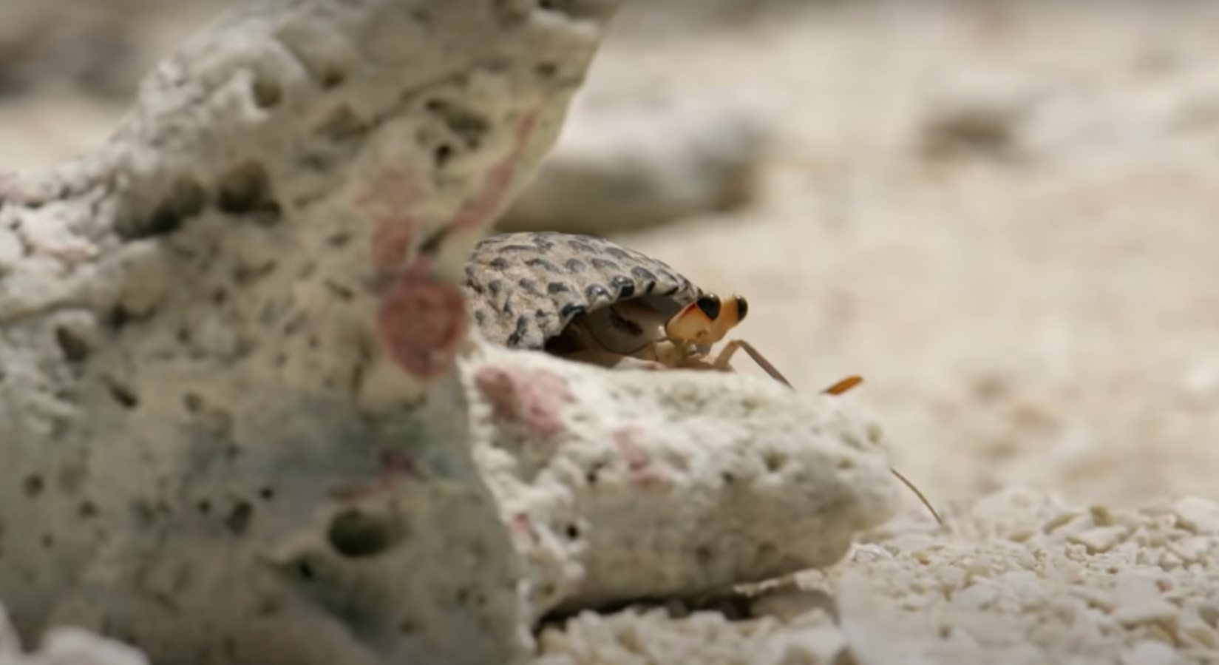

Activity 2 The Great Shell Off
Can you spot the hermit crab?
Notes:
Activity 2: The Great Shell-off
Explain to the class that they are going to be watching a video about Hermit Crabs.
Ask the class to see if anyone has heard of a hermit crab before.
Share the information about hermit crabs (page 2) with the class.
Play Hermit Crab Shell Exchange video: https://www.youtube.com/watch?v=f1dnocPQXDQ&t=196s (4:06 mins). Note: Depending on your class, you may wish to use the video transcript (page xx).
Explain that Hermit Crabs can be found in the ocean off the coast of a country called Honduras. Note: Depending on class, you might like to point to Honduras on a map of the world (page 2 or separate document in g-drive).
Tell the class that they are going to learn more about Honduras later on.
Facilitate a whole class discussion using the following questions as prompts:
What does the word “reuse” mean? [to use something again, more than once!]
Did you notice that the crabs pass on their shells when they grow out of them, and another crab comes along to reuse it after them? What do you think of that?
Have you or anyone you know ever passed your clothes or toys on to someone else? Do you think this is a good thing? Why/not?

Slide 10

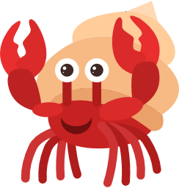
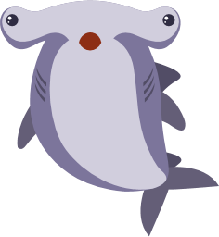
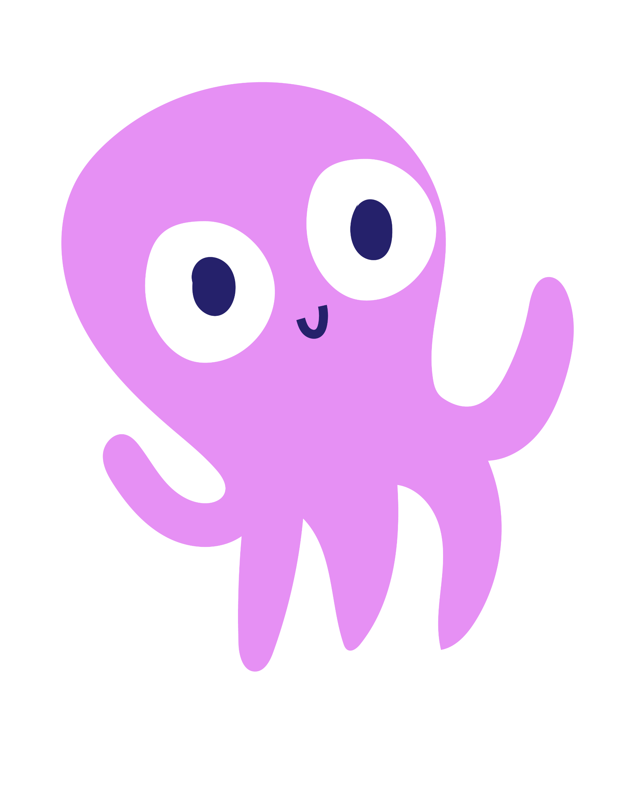
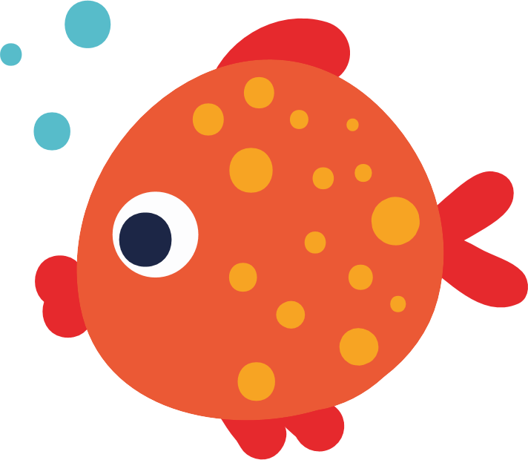
Activity 3 Knowing H2O
TRUE
FALSE
Notes:
Activity 3: Knowing H20
Explain to the class that they are going to be asked some questions. They need to take a little bit of time to think and then give a thumbs up 👍 for true and thumbs down 👎 for false.

Slide 11
Activity 3 Knowing H2O
Q1. All humans need water to live.
TRUE
Q2. We all have water in our bodies.
TRUE
More than half of our body is water!
Q3. Animals who live on land can survive without water.
FALSE
All animals on land need at least some fresh water to live and be healthy.
Q4. Seas and oceans are two different words that mean the same thing.
FALSE
Seas are smaller than oceans and are partially surrounded by land.
Q.5 We can drink the water in the seas/oceans.
FALSE
Sea water has salt in it, so we can’t drink it, or it will make us even more thirsty!
Q6. Plants need water to live.
TRUE
Q7. Seas and oceans are the only place that fish can live.
FALSE
Fish can live in rivers, in lakes, or even in-doors, in Fishbowls and Aquariums!
Q8. All streams and rivers will eventually flow into a sea or ocean.
TRUE
So we’re all connected by water around the world!

Slide 12
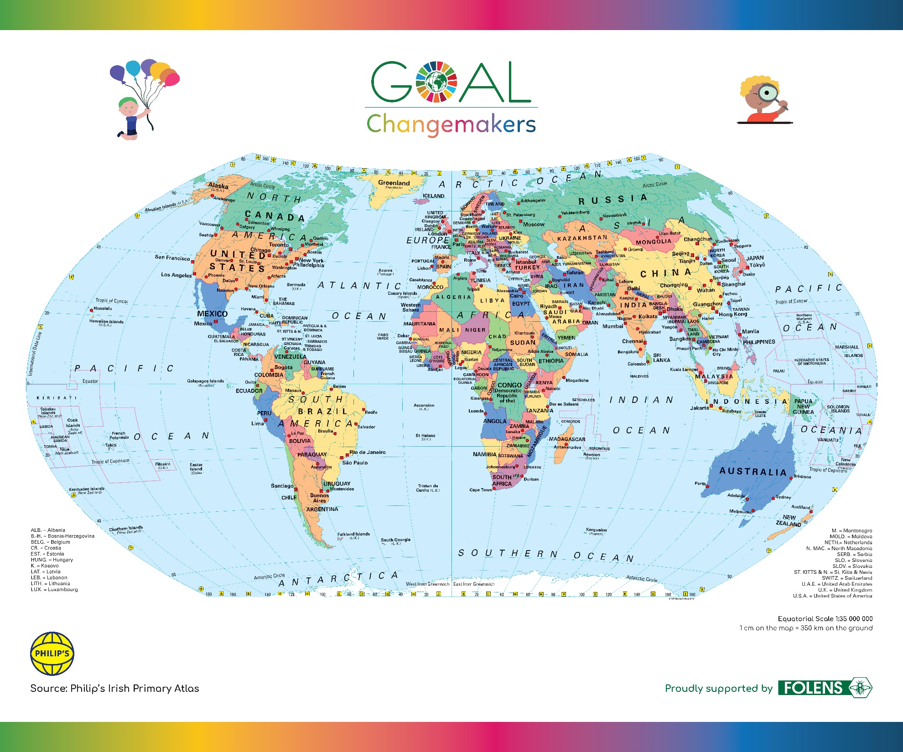
Activity 3: Knowing H2O continued
Write here
Notes:
Activity 3: Knowing H20 continued
Display the map of the world on the board.
Note: Depending on your class, you might like to explain that maps are like pictures of our world taken from way up high in space.
Facilitate a whole class discussion, using the following questions as prompts:
Where do we find water?
[Prompts – Indoors: Taps, Toilet, Baths, Showers, Bottled Water - Outside in Nature: Rain, Puddles, Rivers, Seas, Oceans, etc.]
Why do we need water? Why do animals need water? Do plants need water?
[Prompts – We all get thirsty – plants, animals, people – and we need water to live and be healthy]
Can anyone find Ireland on the map (page 2)?
[Point to Ireland and encourage pupils to note how small a country it is]
3. Explain that we live on an island, and we are surrounded by seas and oceans.

Slide 13
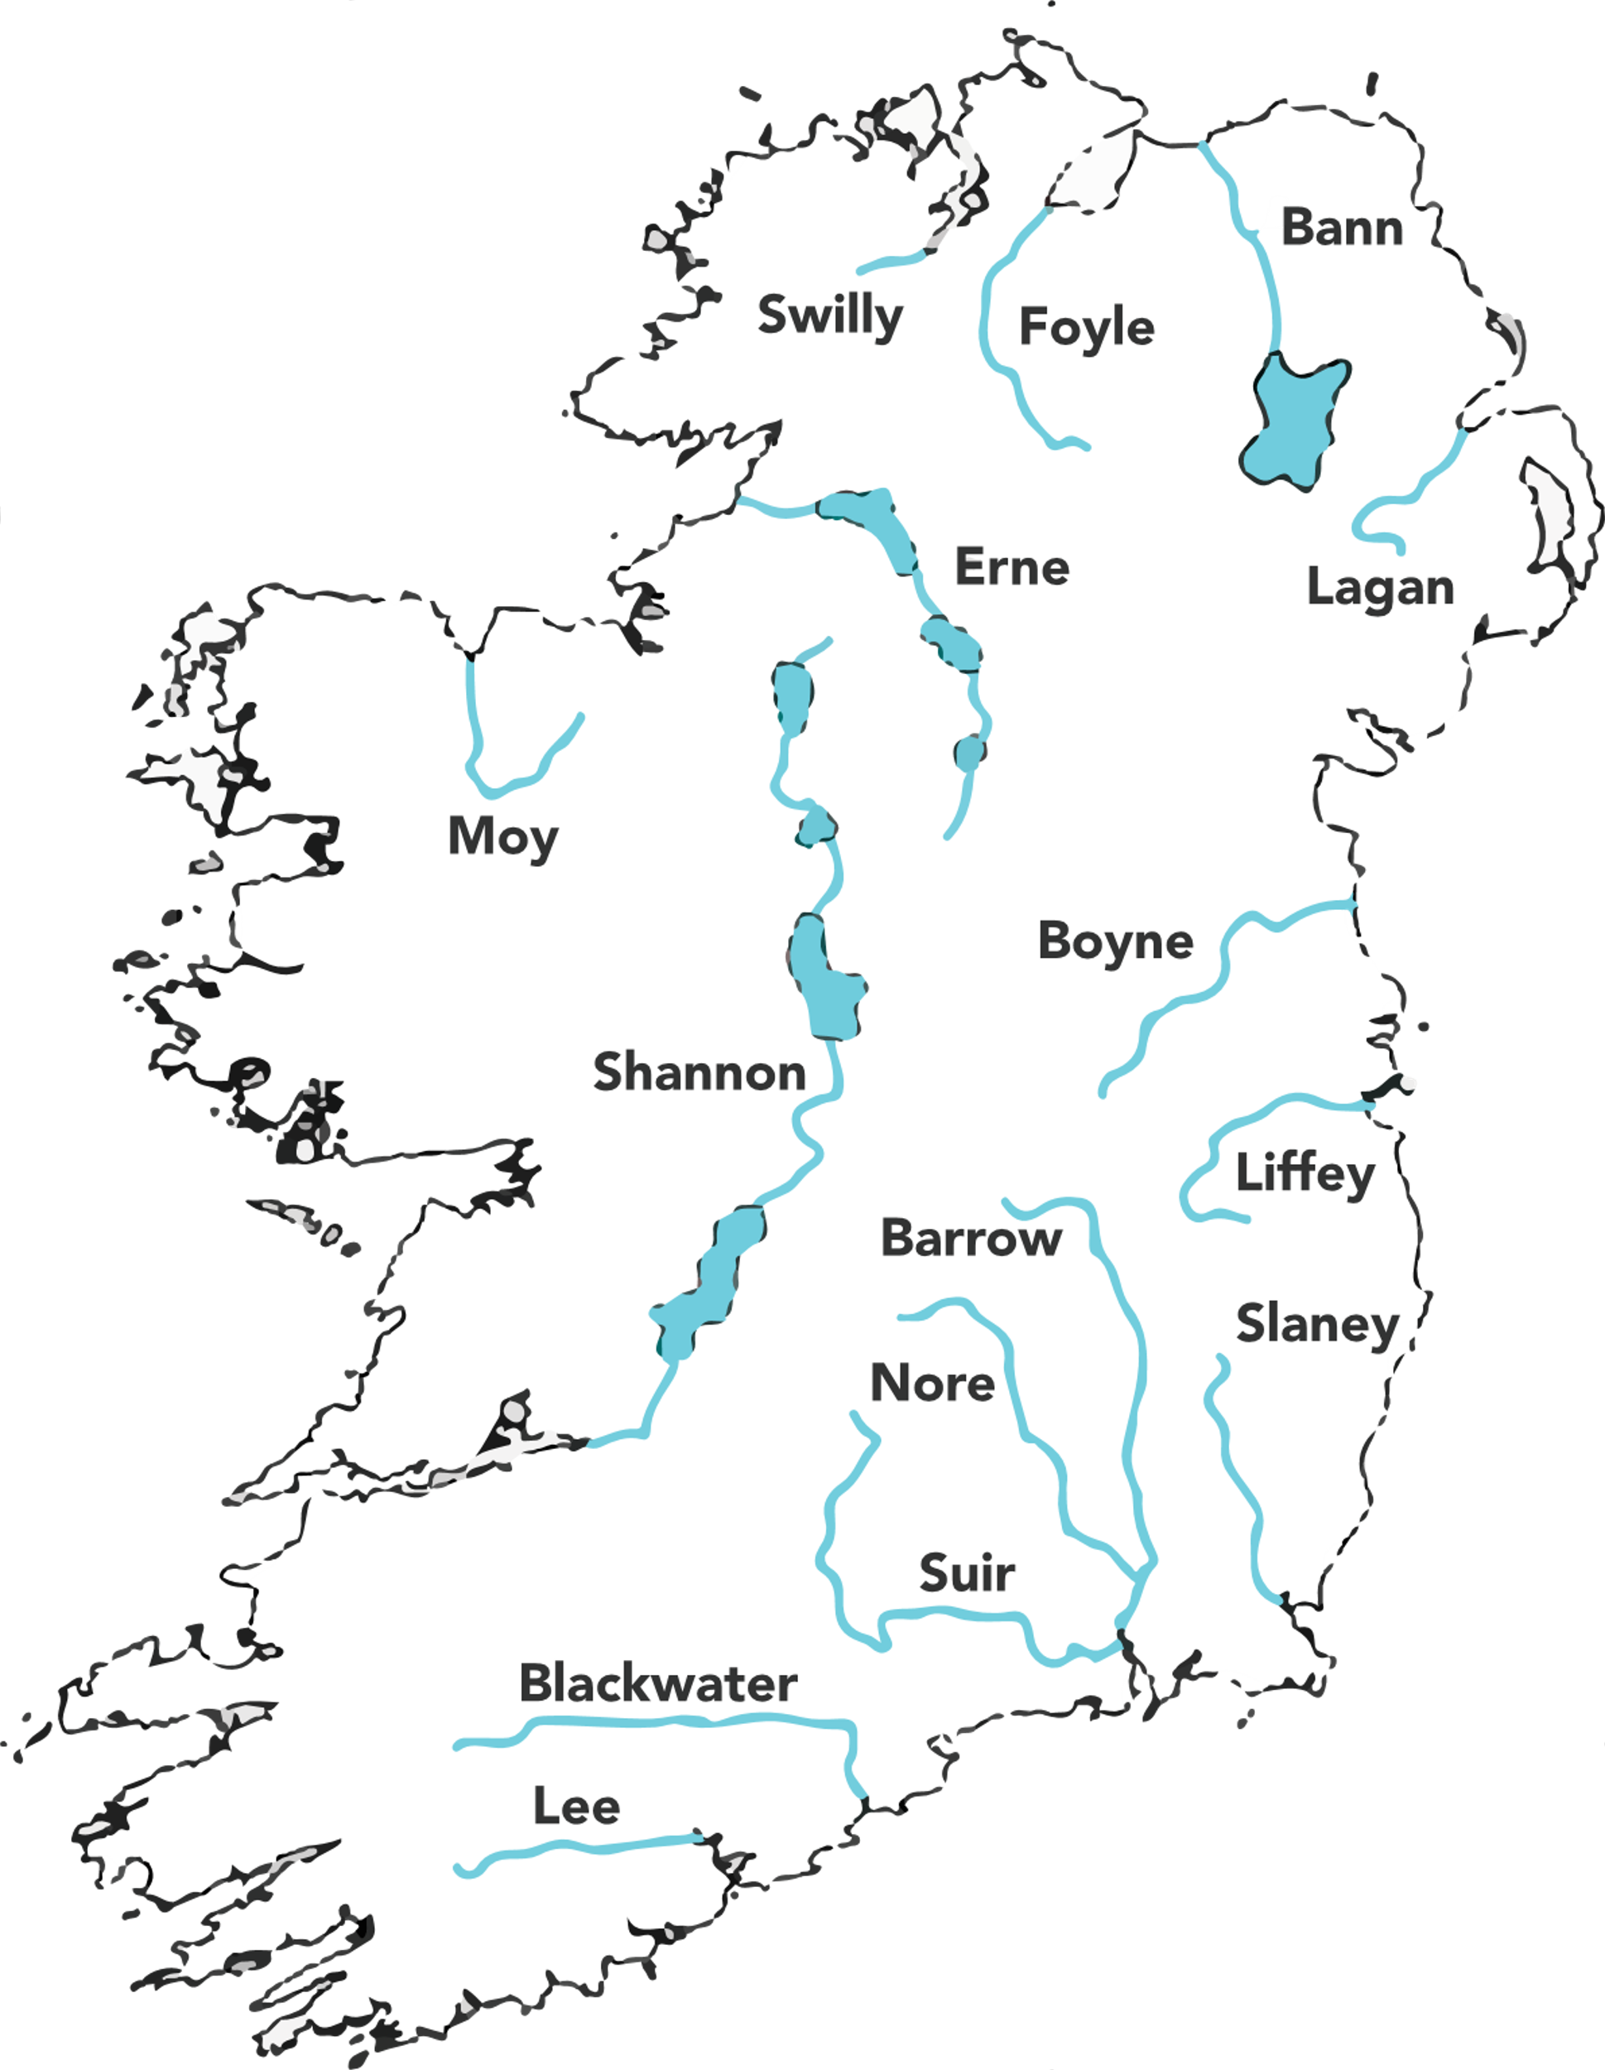
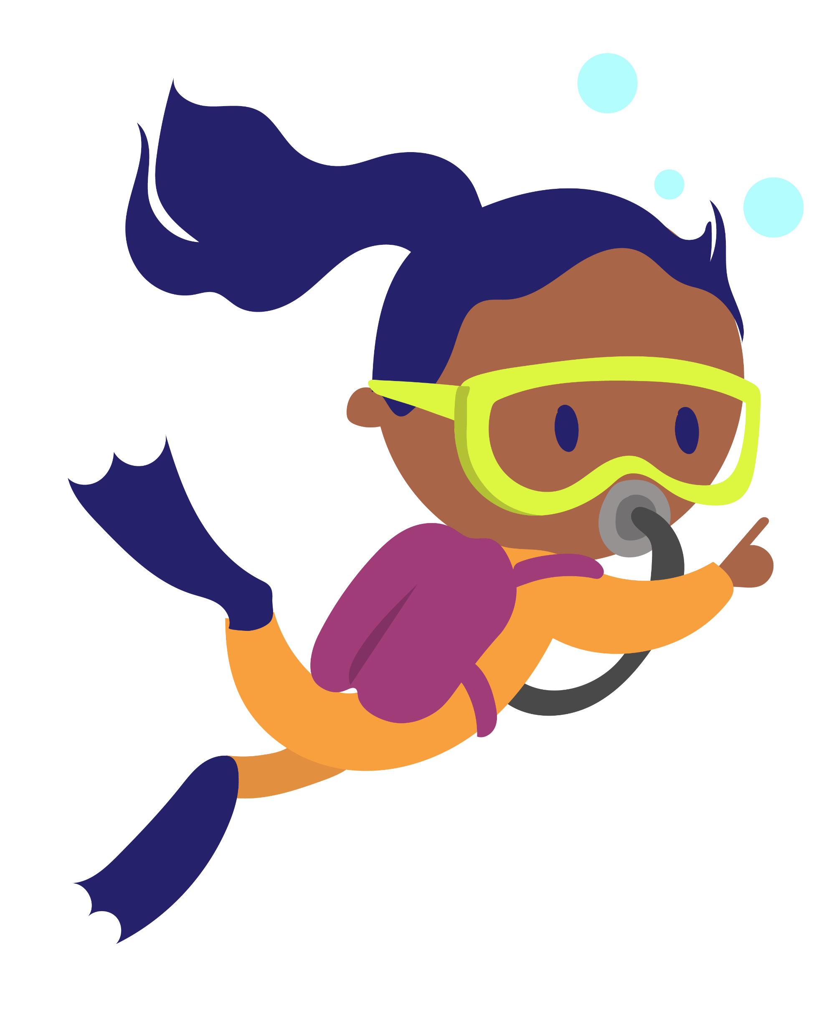
Activity 3: Knowing H20 continued
Did you know?
Salmon are some of the only fish that live in both the salty sea and in fresh-water rivers? That means that salmon could travel all over Ireland, and off out into the sea too!
1. What shape is Ireland?
2. What are the blue lines on the map?
3. Do you or anyone in your family live near the sea/ocean?
Notes:
Activity 3: Knowing H20 continued
4. Display a map of Ireland on the board (page 5). Explain that this is a map of Ireland.
5. Facilitate a whole class discussion, using the following questions as prompts:
What shape is Ireland? [Prompt – Looks like a Teddy Bear]
What are the blue lines? [Answer: Rivers- And look! All the rivers go all the way to the sea/ocean]
Do you or anyone in your family live near the sea/ocean?
Think about the last time you were near water. [Prompts – Was it the sea/ocean? A river? A lake? Maybe when you washed your hands earlier!]
What did you see there? [Prompts – What was in the water? Was there a beach? (Stones, fish, plants insects, rubber ducks, soap etc.)
Did you know that salmon are some of the only fish that live in both the salty sea and in fresh-water rivers? That means that salmon could travel all over Ireland, and off out into the sea too!

Slide 14
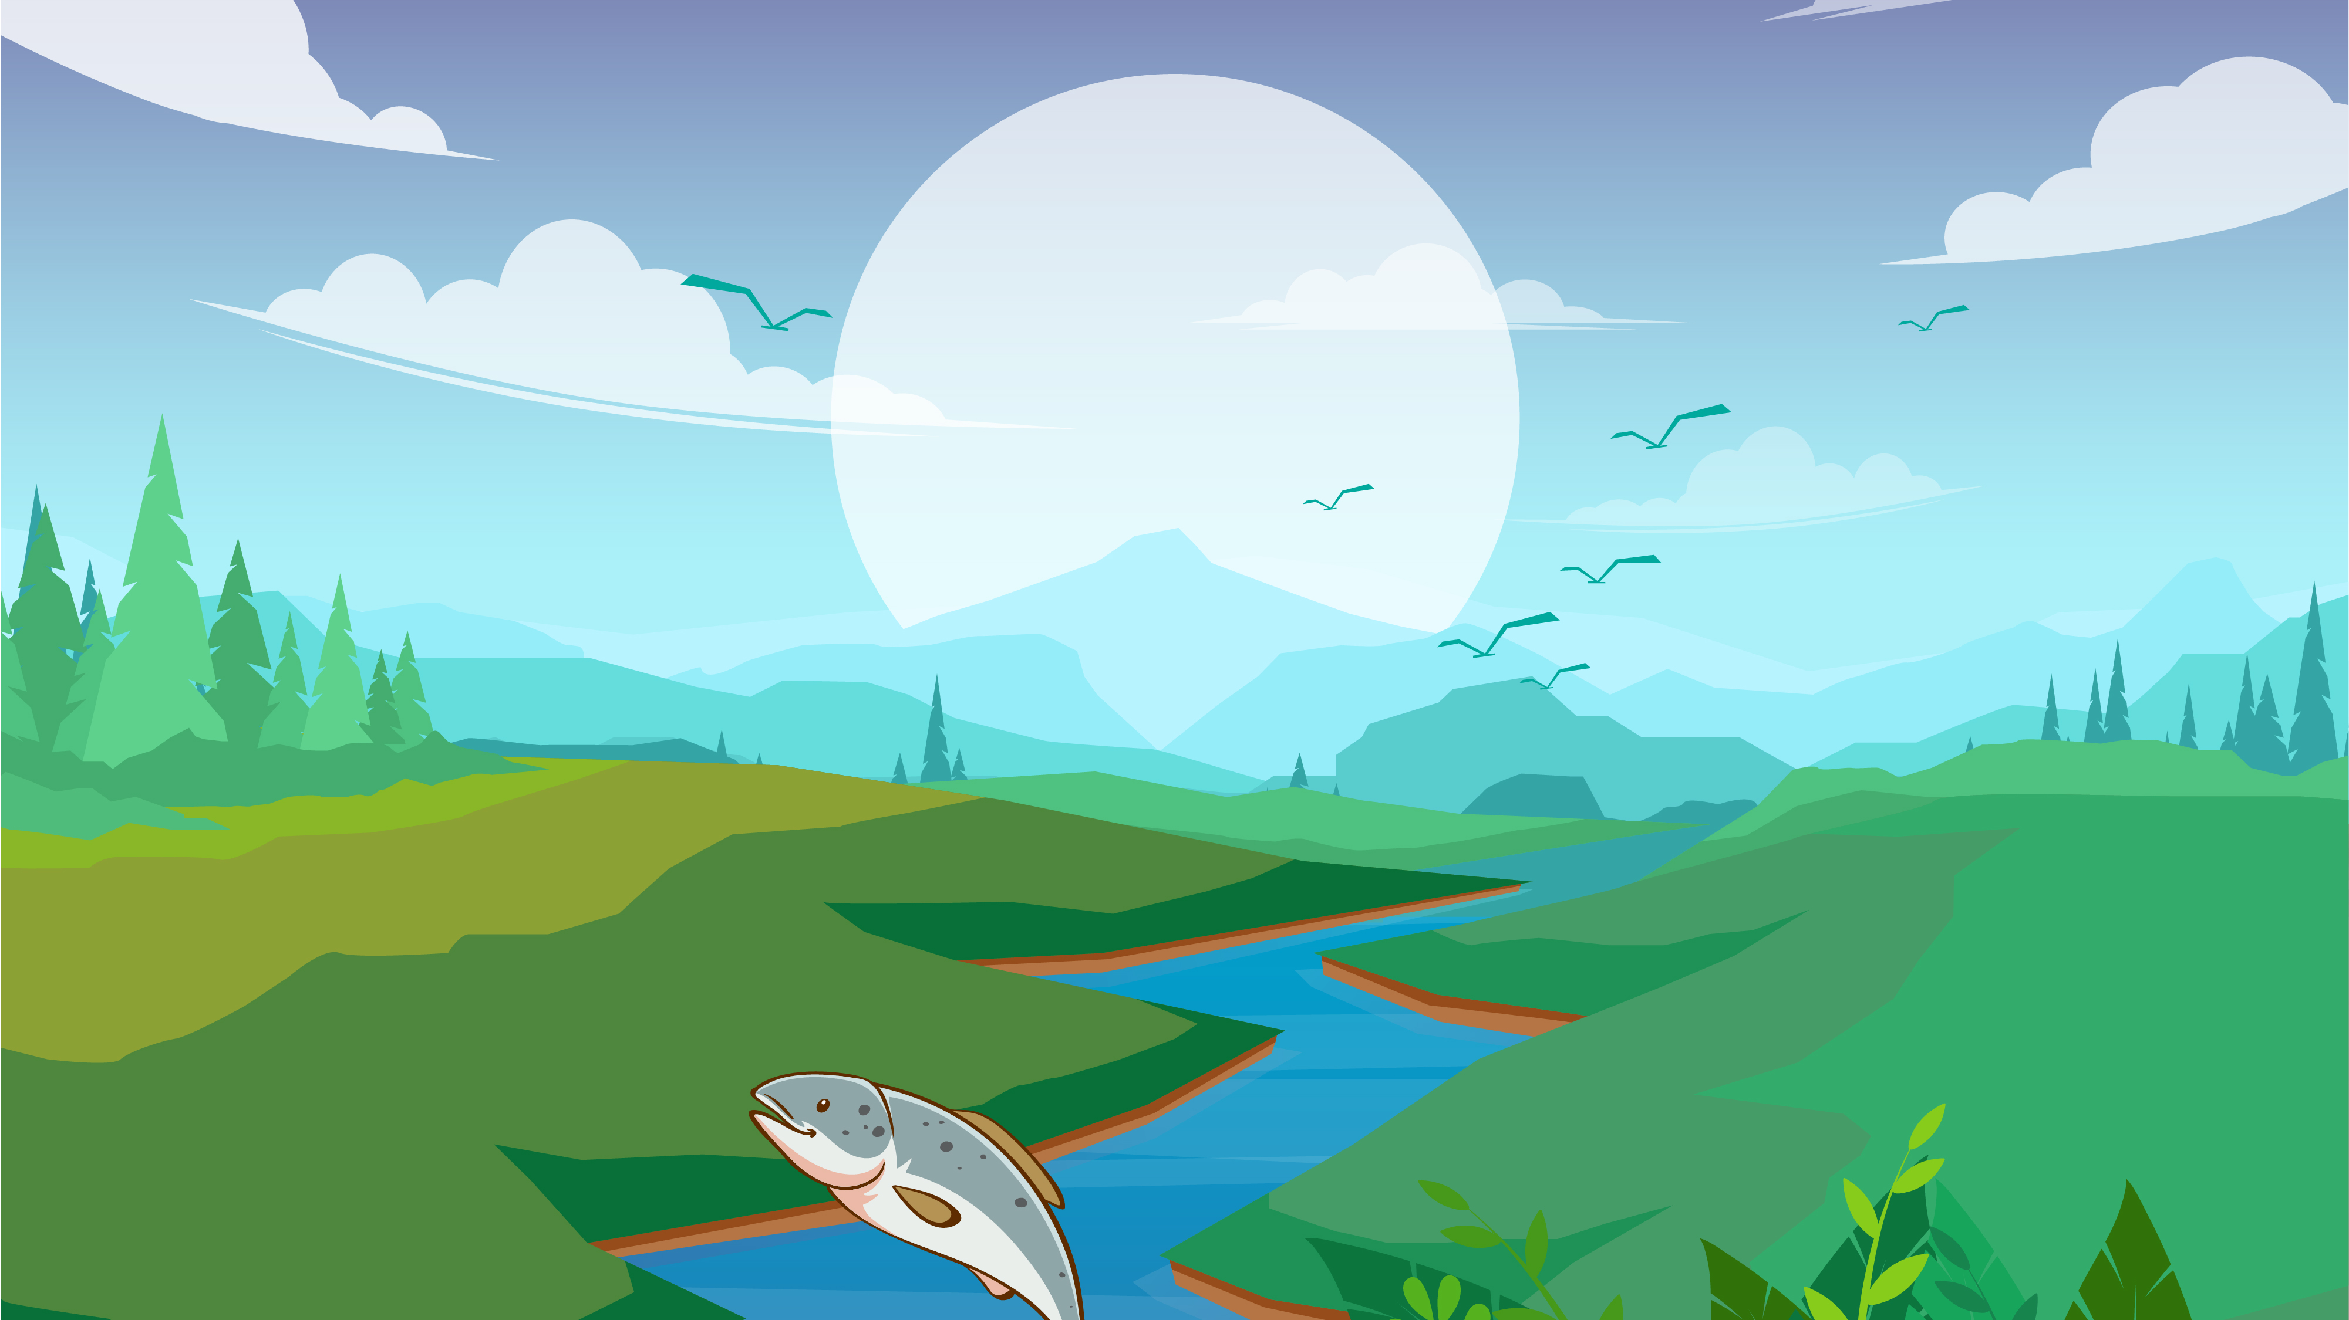
Activity 4: The Salmon of Knowledge
Notes:
Activity 4: The Salmon of Knowledge
Explain to the class that you are going to tell them a story about the salmon of knowledge. They will follow the story by looking at the pictures on the PowerPoint while they listen. Display the PowerPoint and invite pupils to get their listening ears on as you read the Salmon of Knowledge story.
Salmon of Knowledge Slideshow to follow

Slide 15
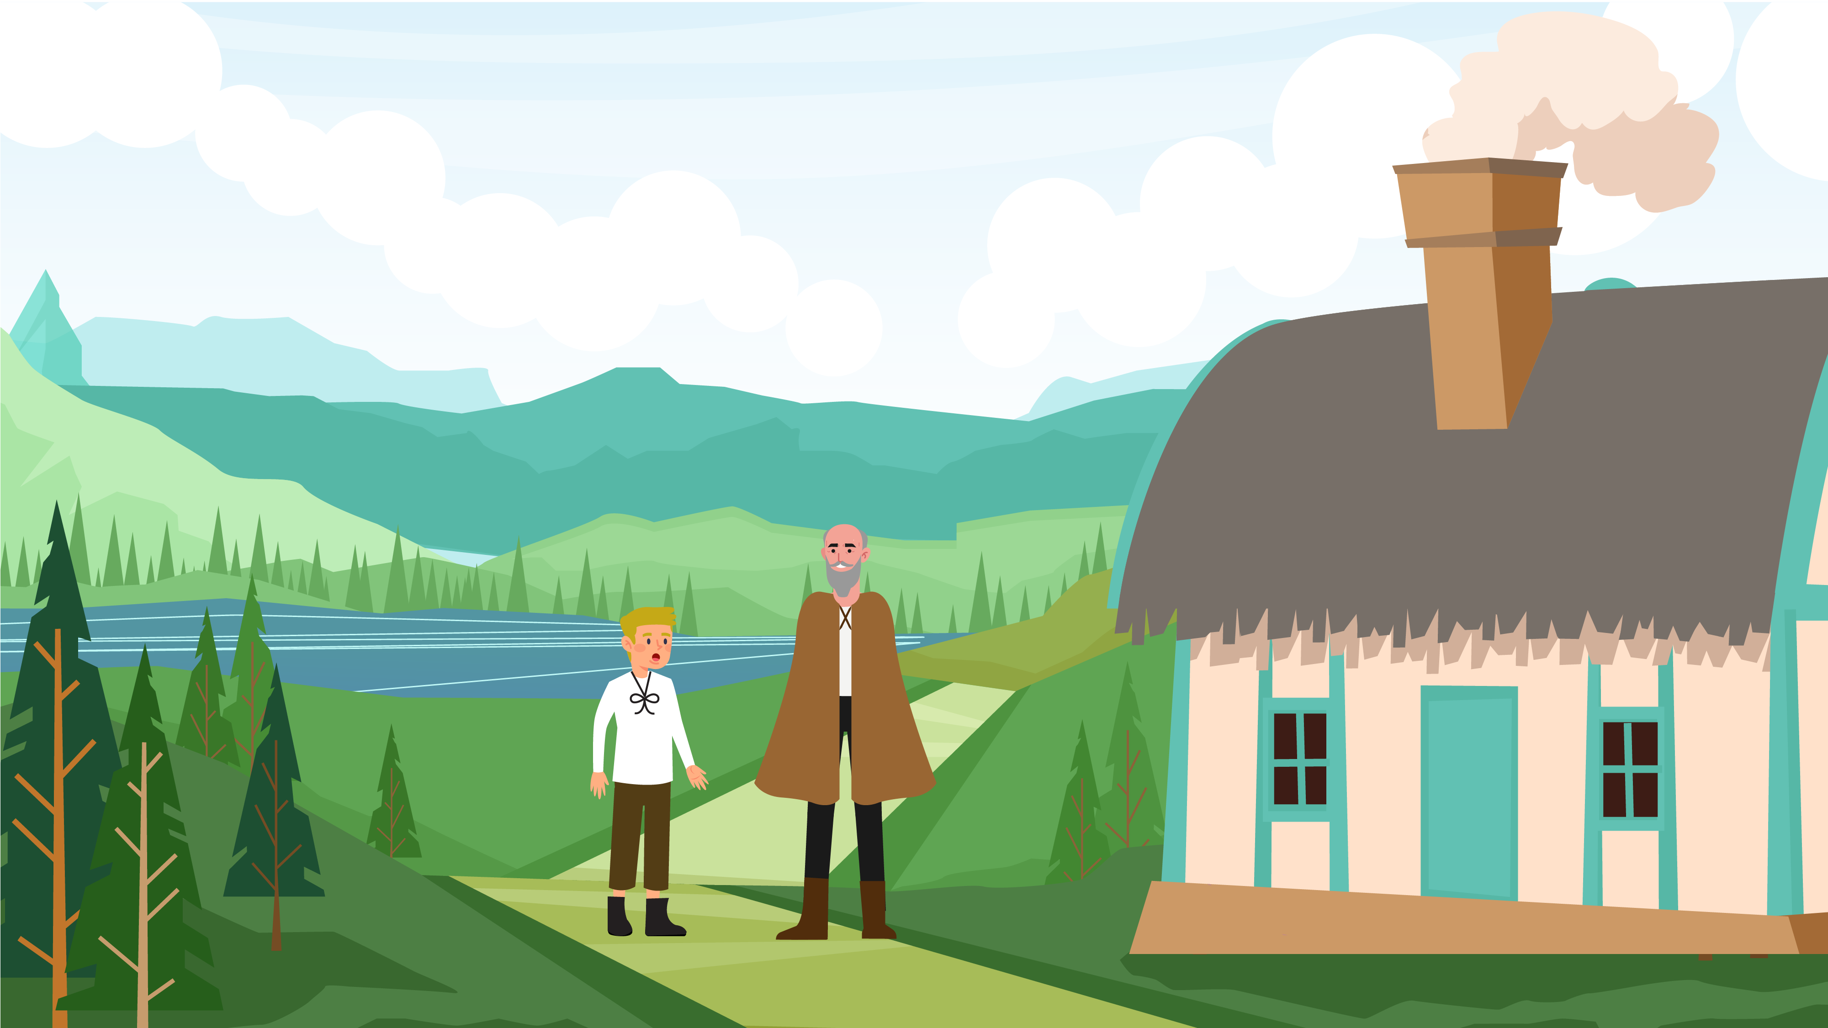
Notes:
Activity 4: The Salmon of Knowledge Story
Long ago, there was a young boy called Fionn Mac Cumhaill. Has anyone ever heard of Fionn Mac Cumhaill? He grew up to be the great leader of the Fianna of Ireland, and one of the wisest leaders in history. But when he was still a young boy, he was sent to live with a very wise man named Finnegas. Finnegas was a poet who lived on the banks of the River Boyne and was famous throughout Ireland for knowing all kinds of things. He knew how to speak lots of languages, and he knew all about the ways of the world: the secrets of the birds in the sky, and the plants and trees on the land, and even all about the stars out in space, and the fish in the deep blue sea.

Slide 16
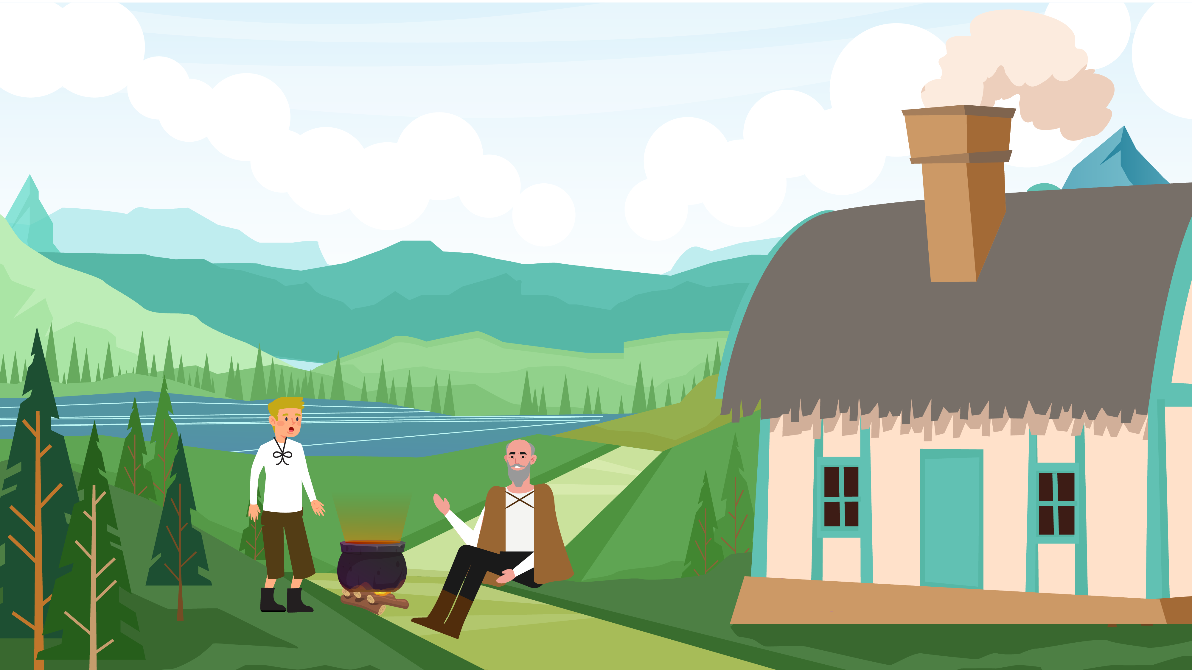
Notes:
Because Finnegas was so wise, Fionn had been sent to learn from him. Fionn loved to listen to the old man’s wonderful stories, and in exchange, Fionn would help with the cooking, cleaning and fishing. But even Finnegas found it hard to answer all of Fionn’s questions, as he was very curious, and wanted to know everything there was to know, about the world, and the people that lived there.

Slide 17
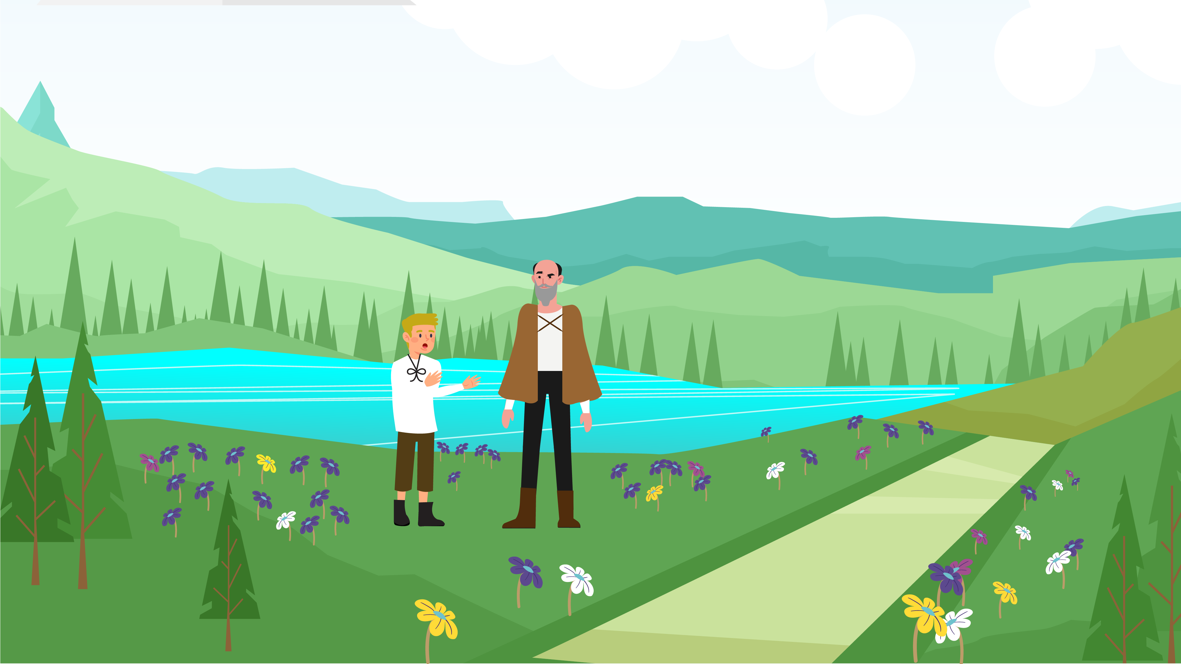
Notes:
‘Is there a way to know everything?’ Fionn asked Finnegas one day. Finnegas whispered that this was the very reason why he now lived next to the River Boyne. It was believed that living in a still, dark pool in the shade of the overhanging hazel trees was the Salmon of Knowledge, a special fish that had gathered all the knowledge of the world. And according to the stories, the person who ate the Salmon would gain all this knowledge too! Finnegas had been living beside the river for years, trying to catch the Salmon.

Slide 18
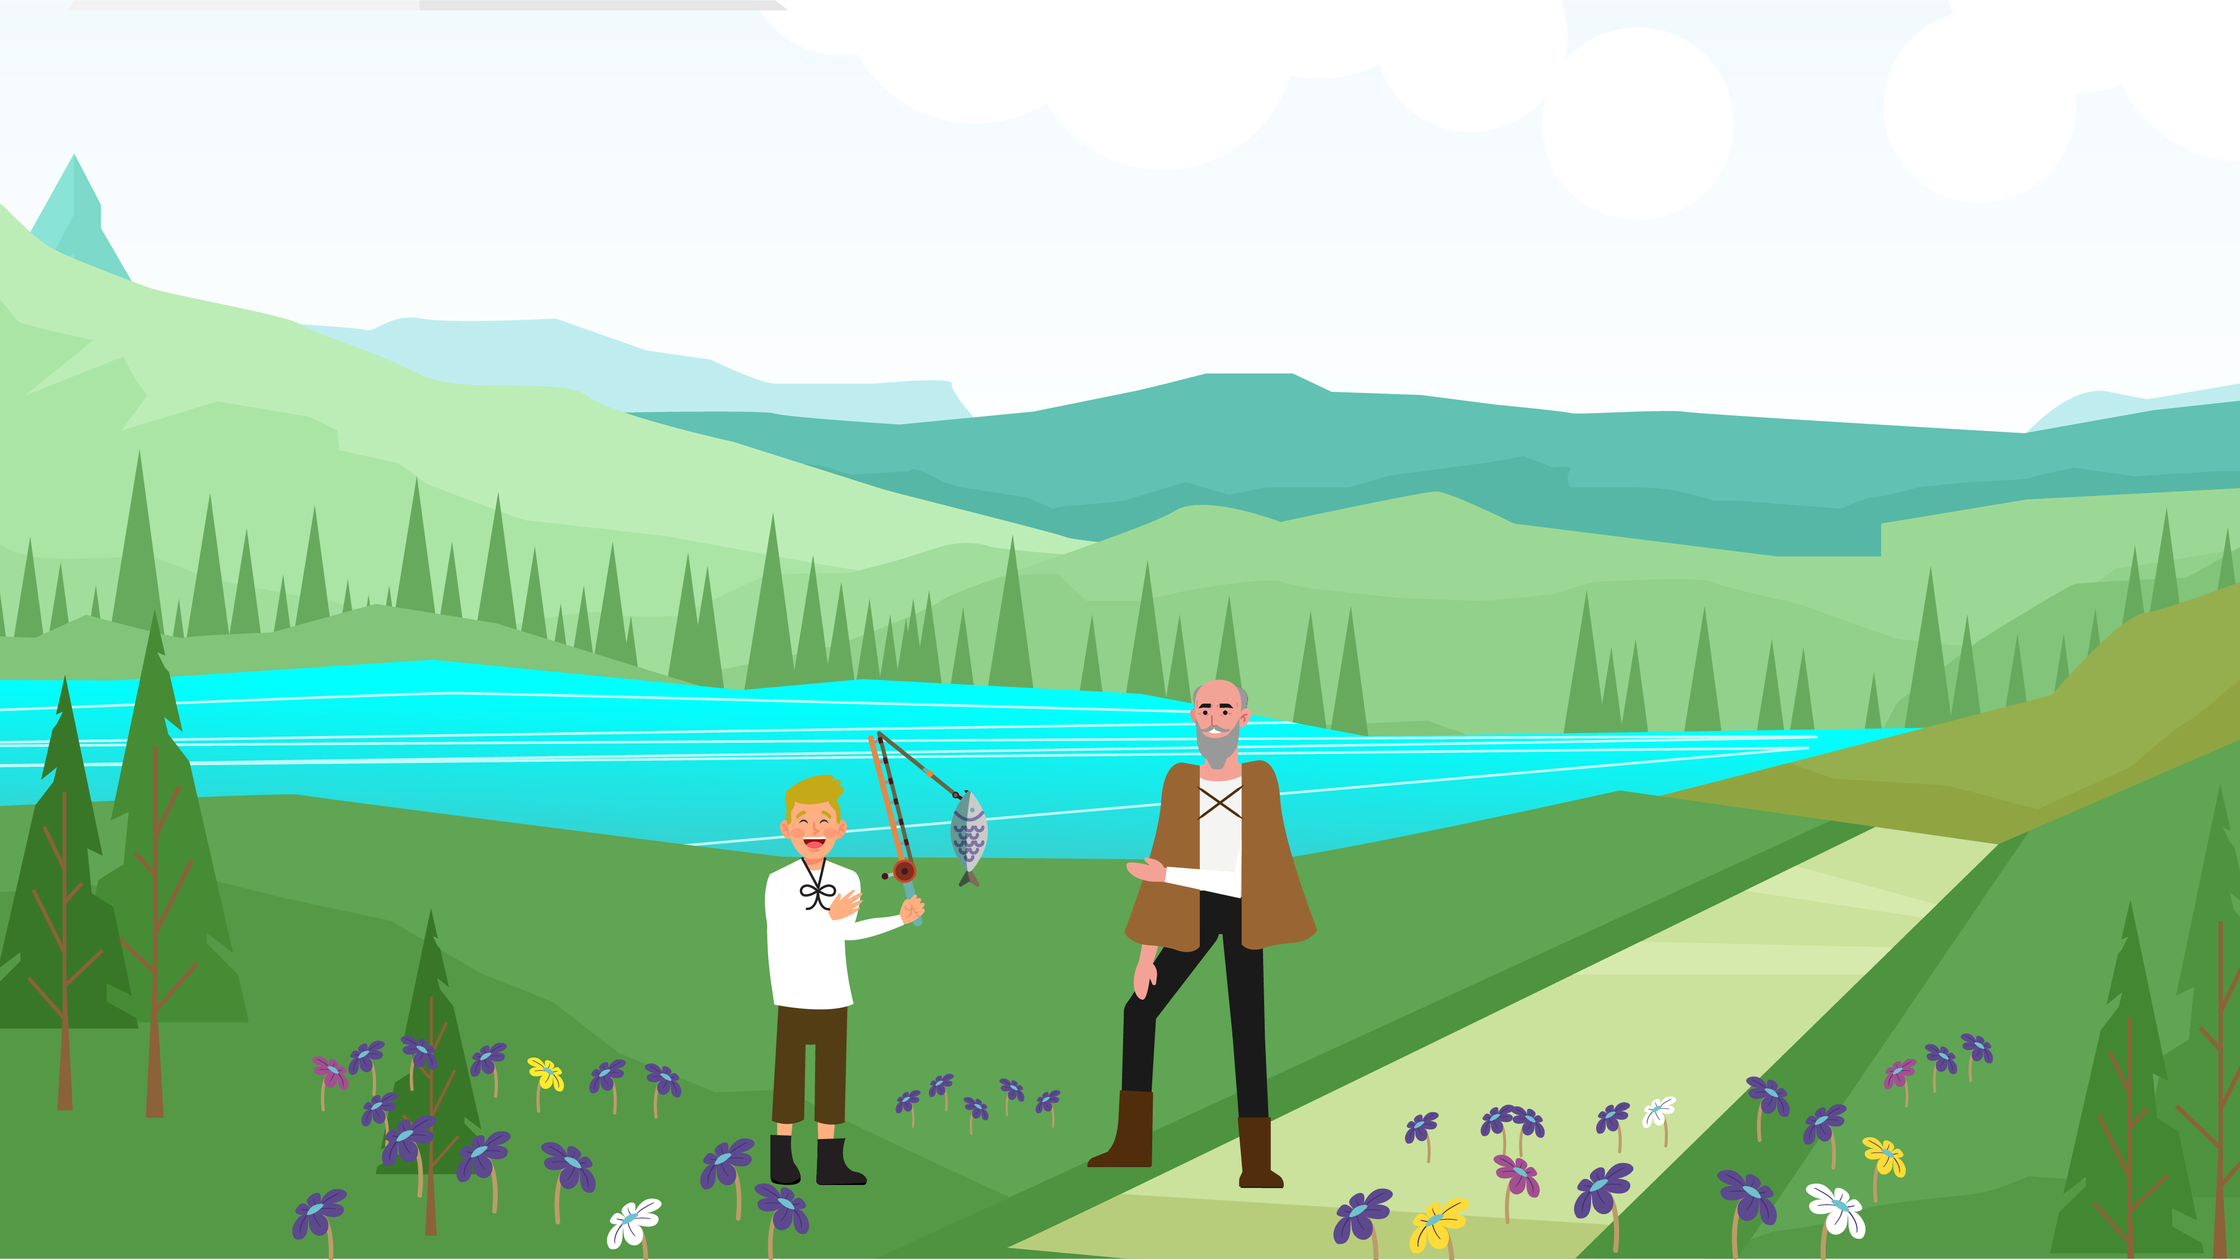
Notes:
One day, Finnegas and Fionn went fishing and felt a tug on their line. They pulled and pulled, and eventually caught the Salmon. ‘I’ve caught it! Hooray!’ cried Finnegas happily.

Slide 19
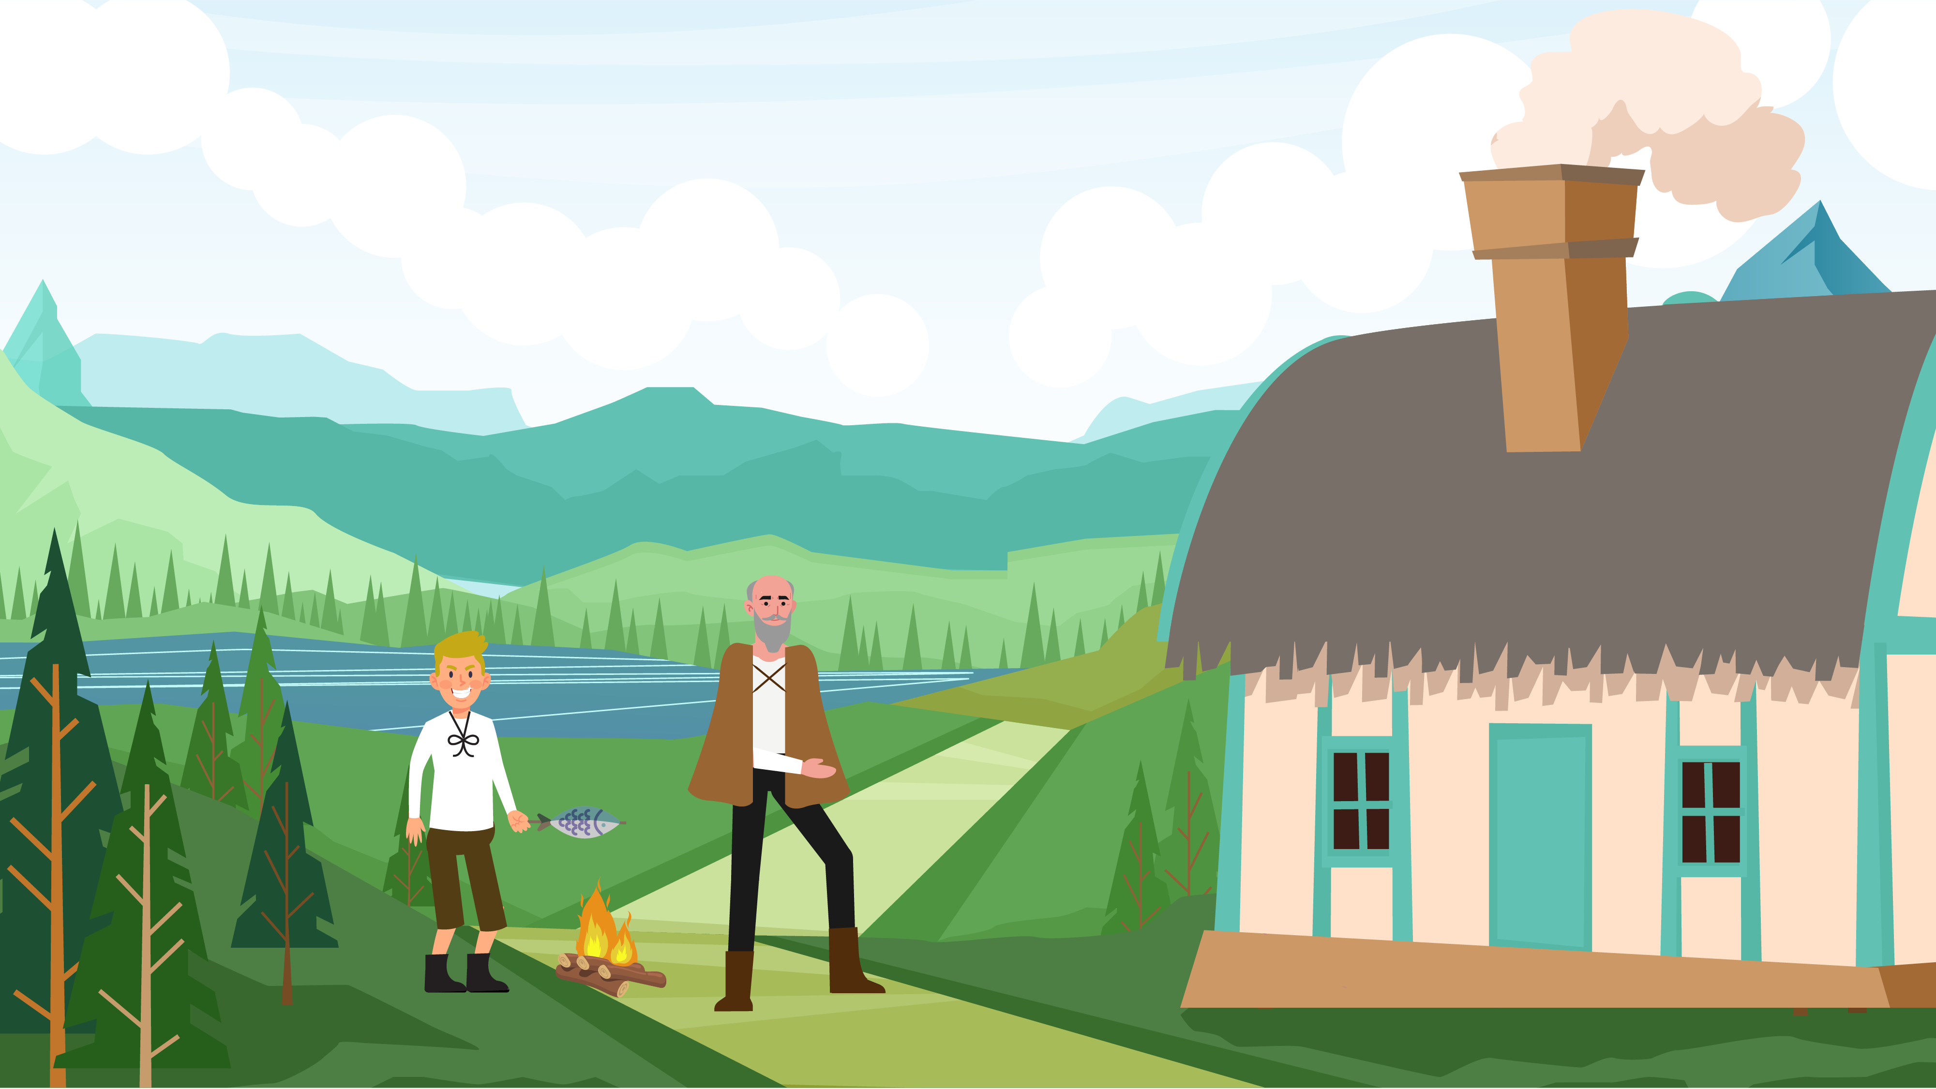
Notes:
Fionn was thrilled for his old friend. ‘You must cook it straight away!’ Finnegas ordered Fionn, dancing and skipping with excitement. As Fionn began to set up the fire to cook the Salmon, Finnegas warned him, ‘Cook it, but whatever you do, do not eat a single bit of it!’ Fionn nodded and went about cooking the Salmon while Finnegas went to fetch some extra wood for the fire.

Slide 20
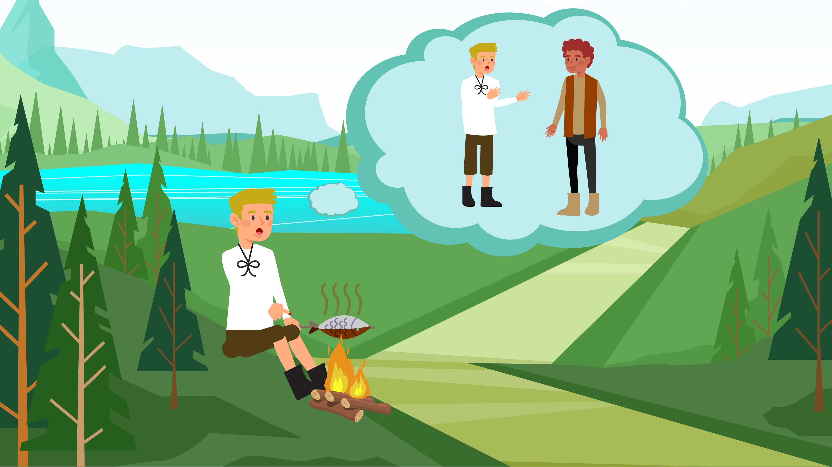
Notes:
While Fionn sat cooking the fish, he turned the salmon over on the fire with his hand and burned his fingers on the fish's hot skin. Shouting in pain, he sucked his thumb ... and suddenly, he had lots of new memories. Memories of conversations in different languages that he would not have understood before, memories of journeys through distant rivers and seas when he had hardly travelled at all, and memories of learning about people and places, far and wide! Fionn didn’t know what had happened, so he carried on cooking while trying to clear his head.

Slide 21
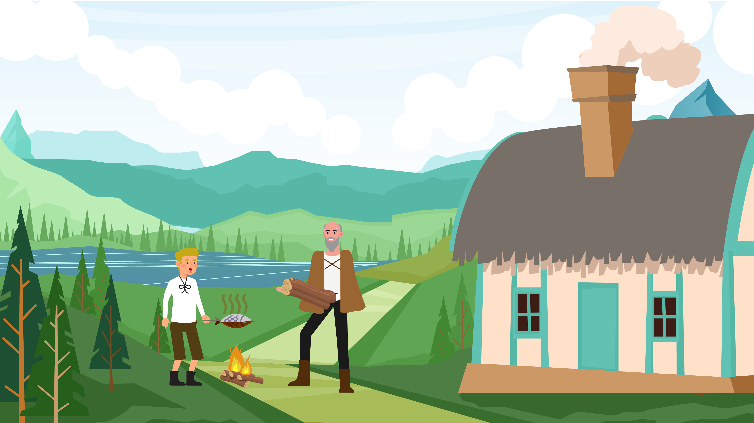
Notes:
When Finnegas returned, he found the Salmon laid out and ready to eat. He looked at Fionn and thought he saw something different about him, as though the light of wisdom now shone in his eyes. ‘Have you eaten any of the Salmon?’ he asked Fionn anxiously. ‘I have not!’ Fionn replied. ‘Even a little bit?’ ‘I swear I have not!’ Fionn replied, ‘but when I was turning it over, I burned my fingers, so I put my thumb into my mouth to ease the pain.’ ‘That is enough’ said Finnegas sadly. ‘You now have all the knowledge of the world.’ Fionn tried to apologise for his mistake, and Finnegas said ‘You must not apologise. Instead, you should use all your knowledge. Never stop learning as much as you can about the world, and try to make our world a better place.’ That day, The Salmon of Knowledge passed all his knowledge on to Fionn, and since then, that knowledge was passed on to all the people who lived from then on, from parents to children, and from siblings to friends!

Slide 22
Draw a picture from your favourite scene in the story
Notes:
Activity 4: The Salmon of Knowledge end of lesson reflection
After the story, ask the class how they think the Salmon of Knowledge came to know so much?
[Prompts: Salmon can swim in all kinds of water, maybe he knows so much because he has travelled to many places and spoken to lots of different animals and people all over our world.]
On a piece of paper/ in their copy books pupils can draw a picture from their favourite scene in the story.
Note: Depending on your class, you might like to collect the drawings done by your pupils during this activity and display them on the classroom walls. You might also prefer to distribute copies of the storyboard (page x) and invite pupils to colour in the pictures as a homework activity.

Slide 23



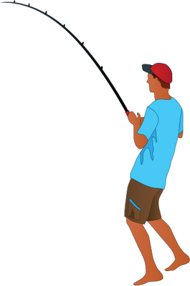

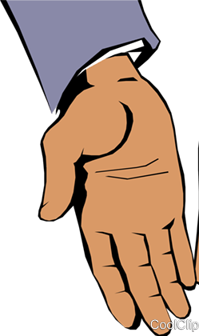
Optional Additional Activity: Hermit Crab Shell-Off
Activity Key
Rock image | Paper image | Scissors
Fish | Fisherman | Crabs
Fist | Hand open | Image of scissors
1 - Uno, 2 - Dos,
3 - Tres!
Notes:
Optional PE/drama activity
Note: This first part of activity can be in class, the middle part in the hall/outdoors during PE, and the pupils can give feedback upon return to class.
In class:
Share the learning intentions for this activity with pupils – We are learning to:
adapt and play a game
use our imaginations in role play
reflect on our learning
Explain to the class that they will be counting 1 – 2 – 3 in Spanish, as that is the language they speak in Honduras.
Ask if anyone knows how to say “1, 2, 3” in Spanish? [Uno, Dos, Tres].
Invite the class to try saying ‘Uno, Dos, Tres’ together and encourage pupils to use their fingers to count at the same time. Ask for a volunteer to quickly explain how to play ‘Rock, Paper, Scissors’.
Explain to the class that they are going to play a version of ‘Rock, Paper, Scissors’, where the scissors becomes the Hermit Crab, paper becomes a Fisherman, and rock becomes a Fish. Hermit Crabs (scissors) can beat Fishermen, as they snip the fishing line, Fish (rock) can beat Hermit Crabs, as they eat the Crabs, and Fishermen (paper) can beat Fish, as they catch the Fish.
Remind pupils how to count to three in Spanish.
Invite pupils to get into pairs.
Explain that on the count of “Tres,” each pair should play a couple of rounds of ’Hermit Crab, Fisherman, Fish’.
Allow the activity to go for 2-3 rounds or until the class understand what is being asked of them.
In PE (hall or outside space):
Invite pupils to imagine they are Hermit Crabs using the following prompts:
Let’s see you act like a Hermit Crab.
Do you have claws? Snip snip!
Shells on your backs? Wiggle your shells.
Tell the pupils to pair up and get ready to play ‘Hermit Crab, Fisherman, Fish’ again.
Explain that this time the person who loses should place their hands gently on the winners back (shell). They need to keep their hands on the winners back as the winner goes to find another person to play. After each round, the loser and all the people behind them should line up behind the winner, touching the back of the person in front. As winning ‘crabs’ collect more people like a Hermit Crab getting a bigger and bigger shell as it grows.
Allow the activity to run until there are two pupils left. The pupil with the most people lined up behind them (the crab with the biggest shell) is the winner.
In class:
Facilitate a whole class discussion using the following questions as prompts:
Why is it important that the Crabs pass on their shells? [to make sure that there are enough shells for the smaller, growing crabs]
Do you know what a trade is? [When someone gives you something, and you give them something in return.]

Slide 24

End of Lesson Reflection
After this lesson I can:
practice breathing as a way of feeling calm
experience what it means to ‘reuse’
discuss the importance of water in our lives
read a map/extract meaning from a map
consider the need to share knowledge and collaborate
Notes:
End of lesson reflection:
Encourage pupils to check that their thinking caps are securely on their heads (mime checking the invisible thinking cap is positioned carefully on your head).
Explain that Salmon of Knowledge passed his knowledge on to others, and we need to gather knowledge and spread it to everyone we know as well.
Invite pupils to turn to a partner and, like the Salmon of Knowledge, share one thing that they have learned in this lesson.
Read the learning intentions for this lesson, simplifying as needed.
In response to each learning intention, ask pupils to give a thumbs up (I’m happy I know or can do this), thumbs down (I need help with this) or palm flat in the middle (I’m not sure).
After this lesson I can:
practice breathing as a way of feeling calm
experience what it means to ‘reuse’
discuss the importance of water in our lives
read a map/extract meaning from a map
consider the need to share knowledge and collaborate
Scan the room to see how pupils are managing with the learning intentions.
Invite the class to mime taking off their thinking caps, take a bow and put their thinking caps somewhere safe (desk, pocket, bag) until they need it again.

Slide 25
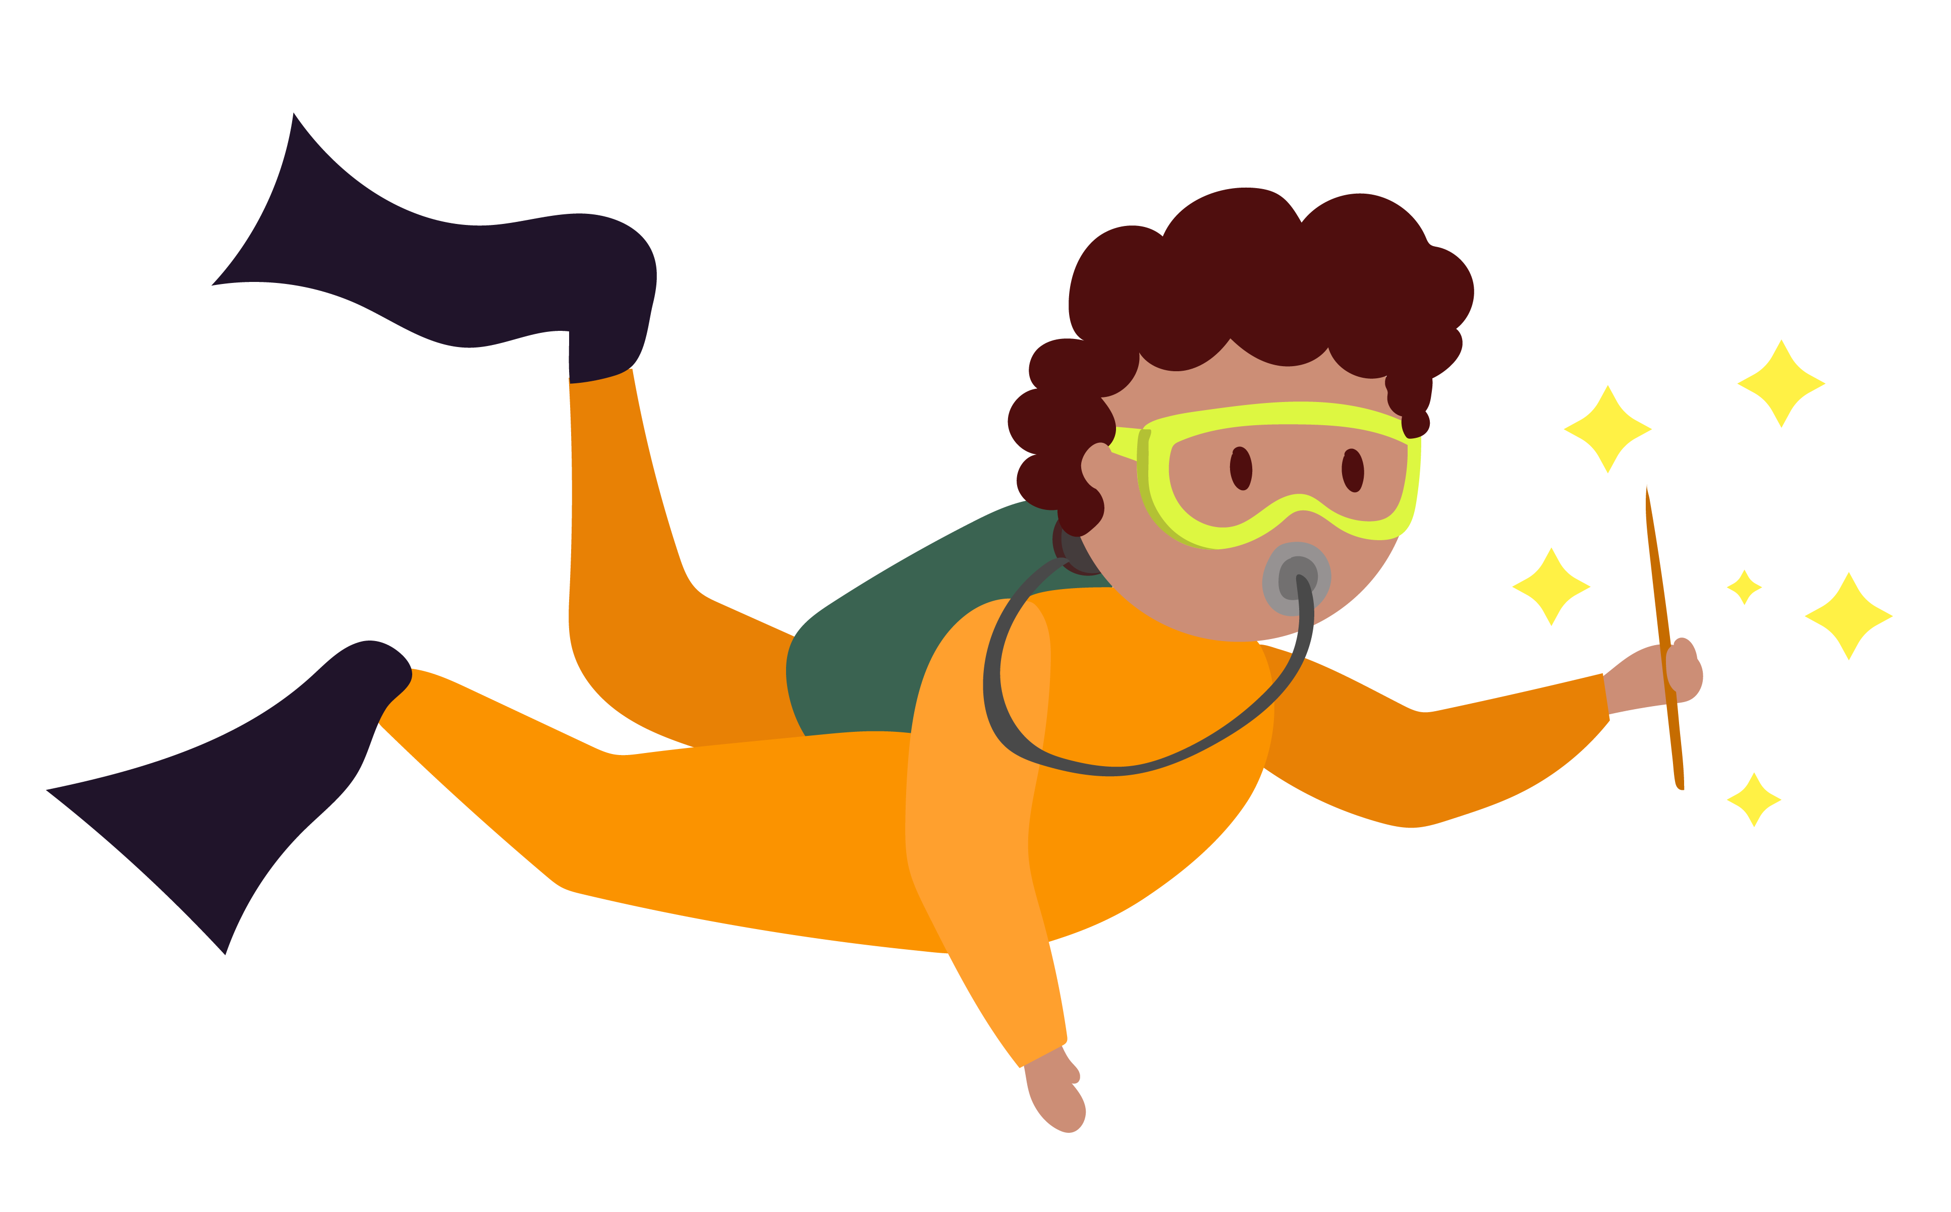

Lesson 2
Notes:
Notes for teachers
Water Wishes 1st – 2nd class: Lesson 2 Title slide (No animation)

Slide 26

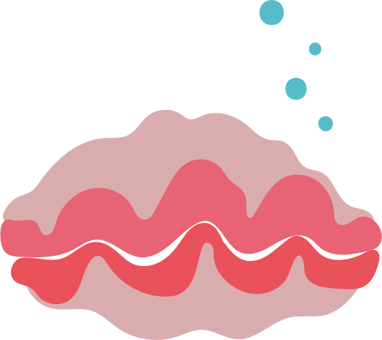
Lesson 2
Learning intentions
In this lesson, we are learning to:
practice breathing as a way of feeling calm
consider what it means to overfish
discuss the importance of sustainability
listen and respond to a story
collaborate, listen and share knowledge
reflect on their learning
Notes:
Lesson 2 Teacher notes
Approximate time of lesson: 45 minutes

Slide 27
Activity 1 Mindful Giant Clams
Can you spot the clam?
Notes:
Teacher’s Step-by-step Activity Guide
Activity 1: Mindful Giant Clams
Explain that one way to feel calmer or better is to breathe in and out, slowly and deeply.
Tell the class that they are going to practice breathing as a way of feeling calm. Sometimes it can help to imagine something at the same time as we breathe, to help us slow down our breath.
To guide the breathing activity, you can either play the video or use the script provided (below)
Depending on your class, you might like to demonstrate and invite the class to join in for a second or third practice breath.
Script
This is a Giant Clam.
Clams live on the ocean floor, and once they find a nice home, they stay planted in that spot for the
rest of their life with their shells gently opening and closing as the water swirls around them.
So, settle yourselves down like a Giant Clam, with your feet firmly planted on the ground and bring
your hands together, to make the shell of a clam. Remember that no matter how rough the water
gets, or how many thoughts we have, we can always come back to our breath.
As I count, we’re going to slowly practice breathing in and out, opening and closing our shells.
1 -2 -3 – 4 and pause, and now slowing breathing out 1 2 3 4 closing our shell.
Now let’s repeat this a few times.
Breathing in 1 2 3 4 shells open
Breathing out 1 2 3 4 shells closed
Breathing in 1 2 3 4 shells open
Breathing out 1 2 3 4 shells closed
Breathing in 1 2 3 4 shells open
Breathing out 1 2 3 4 shells closed

Slide 28
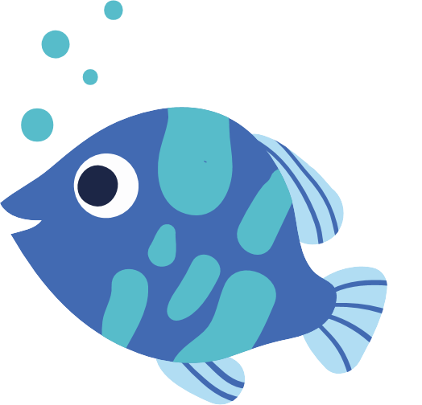

Activity 2: Recap Lesson 1
What do you remember about the Salmon of Knowledge story?
What do you remember about rivers and oceans?
What do we find in rivers and oceans?
Why do we need rivers, lakes, seas and oceans?
Notes:
Activity 2: Recap of Lesson One
Ask pupils what they remember about the Salmon of Knowledge story .
Tell the class that the Salmon of Knowledge wants to know what they remember about rivers and oceans.
Pose the following questions and record pupil responses on the board
What do we find in rivers and oceans?
[Prompts: crabs (like the Hermit Crabs we saw in the video in our last Water Wishes lesson), fish, coral, seaweed, boats, plastic]
Why do we need rivers,lakes,seas and oceans?￼If not mentioned by pupils, add the following to the list on the board: transport, food, water, oxygen, energy, and medicine]

Slide 29
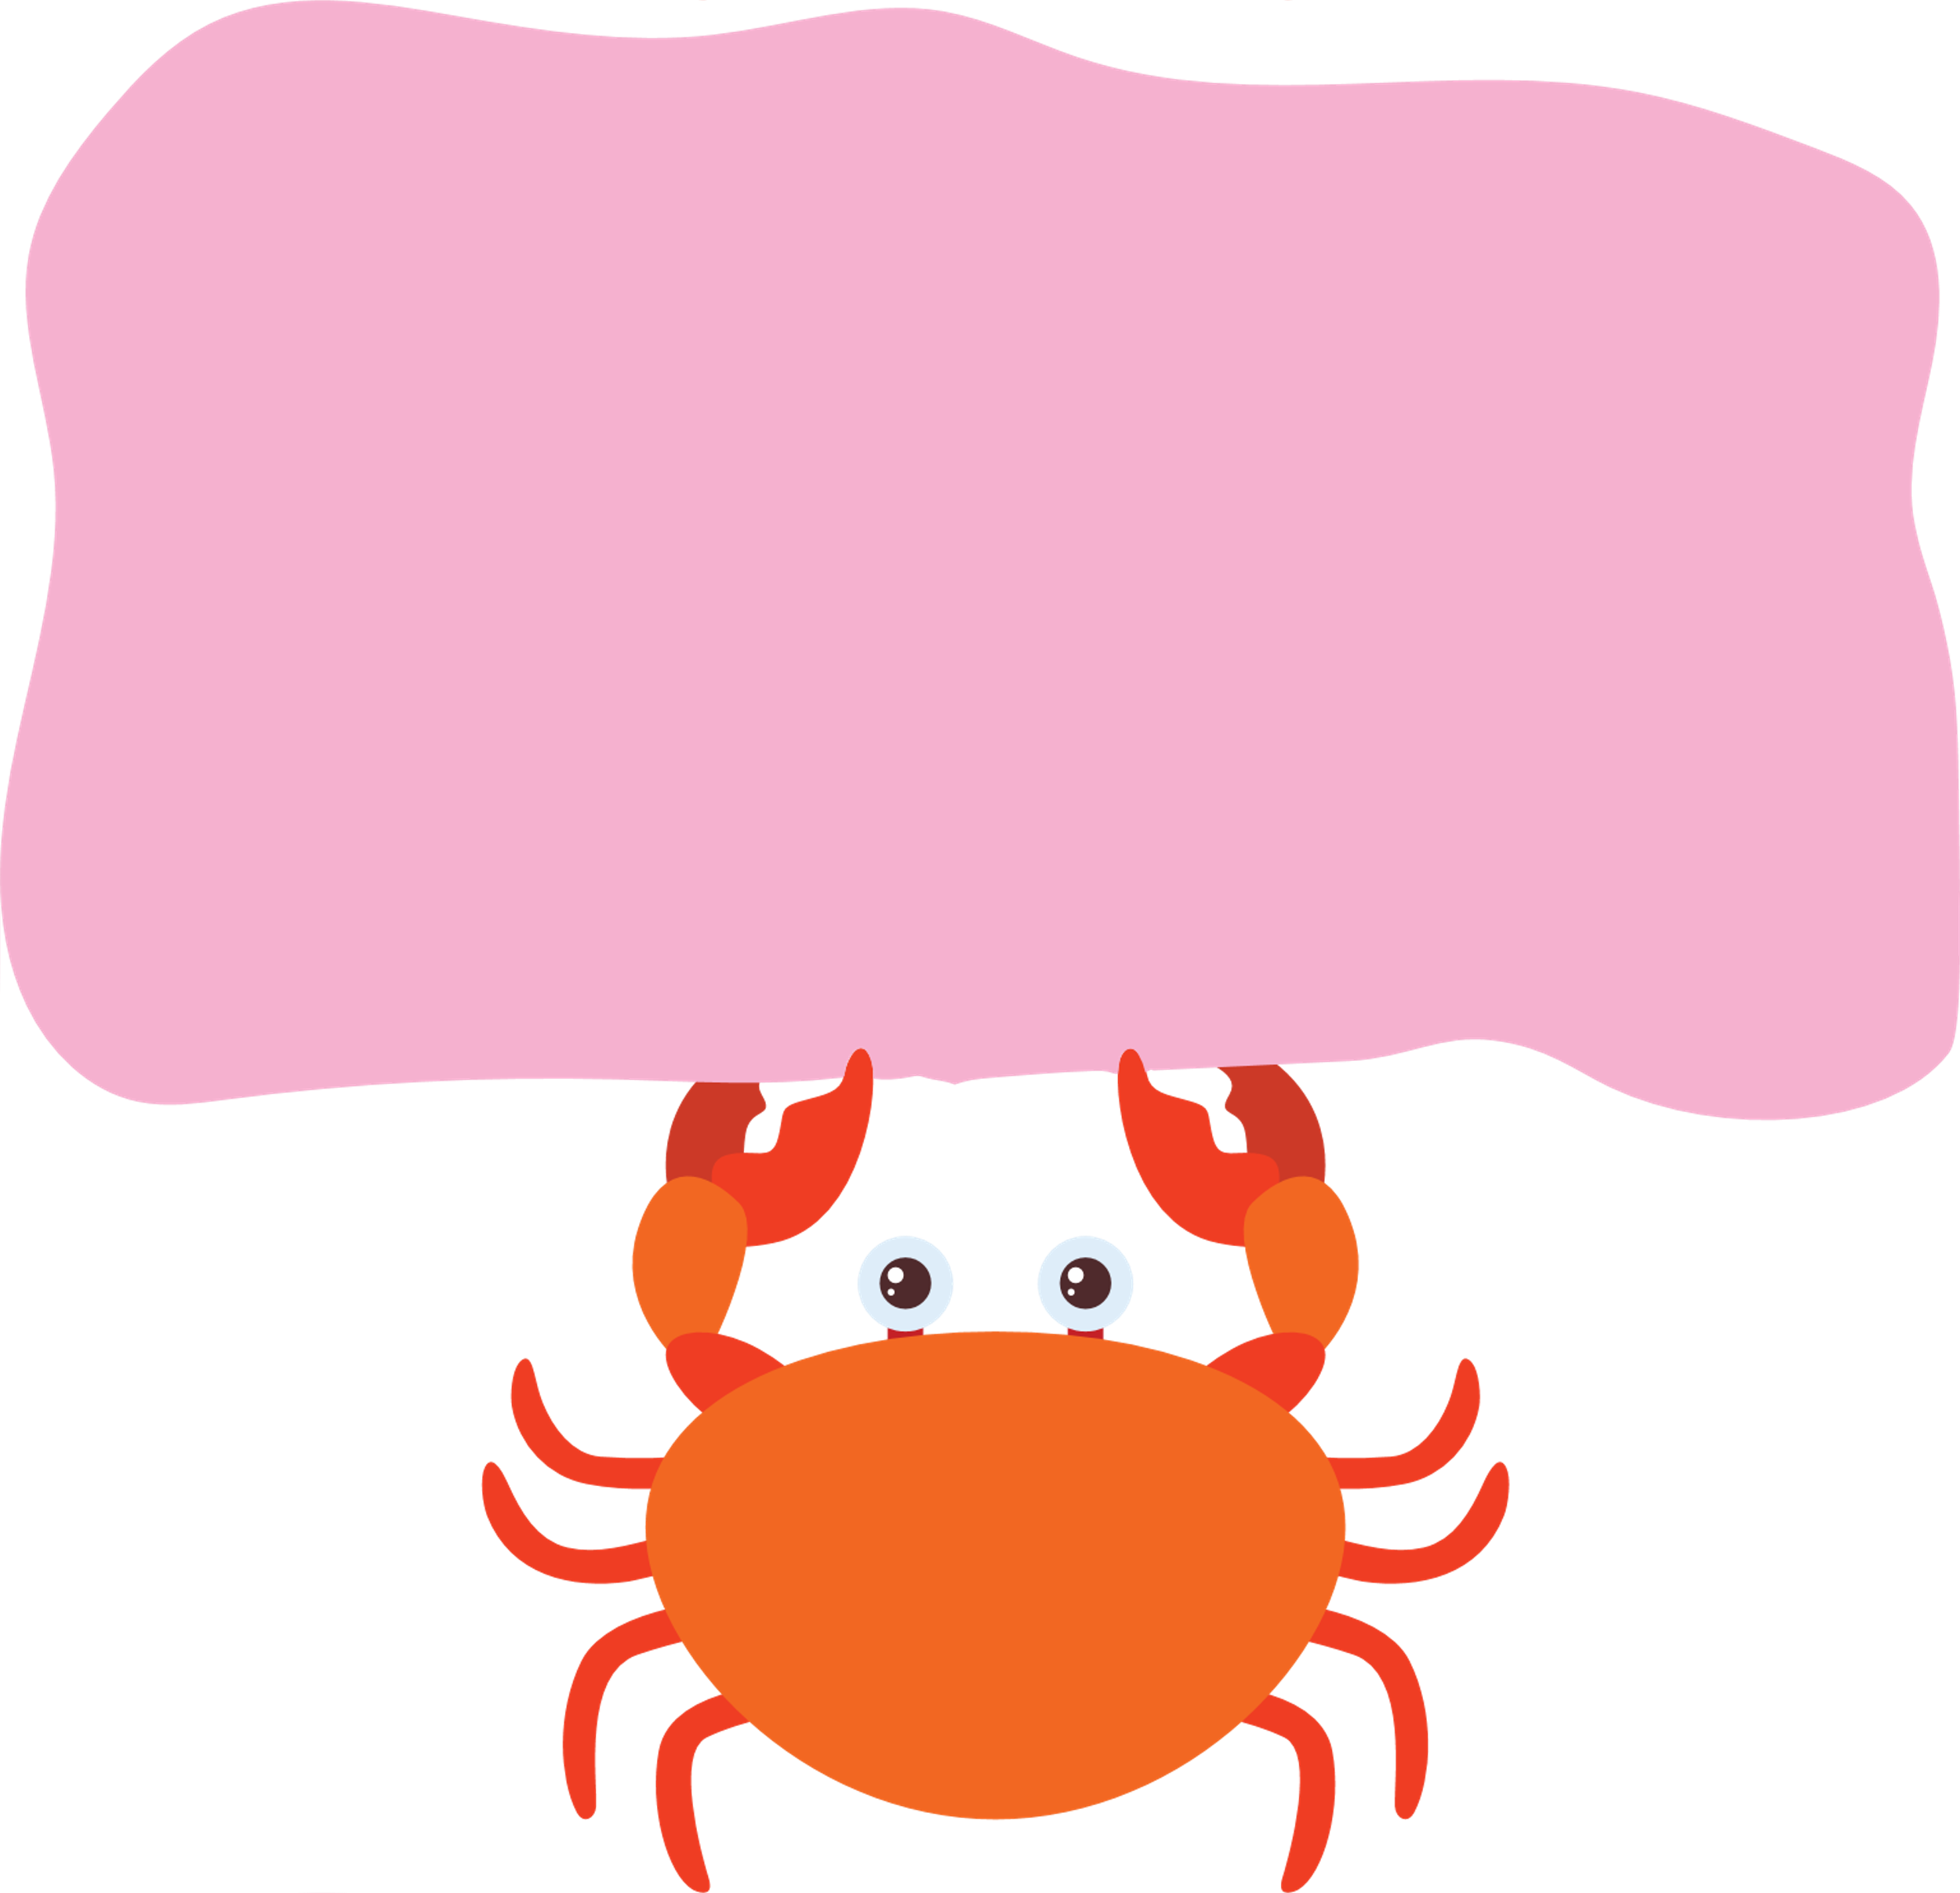
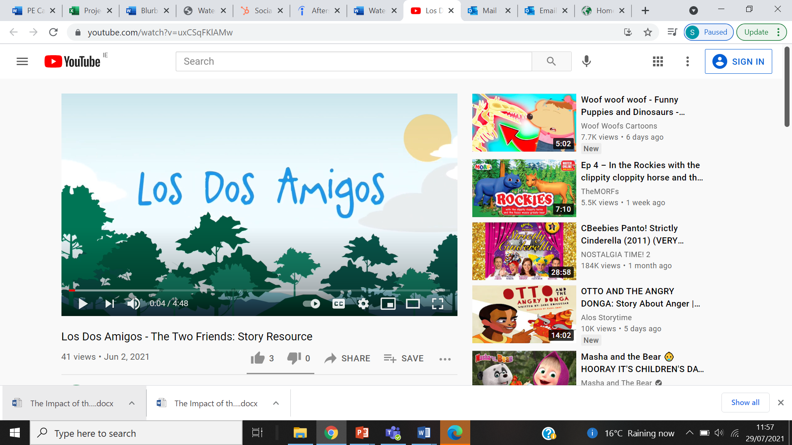
Did you know?
The most widely spoken language in Honduras is Spanish, but people in Honduras speak other local languages as well. “Tinki Pali” is how to say “Thank you” in the Miskito language of the La Mosquita region of Honduras – a place where GOAL works!
Notes:
Teacher’s Step-by-step Activity Guide
Activity 3: Los Dos Amigos (The Two Friends)
Tell the class they are going to listen to a story called Los Dos Amigos, about two friends who live along the River Boyne.
Ask if anyone remembers how to count to three in Spanish. [Uno (1) – dos (2) – Tres (3)!]
Explain that in Spanish, the word for friend is amigo.
Repeat the title of the story, ‘‘Dos Amigos’, and ask if anyone can translate the title. [“Los Dos Amigos” means” The Two Friends” in Spanish]
Ask if anyone can say “The Two Friends” in any other language.
Did you know?
The most widely spoken language in Honduras is Spanish, but people in Honduras speak other local languages as well. “Tinki Pali” is how to say “Thank you” in the Miskito language of the La Mosquita region of Honduras – a place where GOAL works. GOAL is a non-governmental organization (NGO, or charity) which tries to support disadvantaged communities in certain countries outside of Ireland. Practice saying "Tinki Pali” together and listen out for the phrase “Tinki Pali” in the next story.
Facilitate a whole class discussion, using the following questions as prompts:￼
What did you see in this video? (The characters and setting)
What did you hear in the video (music, the sound of the wind etc.)?
Can you think of a word to describe: (1) the salmon (2) Juan (3) Sean? (Introduce the idea of adjectives – a describing word)
Who do you think is the strongest character in the story?
If you were Juan, would you have gone back to the salmon to ask for a bigger boat the first time?
Why do you think the salmon made everything disappear in the end?
What do you think the amigos could have done differently so that they didn’t lose everything at the end?
Which character from the story would you like to be? Why?
Did you hear the word ‘Tinki Pali’? Can you remember what it means? [see Did you know box, above]
Do you know how to say ‘Tinki Pali’ in any other languages?

Slide 30


Homework Activity
Draw a picture of your favourite scene from the story.
Activity 3: Los Dos Amigos Continued
Notes:
Activity 3: Los Dos Amigos (The Two Friends) continued…
Homework activity idea: Draw a picture of your favourite scene from the story. Explain that this is why it is important to have a balance of everything. If there are too many fishermen or fishermen who have ways of catching lots of fish, then this can lead to overfishing (when there are not enough fish left). This isn’t fair to the fish or to people! We need to make sure that there are enough fish (and every other type of resource) for the people that will be born after us, this means using only what we really need. When we use what we need we are being sustainable because we are making things last.
Ask the class if anyone knows any other way that we can be sustainable?
[Prompts: only bringing food that we know we will eat for lunch so that we don’t throw good food away, wrapping sandwiches in paper bags or plastic boxes instead of throwaway plastic bags etc].

Slide 31

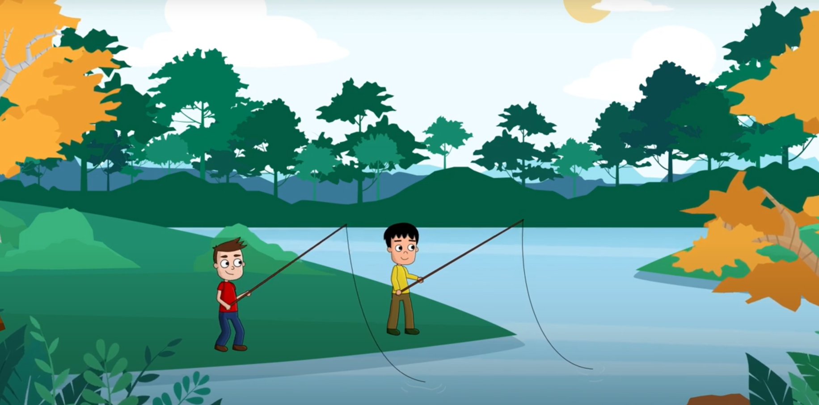
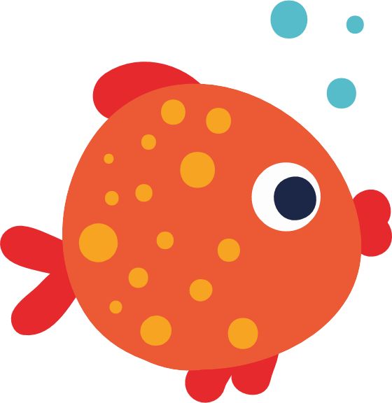
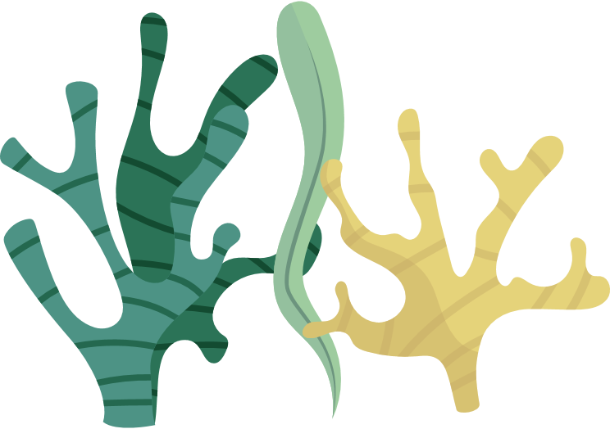
Optional PE/ Drama Activity: Let’s Go Fishing!
We are learning to:
use our imaginations in role play
make decisions about how we use the space to avoid getting caught
reflect on our learning
Notes:
Optional PE/Drama activity
Share the learning intentions for this activity with pupils – We are learning to:
use our imaginations in role play
make decisions about how we use the space to avoid getting caught
reflect on our learning
Tell the class that they are now going to go fishing. Explain and carry out the activity as follows:
Each person will get a sheet of recycled paper.
Scrunch your sheet of paper into a ball.
Wrap tape around your ball of paper.
Make a pile of the balls of paper in the middle of the room.
Select one person to become the fisherman, telling everyone else to transform into a fish.
Invite the class to imagine that the room is a river or an ocean and it is full of fish. In the middle of the river or ocean is a fisherman on a boat.
Instruct all the ‘fish’ to stand on one side of the river/ocean (room), and instruct the fisherman to stand on their boat in the middle of the room.
On the count of ‘Tres’ the fish need to try and cross from one side of the river/ocean (room) to the other without being caught by the fisherman.
The role of the fisherman is to throw the scrunched-up balls at the fish as they cross to ‘catch’ as many fish as possible When a fish is ‘caught’ (hit with a ball of paper) they transform or change into a fisherman, join the fisherman on the boat (middle of the room) and try to catch fish.
Allow the activity to run until the majority/all of the fish have been caught.
Invite everyone to sit down where they are for the debrief.
Facilitate a short whole class debrief using the following questions as prompts:
How did it feel being a fish?
How did it feel being a fisherman?
What, if anything, did you notice happened at the end?
Were there too many fishermen trying to catch the fish?
Were there any fish left in the end?

Slide 32
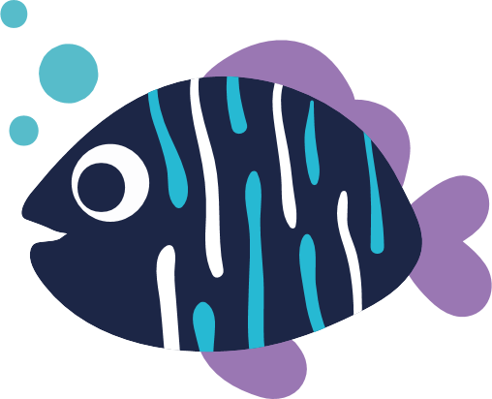
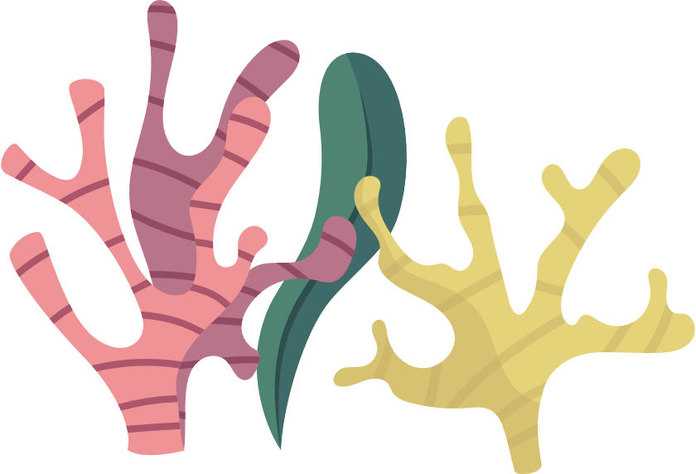
End of lesson reflection
Write here
After this lesson I can:
Practice breathing as a way of feeling calm
Consider what it means to overfish
Discuss the importance of sustainability
Listen and respond to a story
Collaborate, listen and share knowledge
Reflect on my learning
Notes:
Activity 3: End of lesson reflection
1. Encourage pupils to check that their thinking caps are still securely on their heads (mime checking the invisible thinking cap is positioned carefully on your head).
2. Read the learning intentions for this lesson, simplifying as needed.
In response to each learning intention, ask pupils to give a thumbs up (I’m happy I know or can do this), thumbs down (I need help with this) or palm flat in the middle (I’m not sure).
After this lesson I can:
Practice breathing as a way of feeling calm
Consider what it means to overfish
Discuss the importance of sustainability
Listen and respond to a story
Collaborate, listen and share knowledge
Reflect on their learning
Scan the room to see how pupils are managing with the learning intentions.
3. Invite the class to mime taking off their thinking caps, take a bow and put their thinking caps somewhere safe (desk, pocket, bag) until they need it again.​

Slide 33
Lesson 3
Notes:
Notes for teachers
Water Wishes 1st – 2nd class: Lesson 3 Title slide (No animation)

Slide 34
Lesson 3
Learning intentions
In this lesson, we are learning to:
practise breathing as a way of feeling calm
discuss the problems facing our rivers, seas and oceans and solutions to these problems.
work together as a team.
consider the lives and environment of fishing families in Honduras.
use numeracy and literacy to engage in a fishy activity.
reflect on our learning
Notes:
Lesson 3 Teacher notes
Approximate time: 45 minutes

Slide 35
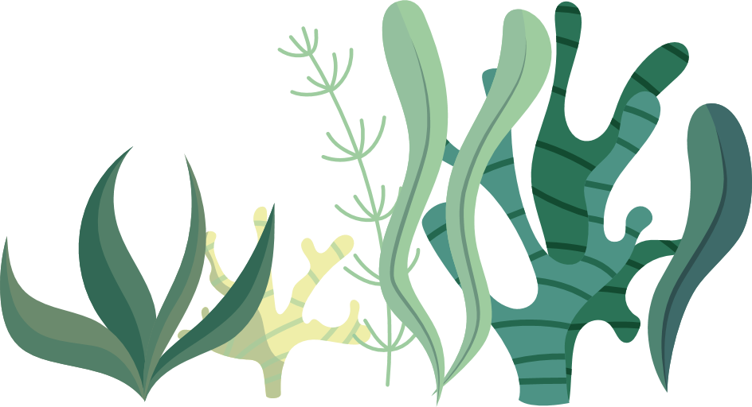
Activity 1: Mindful Giant Clams
Notes:
Teacher’s Step-by-step Activity Guide
Activity 1: Mindful Giant Clams
Explain that one way to feel calmer or better is to breathe in and out, slowly and deeply.
Tell the class that they are going to practice breathing as a way of feeling calm. Sometimes it can help to imagine something at the same time as we breathe, to help us slow down our breath.
To guide the breathing activity, you can either play the video or use the script provided (below)
Depending on your class, you might like to demonstrate and invite the class to join in for a second or third practice breath.
Script
This is a Giant Clam.
Clams live on the ocean floor, and once they find a nice home, they stay planted in that spot for the
rest of their life with their shells gently opening and closing as the water swirls around them.
So, settle yourselves down like a Giant Clam, with your feet firmly planted on the ground and bring
your hands together, to make the shell of a clam. Remember that no matter how rough the water
gets, or how many thoughts we have, we can always come back to our breath.
As I count, we’re going to slowly practice breathing in and out, opening and closing our shells.
1 -2 -3 – 4 and pause, and now slowing breathing out 1 2 3 4 closing our shell.
Now let’s repeat this a few times.
Breathing in 1 2 3 4 shells open
Breathing out 1 2 3 4 shells closed
Breathing in 1 2 3 4 shells open
Breathing out 1 2 3 4 shells closed
Breathing in 1 2 3 4 shells open
Breathing out 1 2 3 4 shells closed

Slide 36
Activity 2: Recap lesson 2
Can you remember the names of the two boys from the ”Los Dos Amigos” story
Can you remember what “Los Dos Amigos” was about?
Where was the story set, where did it take place?
Who was the strongest character in the story? Why?
Notes:
Activity 2: Recap of lesson 2
Ask the class if anyone can remember the names of the two boys from the ”Los Dos Amigos” story [Answer: Seán and Juan]
Ask for volunteers to remind the class what “Los Dos Amigos” was about. [Prompts: Can you remember the characters in the story?
Where was the story set, where did it take place?
Who was the strongest character in the story? Why?]
Remind pupils that Seán and Juan loved fishing together, chatting and helping each other to reel fish into the riverbank.

Slide 37
Activity 3: Honduras
Write here
Notes:
Activity 3: Honduras
Locate Honduras on the world map, drawing a line across from Ireland to Honduras. Explain that even though Honduras is all the way across the Atlantic, we share the same ocean.
Explain that even though the name Juan is originally a Spanish name, the character Juan in the story didn’t come from Spain. He came from Honduras, another country in our world where Spanish is spoken .
Ask if anyone in the class has family in or from a country where another language(s) is spoken?
In the story of Los Dos Amigos, Juan had come to Ireland from a fishing community in Honduras and was able to bring his knowledge and experience with him and share it with Sean.

Slide 38
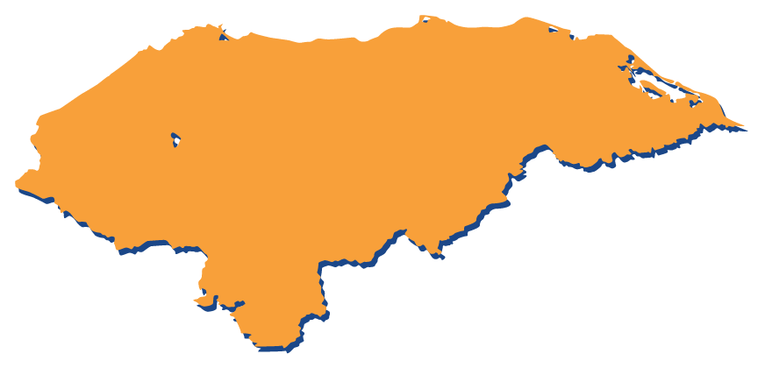
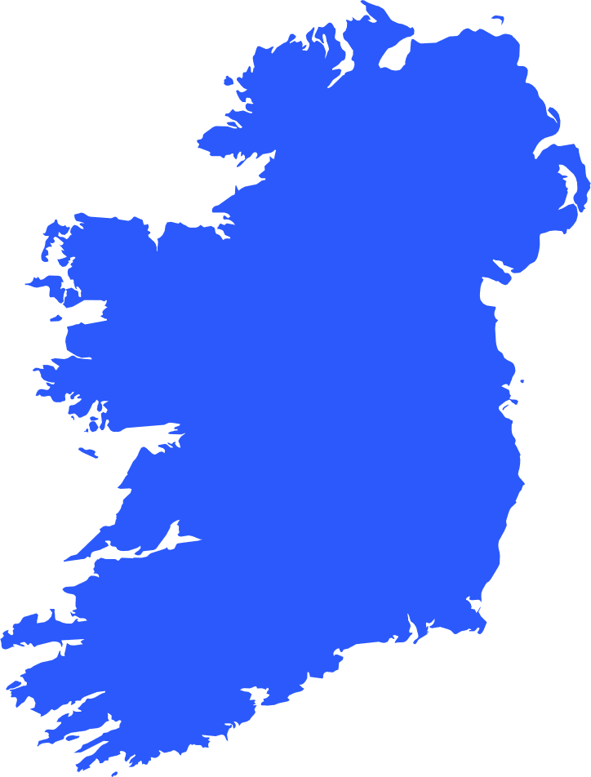
Activity 3: Honduras
Do you recognise this country?
Honduras
Ireland
Notes:
Activity 3: Honduras continued

Slide 39
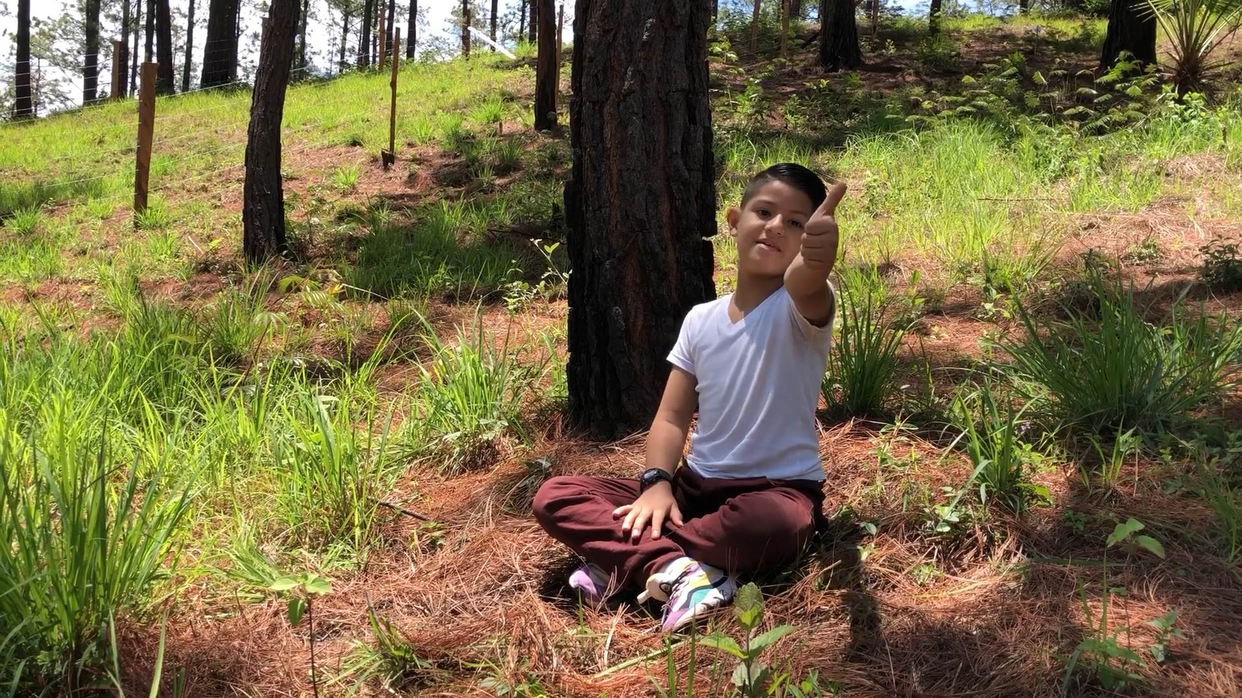
Activity 4: Honduras
Meet Juan!
Hi everyone, my name is Juan!
I’m 9 years old and I live in Honduras. Honduras is a small country in Central America. I speak Spanish. I really like school. I’ve been on the honour roll 3 times! (This is the same as getting student of the week award).
My favourite subject is Science because I like nature so much, especially the ocean. What I like the most is that there are a lot of coral reefs, animals, and lots of life in the ocean. The ocean is important because there are lots of animals that give many good things to the earth.
There are many beautiful whales, sharks and different species of fish in the ocean. My favourite creature is the shark!
The majestic shark has several species types - Tiger sharks, Bull sharks, Basking sharks, Whale sharks and many others.
Also, sharks have ancestors who were called Megalodons. They had large teeth and measured between 20 – 30 metres.
That’s why for me, sharks are such majestic animals – some of them grow so big!
Nature and the importance of the ocean are two very important things to me.
Notes:
Activity 4: Juan from Honduras
1. Explain that people in Ireland and Honduras are connected through the ocean. For this reason, it is important that we all work together to keep our ocean in between healthy and protected!
2. Tell the class that they are going to read about another boy called Juan, who is close to their age and lives in Honduras.
3. Invite the class to listen as you read out Juan’s case study. Identify what Juan says the problems facing our oceans are and possible solutions to these problems.

Slide 40
Problems
Solutions
How can people look after our oceans?
What is bad
for our oceans?
Notes:
Activity 4: Juan from Honduras continued
4. Draw a line down the centre of the board. On the left, write the word ‘Problems’ and on the right ‘Solutions.’
5. Ask the class talk about the different things that are bad for our oceans [e.g. pollution, overfishing, plastic etc.] Record their responses on the left of the board.
6. Ask the class for ideas about how people can look after our oceans. Record their responses on the right of the board.
7. Facilitate a brief whole class discussion using the following prompt questions:
Do you think there are things people across the ocean in Honduras (like Juan’s family) know that we do not?
Could we learn from them about how to take better care of our oceans?
8. Explain to the class that they are going to take part in activities to get them thinking about what it might be like to be the fish in The Windward Passage, swimming from Ireland to Honduras, to see if they can learn more about what can be done to take care of our oceans.

Slide 41
Activity 4: Arrival in Honduras
Notes:
Activity 4: Arrival in Honduras!
Ask them to imagine that they are fish who, after a long journey, have arrived on the coast of Honduras. Invite them to look around.
Prompts: What do they see? What kind of smells are there? What sounds do they hear?
Display images of Honduras using the following prompts for each image:
Image 1 - 4: What the weather is like? Explain that the weather is much warmer in Honduras than Ireland. There are lots of different fish and plants in the water in Honduras, and some of the same ones as home too! Do you see any trees? Do you see any water?

Slide 42
Notes:
Activity 4: Arrival in Honduras continued
Image 5: Explain that because Honduras has a very long coastline, many Honduran families live by the sea. Many of those are fishing families. They catch fish to eat and to sell to make money. Many young teenagers help their families to catch fish. But as you can see in the photo, it is important for everyone to learn to be safe when they are fishing, to make sure they are safe in the water, that they do not fish too much (overfish) and to know how to sell their fish at the market. Fishing families search for lots of different kinds! Lobsters, Wild Tilapia, Lionfish, Jellyfish, Catfish. This image shows two young men fishing for lobsters on the ocean floor. [See if pupils can name any other types of fish.]
Image 6 & 7: It is important that everyone does their best to pay attention to how much of each type of fish is there, and to know when they need to take a break from fishing so that the fish have time to grow in number again. Here is a photo of people in Honduras bringing their fish to the market to sell. Fishing families sell fish to supermarkets, or to other people in the area, to earn money for other things they need.

Slide 43
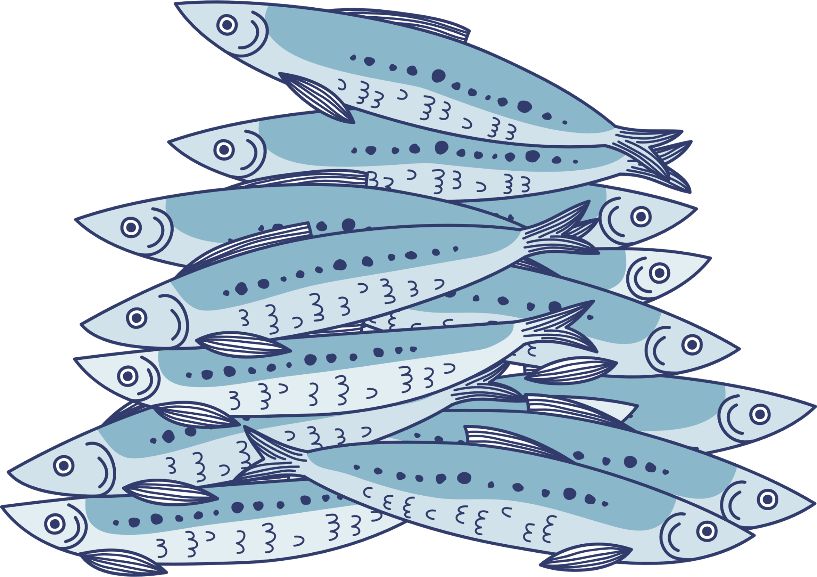
Optional PE/Drama/Mathematics activity: Sardines!
We are learning to:​
use our imaginations in role play​
cooperate to make groups made up of the correct number​
reflect on our learning​
Notes:
Optional PE/Drama/Mathematics activity
Note: This activity requires a large free space.
share the learning intentions for this activity with pupils – We are learning to:
use our imaginations in role play
cooperate to make groups made up of the correct number
reflect on our learning
Explain that sardines are a small fish that swim around the ocean in big groups called ’schools.’ They stay in groups as a protection from predators like sharks, dolphins, and other big animals.
Explain that in a few minutes, everyone is going to magically change into a sardine, and make their way across the ocean from Ireland to Honduras. They will walk around slowly, imagining they are swimming from Ireland to Honduras. While they swim, they will have to watch out for the other sardines in their group, making sure not to bunch together or hit into one another.
Explain that every now and then you are going to call out a number between 1 – 10. Whenever a number is called, they must try get into “schools” or small groups made up of that many sardines. So, for example, if you call out ‘5’, then they need to find four other sardines to huddle with. Any ‘sardines’ who find themselves alone or in groups of less or more than 5 (in this case) will magically turn into dolphins. Once you say it’s ok, the dolphins can try to ‘eat’ a sardine, which will scatter the groups up again, and a new number can be called.
Practice to make sure that everyone understands the instruction, then signal the start of the activity by saying ‘Uno – Dos – Tres.’
Repeat the activity three to four times or as appropriate.

Slide 44
End of Lesson Reflection
After this lesson I can:
Practise breathing as a way of feeling calm.
Discuss the problems facing our rivers, seas & ocean, and solutions to these problems.
Work together as a team.
Consider the lives and environment of fishing families in Honduras.
Cooperate and use numbers to make small groups.
Notes:
Activity 5: End of lesson reflection
Encourage pupils to check that their thinking caps are securely on their heads (mime checking the invisible thinking cap is positioned carefully on your head).
Invite pupils to share one word they learnt/ think is important from the lesson.
Note: Depending on time, you can record pupils responses in a word cloud on the board.
Read the learning intentions for this lesson, simplifying as needed.
In response to each learning intention, ask pupils to give a thumbs up (I’m happy I know or can do this), thumbs down (I need help with this) or palm flat in the middle (I’m not sure). Scan the room to see how pupils are managing with the learning intentions.
After this lesson I can…
Practice breathing as a way of feeling calm
Discuss the problems facing our rivers, seas and oceans and solutions to these problems.
Work together as a team.
Consider the lives and environment of fishing families in Honduras.
cooperate and use numeracy to make small groups
Invite the class to mime taking off their thinking caps, take a bow and put their thinking caps somewhere safe (desk, pocket, bag) until they need it again.​

Slide 45
Lesson 4
Notes:
Notes for teachers
Water Wishes 1st – 2nd class: Lesson 4 Title slide (No animation)

Slide 46
Lesson 4
Learning intentions
In this lesson, we are learning to:
practice breathing as a way of feeling calm
identify the different United Nations Global Goals
discuss Changemakers working to progress Global Goal 14: Life under water
generate action ideas to protect our waterways
reflect on our learning
Notes:
Lesson 4 Teacher notes
Approximate Time: 45 minutes

Slide 47
Activity 1: Mindful Giant Clams
Notes:
Teacher’s Step-by-step Activity Guide
Activity 1: Mindful Giant Clams
Explain that one way to feel calmer or better is to breathe in and out, slowly and deeply.
Tell the class that they are going to practice breathing as a way of feeling calm. Sometimes it can help to imagine something at the same time as we breathe, to help us slow down our breath.
To guide the breathing activity, you can either play the video or use the script provided (below)
Depending on your class, you might like to demonstrate and invite the class to join in for a second or third practice breath.
Script
This is a Giant Clam.
Clams live on the ocean floor, and once they find a nice home, they stay planted in that spot for the
rest of their life with their shells gently opening and closing as the water swirls around them.
So, settle yourselves down like a Giant Clam, with your feet firmly planted on the ground and bring
your hands together, to make the shell of a clam. Remember that no matter how rough the water
gets, or how many thoughts we have, we can always come back to our breath.
As I count, we’re going to slowly practice breathing in and out, opening and closing our shells.
1 -2 -3 – 4 and pause, and now slowing breathing out 1 2 3 4 closing our shell.
Now let’s repeat this a few times.
Breathing in 1 2 3 4 shells open
Breathing out 1 2 3 4 shells closed
Breathing in 1 2 3 4 shells open
Breathing out 1 2 3 4 shells closed
Breathing in 1 2 3 4 shells open
Breathing out 1 2 3 4 shells closed

Slide 48
Activity 2: Global Goals
Notes:
Activity 2: Global Goals
Explain that there are many people in every country in our world who do not have all the things that they need – some people do not have enough food, or clean water to drink, others don’t have the chance to go to or stay in school; others who do not have a home; or can’t afford to go to a hospital when they are sick. Because of this, all the countries in our world, including Ireland, have come together to work on a plan to try to make our world a better place, where everyone has what they need to survive and be safe. This plan includes trying to care for and protect our waterways (rivers and lakes, seas and oceans) .
This plan is called the Global Goals (more information on page 12). There are 17 Global Goals. Depending on your class, you may wish to explain that goals are like things that you aim for or wishes that you are working on to make them come through.
Display the black and white version of the 17 Global Goal icons (page 13). Invite the class to look closely at the icons on the board.
Ask if anyone can guess which Goal(s) should be coloured blue, that is, which Goal(s) might be about water. [Answer: Goal 6: Clean water and sanitation, and Goal 14: Life under water]
*Animate the slide to show the coloured in pictures of the Goals and compare to see which ones they guessed correctly

Slide 49
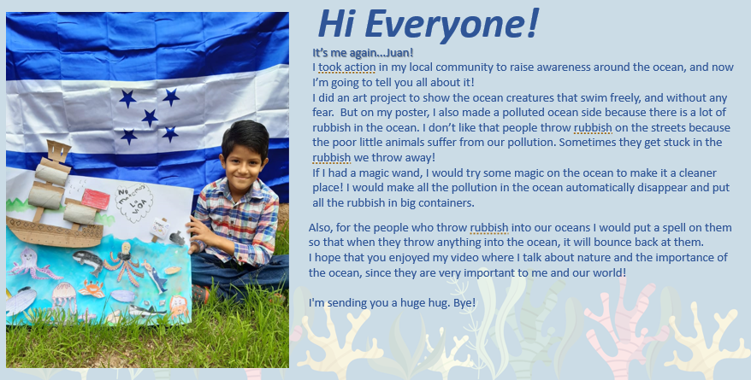
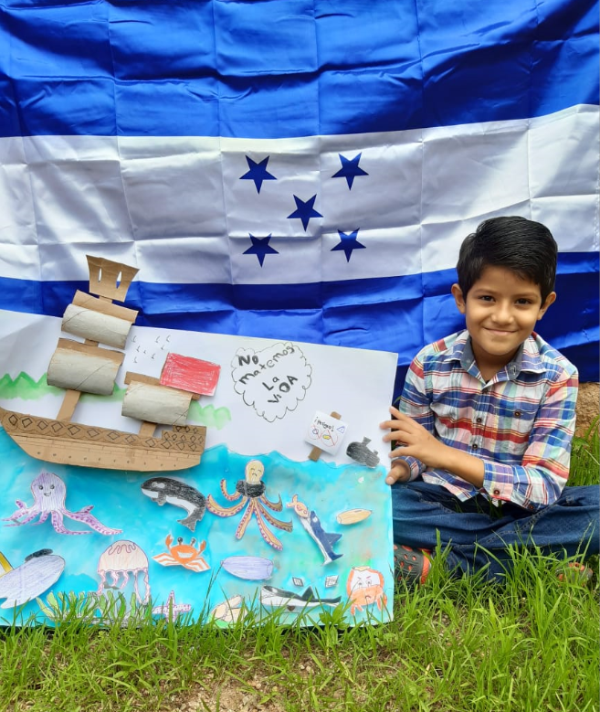

Activity 3: Changemakers for the Goals
Notes:
​​​Activity 3: Changemakers for the Goals
Prompt the class to think back to the lesson where they met Juan from Honduras (Lesson 3: Activity 3, see Honduras Case Study Powerpoint).
Ask the pupils what they remember about Juan.
Tell the class that Juan is a Changemaker. This means that he is someone who is working hard to try to make our world a better place.
Display the case study of Juan in Honduras
Read it together as a class.

Slide 50
Activity 3: Changemakers for the Goals cont…
Notes:
​​​ Activity 3: Changemakers for the Goals continued
​​Display the 17 Global Goals on the board (page 14).
Ask pupils which Global Goal Juan is teaching people about in his artwork?
[Global Goal 14: Life under water, but also Global Goal 12: Responsible production and consumption]
Ask pupils whether they know any other Changemakers who are helping to make one or more of the Global Goals come true? [e.g. Greta Thunberg, David Attenborough, maybe someone in the class or someone in the local area!]

Slide 51
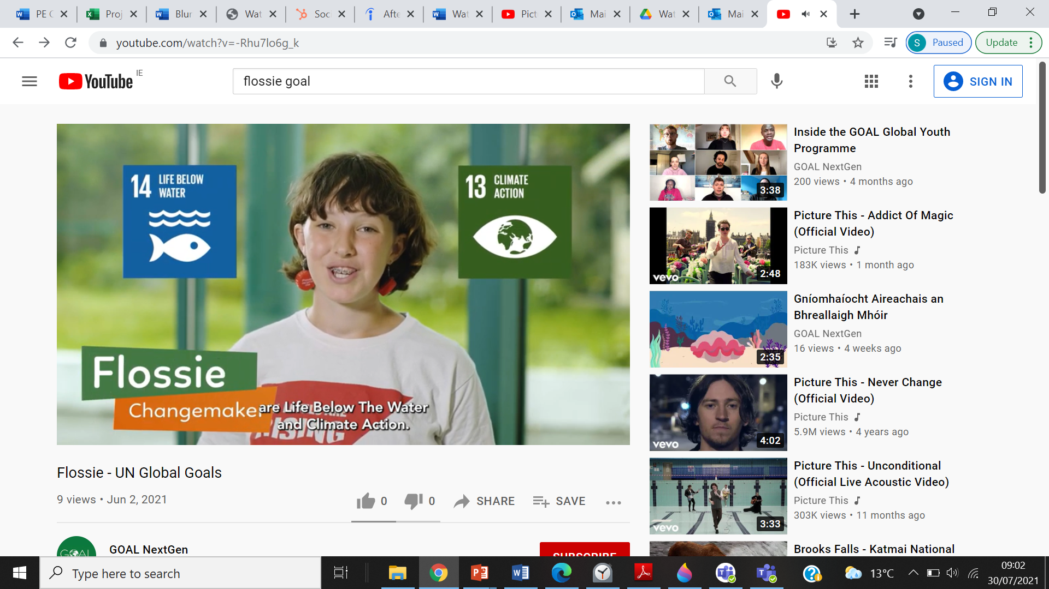
Activity 3: Changemakers for the Goals cont…
Notes:
Activity 3: Changemakers for the Goals continued
Explain to the class that they are going to watch a short video about a girl called Flossie who lives in Ireland and is doing a lot of work to try to help and protect our oceans.
Play Flossie’s video.
8. After watching, display the 17 Global Goals on the board (page 14).
Remind the class that Flossie talks about her favourite Global Goals – Life Below Water and Climate Change.
Ask pupils to identify the correct numbers of these two Goals that Flossie speaks about.
Ask whether they think these two Goals are important? Why/not?

Slide 52
Imagine you had a magic wand that you could wave to make a wish come true that would help our oceans
What would you wish for?
How can we help make our waterways a better place?
Notes:
Activity 4: Action ideas
Remind the class that in the Water Wishes lessons you have all talked a lot about the importance of our rivers and lakes, seas and oceans. By working together, we can all make a difference and make sure that our waterways are healthy, which will mean healthier lives for all!
Encourage pupils to check that their thinking caps are securely on their heads (mime checking the invisible thinking cap is positioned carefully on your head).
Tell pupils that they are going to use their thinking caps to help come up with something they can do to help make our waterways a better place.
Read the second case study again of Juan speaking about the magic spell he wants to put on anyone who litters (doesn’t get rid of their rubbish properly) and pollutes (dirties) the ocean (slideshow of Honduras Case study).
Facilitate a short whole class discussion, using the following questions as prompts:
What magic spell does Juan want to put on anyone who litters?
Can you think of another magical spell that might help make the oceans a better place? Encourage pupils to come up with their own ideas of a magic spell through a drawing or collect the answers on the whiteboard and record their ideas for GOAL. Imagine you had a magic wand that you could wave to make a wish for the good of our ocean come true. What would you wish for? ​
How can we be like the Salmon of Knowledge (and Finnegas and Fionn) and share our knowledge about the importance of our oceans? Do you have any ideas?

Slide 53
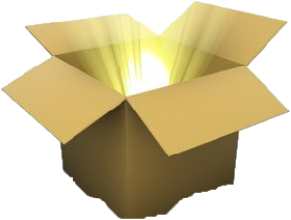
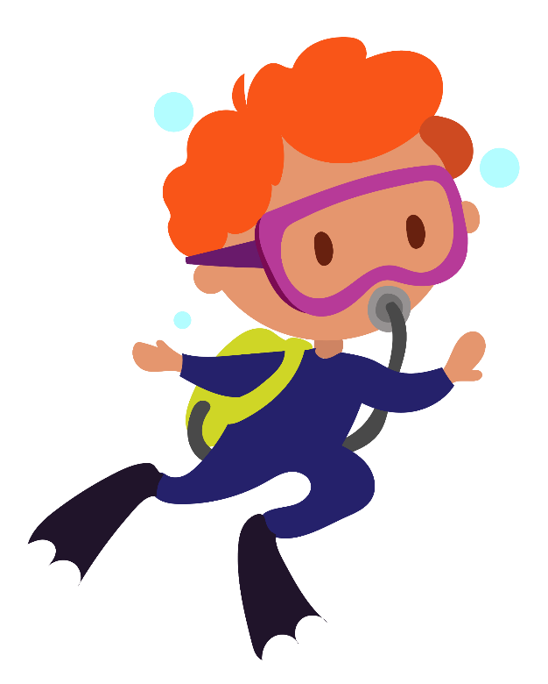
After this lesson I can…
practice breathing as a way of feeling calm
identify the different United Nations Global Goals
discuss Changemakers working to progress Global Goal 14: Life under water
generate action ideas to protect our waterways
reflect on our learning
Notes:
End of lesson reflection
[Note: This activity can be done at desks in pairs, or if time permits, it can be done as a larger group.]
Encourage pupils to check that their thinking caps are securely on their heads (mime checking the invisible thinking cap is positioned carefully on your head).
Demonstrate and then invite pupils to mime placing a magic box on their desks.
Explain that when they open the box they are going to take something out that made an impression on them from the Water Wishes lessons. For example, in their magic box they might find a calm clam, a hot salmon, a Hermit Crab, a boat, a friend. Demonstrate by miming taking something out of your own magic box. Ask pupils to guess what you have in your hands.
Invite pupils to take turns miming and guessing (in pairs or larger groups).
In response to each learning intention, ask pupils to give a thumbs up (I’m happy I know or can do this), thumbs down (I need help with this) or palm flat in the middle (I’m not sure) and record.
After this lesson I can…
practice breathing as a way of feeling calm
identify the different United Nations Global Goals
discuss Changemakers working to progress Global Goal 14: Life under water
generate action ideas to protect our waterways
reflect on our learning
Invite the class to mime taking off their thinking caps, take a bow and put their thinking caps somewhere safe (desk, pocket, bag) until they need it again.

Slide 54



THANK YOU!
Follow us on
@goalnextgen
Notes:
Please send any actions your class have taken to globalc@goal.ie, we would love to feature your work on our website to inspire others.

