Slide 1
3rd-6th class unit
2020/21
Notes:
Notes for teachers
Changemaker Unit 3rd – 6th class: Title slide (No animation)
Acknowledgements:
This resource has been published by GOAL as part of GOAL’s Development Education programme in Primary schools 2020.
All artwork for this resource has been designed in house by GOAL’s Design team in Honduras.
© GOAL 2020
Background:
GOAL Global is a humanitarian aid agency founded in 1977. GOAL has responded to many of the world’s major humanitarian crises, working with vulnerable communities in over 60 countries. Today, GOAL is supporting vulnerable communities in 13 programme countries across Africa, the Middle East and Latin America. Currently GOAL is applying its unique expertise in Emergency Response to the Global Covid-19 crisis. In addition to emergency response, GOAL also works towards: food & nutrition security, resilient health & sustainable livelihoods, and fostering Global Citizenship by recognising that we all share responsibility for a better world. We all need to work together as we strive to achieve GOAL’s mission: A world without poverty.

Slide 2
Aim
To encourage pupils to understand and contribute to the United Nations Global Goals by taking part in learning activities and undertaking meaningful actions to bring about positive change.
Notes:
Notes for teachers
Changemaker Unit 3rd – 6th class: Aim slide (No animation)

Slide 3
Unit overview
3 curriculum-linked lessons
Visually attractive slides for use with 3rd-6th class
Multi-media stimuli embedded in slides, meaning there is no need for internet access (but just in case, the links are all in the slide notes)
Step-by-step teacher support in the slide notes (including ideas for to adapt to online learning contexts)
PowerPoint Contents | Section | Slide number
 | Curriculum links and unit learning intentions | 4-6
 | Lesson 1: Global Goals Changemakers | 8-18
 | Lesson 2: Global problems, Goal solutions | 19-26
 | Lesson 3: Changemaker action | 27-37
Everything you need to teach for change right now – all in one PowerPoint!
Submission form available Here!
Notes:
Notes for teachers
Changemaker Unit 3rd – 6th class: Overview slide, including contents (No animation)
Dear teacher
Welcome to GOALs Changemakers programme. We’re delighted that you and your class have decided to take part!
Here are a couple of things that might be helpful to know to ensure Changemakers runs smoothly in your class.
This Changemaker unit is made up of 3 lessons. With the exception of 2 optional activities in Lesson 2 (slides 24-25: bingo activity for 3rd-4 class and quiz for 5th-6th class), all lesson activities have been designed as suitable for use with 3rd-6th class pupils.
It is recommended that you play the slides and read the slide notes in advance of the class. A thumbnail of each slide, with the associated notes can be printed to a single page, using the PRINT – SETTINGS - NOTES PAGE facility.
There is very little preparation required. The first time you use this resource, you will need to print and cut cards for 2 activities (Lesson 1 – approx. 10 pages & Lesson 3 – approx. 3 pages). But, if you collect these cards after use, you will not have to do this again.
During the lesson, show the slides in presenter mode to maximise animation. On the very few occasions you have to come out of presenter mode (e.g. to type feedback from pupils on a slide), this is flagged in the slide notes. (Animated slides are indicated with a star icon beside them *)
As you and your class engage with the Changemaker lessons and/or undertake Changemaker related actions, we would love to hear how you are getting on. Tweet us your thoughts, pupils comments etc. @GoalNextGen using the hashtag #GOALchangemakers.
If you need additional support or have questions relating to the programme, phone or email Jessica Sargeant on 0863542491 or jsargeant@goal.ie and one of our Changemakers team members will get back to you as soon as possible.
We want to celebrate your participation in the Changemakers programme, regardless of how small or big that participation is. If you would like to receive a Changemakers certificate of recognition and a large map of the world for classroom display, all you have to do is take a few minutes to fill out our simple submission form, link available in the slide above.
Jessica Sargeant – Development Education Officer]

Slide 4
Curriculum links & unit learning intentions
Slides 4-6
Notes:
Notes for teachers
Changemaker Unit 3rd – 6th class: Curriculum links & unit learning intentions (title slide) (No animation)

Slide 5
Curriculum links
Languages | Oral Language
 | Element | Learning outcome
 | Communication | Engagement, learning and attention Social conventions and awareness of others
 | Exploring and using | Requests, questions and interactions
 | Reading | Engagement Information-giving, exploration and justification
SPHE | Strand | Strand unit
 | Myself | Growing and changing (feelings and emotions)
 | Myself and the wider world | Developing citizenship
SESE – GEOGRAPHY | Strand | Strand unit
 | Human environments | People and other lands Trade and Development issues
 | Environmental awareness and care | Environmental awareness Caring for the environment
Drama | Strand | Strand unit
 | Drama to explore feelings, knowledge and ideas leading to understanding | Exploring and making drama Co-operating and communicating in making drama
SESE – SCIENCE | Strand | Strand unit
 | Environmental awareness and care | Environmental awareness Science and the environment
Notes:
Notes for teachers
Changemaker Unit 3rd – 6th class: Curriculum links slide (No animation)

Slide 6
Learning intentions
Lessons 1 - 3
We are learning to…
practice breathing as a way of feeling calm
discuss what it means to be a Changemaker
tell the difference between needs and wants, connecting needs to relevant United Nations Global Goals
identify some of the challenges facing people and the planet
recognise that the Global Goals are a plan to make our world a better place
identify actions that have and can be taken to contribute to the Global Goals
Notes:
Notes for teachers
Changemaker Unit 3rd – 6th class: Learning intentions for the 3 lessons in the unit (No animation)
Depending on your class, you might like to share the unit learning intentions before starting the first lesson. If this is the case, you could ask for volunteers to read the learning intentions on the slide aloud, clarifying/adapting language as required.

Slide 7
Lessons 1-3
Slides 8-39
Notes:
Notes for teachers
Changemaker Unit 3rd – 6th class: Lessons 1-3 (title slide) (No animation)

Slide 8
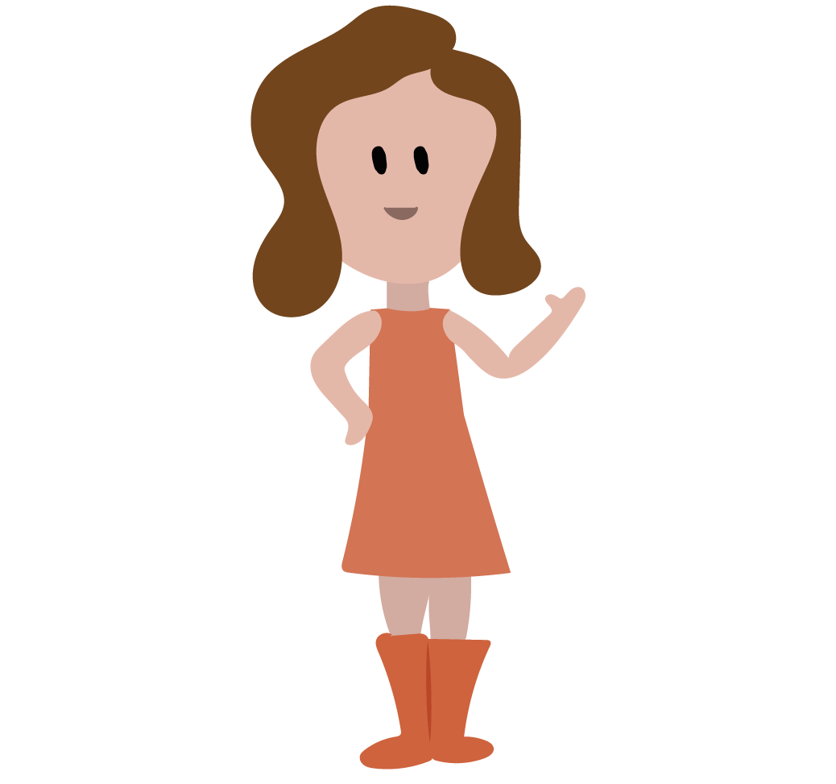
Lesson 1
Global Goal Changemakers
Learning intentions
We are learning to…
practice breathing as a way of feeling calm
discuss what it means to be a Changemaker
identify some of the challenges facing people and the planet
tell the difference between needs and wants, connecting needs to relevant United Nations Global Goals
Materials
You will need…
Changemaker ID card
(one for each pupil)
available Slide 17
Notes:
Notes for teachers
Changemaker Unit 3rd – 6th class: Lessons 1 (title slide with learning intentions and note re materials) (No animation)
NB: In advance of delivering this lesson, you will need to print and cut one Changemaker ID card for each pupil in your class (see slide 17).
Depending on your class, you might like to share the learning intentions for Lesson 1 with pupils before starting. If this is the case, you could ask for volunteers to read the learning intentions on the slide aloud, clarifying/adapting language as required.

Slide 9
Lesson 1
Part 1
Can you name different emotions or feelings?
Do you think it is normal to feel all these emotions at different times?
Do you think that it is possible to be happy all the time?
Which feelings can be tricky?
If a feeling gets too strong, what can we do to calm down or feel better?
Do we need other people to help or can we get calmer or feel better by ourselves?
Notes:
Notes for teachers
Changemaker Unit 3rd – 6th class: Lesson 1/Part 1 (6 animations at * – questions animate in one by one)
* Animate in six questions, one by one
Read these questions aloud, clarifying/adapting language when necessary.
Encourage as many different children as possible to respond.
Question 1: There is a visual prompt immediately after question 1, which may assist children to name emotions/feelings.
Question 2: Answer = yes
Question 3: Answer = no

Slide 10
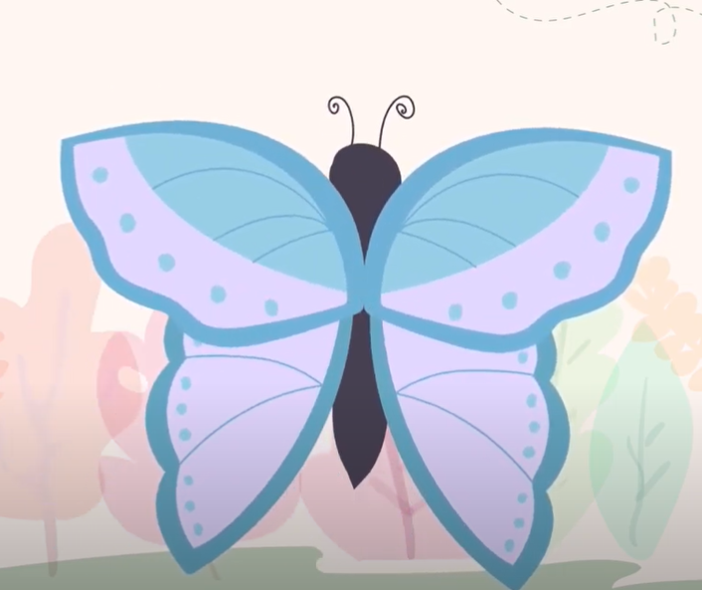
Lesson 1
Part 2
Do you feel calmer now?
Notes:
Notes for teachers
Changemaker Unit 3rd – 6th class: Lesson 1/Part 2 (1 animation at *)
Explain that one way to feel calmer or better is to breathe in and out, slowly and deeply.
Tell the class that they are going to practice breathing as a way of feeling calm. Sometimes it can help to imagine something at the same time as we breathe, to help us slow down our breath.
Depending on your class, you might like to demonstrate and invite the class to join in for a second or third practice breath.
To guide the breathing activity, you can either play the video provided, by clicking on the image of the butterfly. Also available here: https://youtu.be/BqGQoZTo3CY (English language version);
https://youtu.be/WAd55dolYl4 (Irish language version); and/or use the instructions below:
Bring your hands together, palms touching. Imagine your hands are a butterfly whose wings are closed. As I count, we’re going to slowly open our wings and breath in.
Now, together 1, 2, 3, 4 and pause. Now, breathing out and closing, 1, 2, 3, 4.
Now, lets repeat this a few times.
Breathing in 1, 2, 3, 4 open - breathing out 1, 2, 3, 4 closed. [repeat this line twice more]
If using the video, you might decide to play it a second time. If your school is an Irish-medium school, you might like to firstly play the video in Irish, and then a second time in English. If your school is an English-medium school, you might like to firstly play the video in English, and then a second time in Irish.
NOTE: In presenter mode, you can click into the butterfly video directly, without leaving the presentation. The slide is animated so once you finish the video, click once again for the prompting question before moving on. (The other slides in the resource that are animated are marked with an *)
* At the end of the breathing activity, animate in a question for pupils about whether they feel calmer now.
Background information
Grounding activities, like this breathing exercise, can be very useful at the start of Development Education/Global Citizenship Education lessons. They can help children to settle and connect with how they are feeling, before beginning to switch the focus outwards to our wider world.

Slide 11
Lesson 1
Part 3
What do you think a Changemaker is?
Can you think of any people who are Changemakers?
Have you ever been a Changemaker?
Notes:
Notes for teachers
Changemaker Unit 3rd – 6th class: Lesson 1/Part 3 (3 animations one after another at *)
Explain that the class is going to take part in a programme called GOAL Changemakers.
* Click to animate in the three questions one by one.
Read these questions aloud, clarifying/adapting language as required.
Encourage as many different children as possible to respond.
Question 1: Prompt - A Changemaker could be someone who sees a problem or a gap, thinks of a way of solving the problem, improving things or changing things for the better, and decides to do something about it.
Question 2: Prompt – is there someone in this school, at home or someone that you’ve met or seen on TV or online that has done something to solve a problem in our world?
Question 3: Prompt – think about times that you have fixed a problem/ helped someone else/ been kind to a friend who was upset/ cared for our environment.

Slide 12
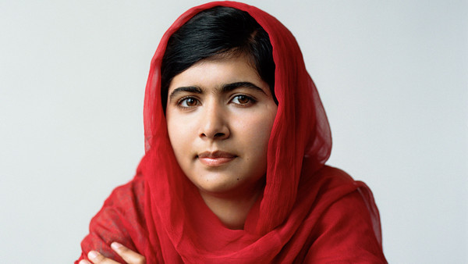
Lesson 1
Part 4
Does anyone know who Malala Yousafzai is?
What do you know about Malala?
What 3 problems are mentioned in this video?
What solutions to these problems are mentioned in the video?
Can you think of any other solutions?
Notes:
Notes for teachers
Changemaker Unit 3rd – 6th class: Lesson 1/Part 4 (3 animations at *, ^ and +)
* Click to animate in the first two questions on the slide
Ask the class if anyone has ever heard of Malala Yousafzai? What do they know about Malala? (see biography of Malala below). Explain that Malala is an inspiring Changemaker, who is helping girls all over the world go to and stay in school.
Explain to the class that they are going to watch a short video (6mins 19secs).
^ Animate in the next pair of questions on the slide
As they watch the video, their job is to listen/look for the 3 problems and the solutions to these problems mentioned in the video.
Play the video by clicking on the image of Malala (also available: https://youtu.be/pV9PYcghniw (English language version) or https://youtu.be/fpjIu2446PY (Irish version).
Discuss the 3 problems and associated solutions mentioned in the video (answers: problems = inequality, extreme poverty and climate change; solutions = don’t waste food, water or electricity; stick up for people who aren’t being treated fairly; respect each other’s human rights; take care of the planet and each other; share our resources fairly and sustainably).
+ Animate in the final question on the slide
Ask pupils if they can think of any solutions to the global challenges of inequality, extreme poverty and climate change that are not mentioned in the video.
Background information
Malala Yousafzai was born in Mingora, in the Swat Valley in Pakistan, in 1997. The Swat Valley was a popular tourist spot until the Taliban (an Islamic militant group) tried to take control. Malala went to a school run by her father, Ziauddin Yousafzai. After the Taliban began attacking girls' schools, Malala gave a speech in Peshawar, Pakistan, in September 2008. The title of her talk was, "How dare the Taliban take away my basic right to education?"
She continued to speak out about her right, and the right of all women, to an education. In 2012, Malala was shot after the Taliban issued threats against her. She received medical help and moved to the United Kingdom, starting school there in March 2013. In 2014, Malala was awarded the Nobel Peace Prize and donated the $50,000 prize money to help rebuild 50 schools in Gaza. Malala recently graduated from Oxford University and continues to support education for girls through her charity, the Malala Fund.

Slide 13
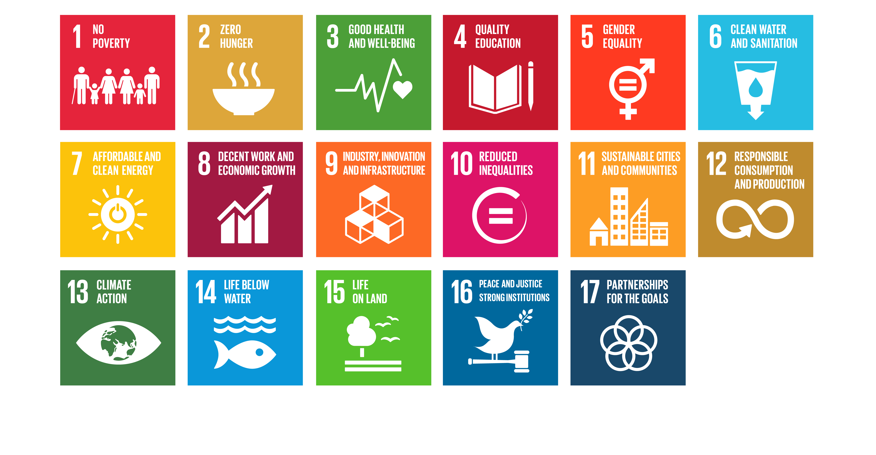
The UN Global Goals
Lesson 1
Part 4
Notes:
Notes for teachers
Changemaker Unit 3rd – 6th class: Lesson 1/Part 4 (No animations)
Explain that the United Nations is like a big club for all the countries in our world. Through the United Nations, member countries work together to solve problems and try to make our world a better place for everyone.
Depending on your class you might like to show a short video (2mins 30 secs) about the United Nations, available here: https://www.youtube.com/watch?v=SaAmfiJtV4I
Tell the class that in 2015, the 193 countries in the United Nations, including Ireland, agreed that they would work together to try to deal with the biggest problems facing our world. Their plan is called the Global Goals. The Goals are really a set of solutions to make the world a better, fairer place for everyone. Global co-operation is really important to achieving the Goals. Governments, businesses and ordinary people in all 193 countries must work together to achieve all 17 Global Goals by the year 2030.
Briefly explain what each Global Goal means (you might find the following child-friendly text for the Global Goals useful).
1. End poverty - so that everyone can afford what they need to survive
2. End hunger - so that everyone has enough good food to eat and stay healthy
3. Make sure everyone can live healthy lives and can go to the doctor or to hospital if they need to
4. Make sure everyone gets to go to school and gets a good education
5. Make sure that women and girls get the same chances as men and boys
6. Make sure that everyone has access to clean water and proper toilets
7. Make sure that everyone has enough heat, light and power without damaging the environment (our world)
8. Help countries to develop and provide good jobs in a way that benefits everyone
9. Build schools, hospitals and roads and help businesses and industries that make all people’s lives better
10. Make sure that everyone is treated fairly, and that countries treat each other fairly
11. Make cities clean, friendly and safe places where all people can live well
12. Make sure we don’t buy too many things so that we do not use up the earth’s scarce resources
13. Act now to fight climate change
14. Look after the life in our oceans and seas
15. Look after forests, animals and the earth itself
16. Work for peace and justice inside and between countries
17. Countries will work together as partners to achieve the Global Goals and make the world a better place for everyone
For more detailed, age appropriate information about the Global Goals see: http://margreetdeheer.com/eng/globalgoals.html#goal1

Slide 14
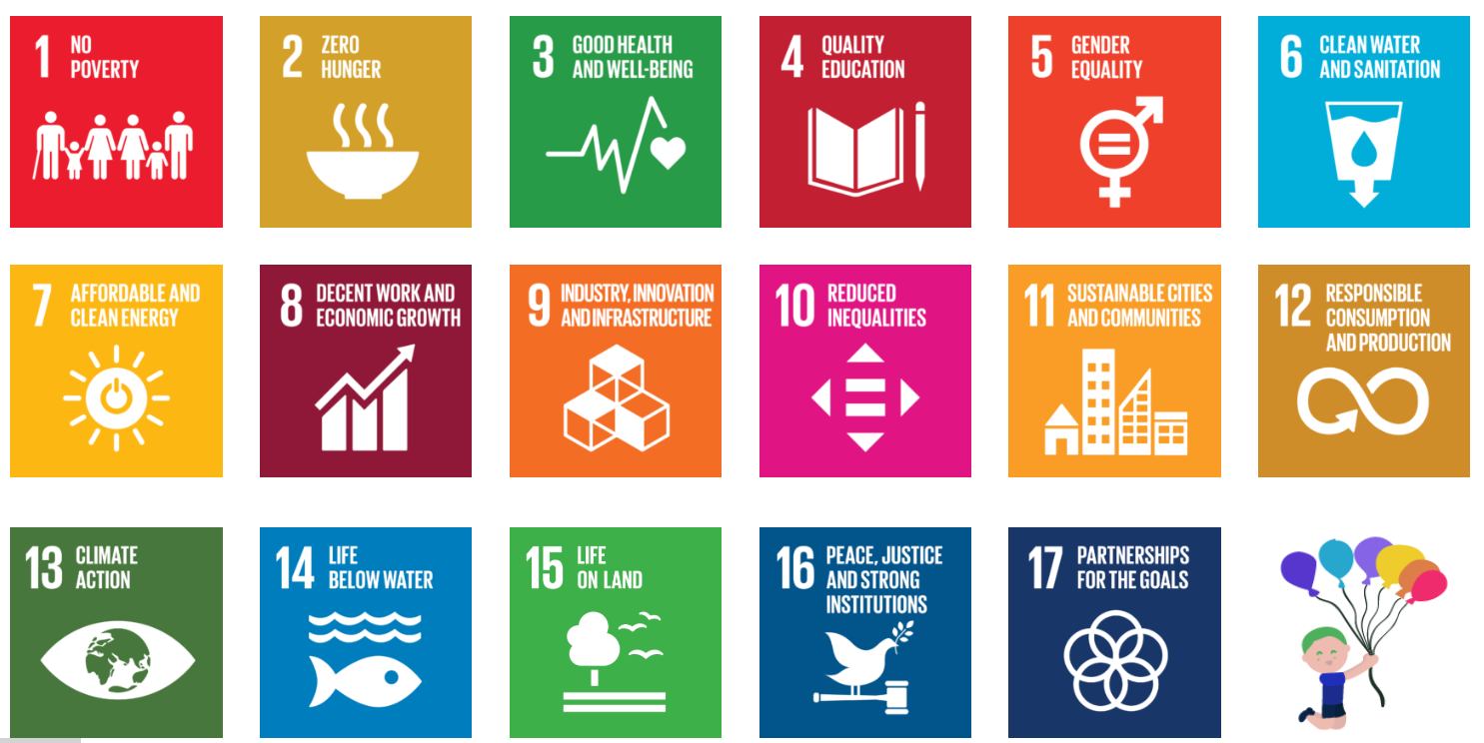
Lesson 1
Part 5
Needs | Wants
Trampoline
Water
Notes:
Notes for teachers
Changemaker Unit 3rd – 6th class: Lesson 1/Part 5 (2 animations at * and ^. Before presenting this slide, read through the NB text below as you will need to move between presentation and normal mode)
Explain that a need is something that we must have to live or survive, for example, water.
* Click to animate the ‘Water’ text box to the first row under Needs.
Explain that a want is something we may like to have, but we can live without it, for example, a trampoline.
^ Animate the ‘Trampoline’ text box to the first row under Wants.
Invite pupils to call out different ideas for needs and wants to insert into the remaining text boxes in the Needs and Wants table.
NB: In order to record their Needs/Wants suggestions into the table, you will have to come out of PowerPoint presentation mode into normal mode (alternatively, you could replicate the Needs/Wants table on a board or a flipchart sheet, and write their suggestions on this second copy of the table). (Prompts: Needs - water, food, healthcare, shelter, education; Wants – ice cream, chocolate, Nintendo).
Ask pupils if they can see any links between the Needs they have listed and the 17 Global Goals. (If you have a Global Goals poster it would be good to keep this on display in your classroom.)

Slide 15
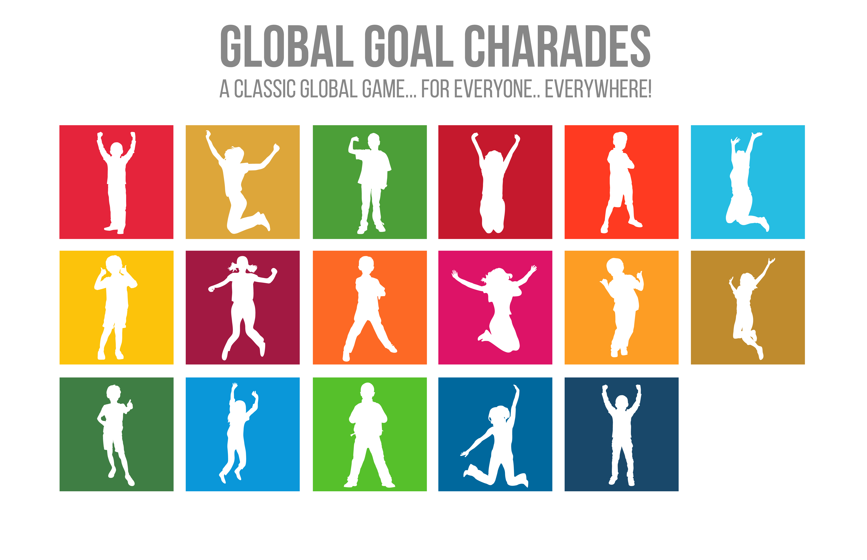
Lesson 3
Part 3
Notes:
Notes for teachers
Changemaker Unit 3rd – 6th class: Lesson 1/Part 6 (1 animation at *)
Explain to the class that they are going to play Global Goal Charades.
One person will pick a Global Goal and do an action or mime to represent this Goal. The first person to guess the correct Global Goal goes next, and so on.
* Animate in the 17 Global Goals to allow pupils to pick their Global Goal.
Depending on your class, you may wish to share some of the following ideas:
Global Goal 2 (Zero hunger) - a person cooking, then a person serving food and then a person eating
Global Goal 3 (Good health and wellbeing) – a person doing different exercises, for example, lifting weights, doing sit-ups, yoga balances etc
Global Goal 4 (Quality education) – a person standing at the top of the class, then sitting down and writing or reading
Global Goal 6 (Clean water and sanitation) – a person washing their hands with soap and hot water, singing happy birthday
Global Goal 7 (Affordable and clean energy) – a person taking money out of their pocket, then miming a windmill
Global Goal 14 (Life under water) – a person pretending to be a fish swimming in the sea
Adaptation note: In the context of online learning, this drama activity could be done via Zoom or similar. If pupils are at home learning, they could be encouraged to play Global Goals Charades with family members.

Slide 16
Lesson 1
Part 7
As Changemakers, you will need an official identity card (I.D.).
Here’s a blank I.D. card.
Fill in your name, age, county (where your school is). You can draw or stick a picture of yourself in the space provided.
Notes:
Notes for teachers
Changemaker Unit 3rd – 6th class: Lesson 1/Part 7 (No animation)
GOAL Changemakers is a programme that is run by an organization or charity called GOAL. GOAL is working to help achieve the Global Goals and make sure that people in poor countries have their needs met – i.e. that they have food, clean water, medicine and schools.
Explain to the class that because they are taking part in GOAL Changemakers programme, they get special Changemaker I.D. cards.
Distribute one copy of the blank Changemaker ID card to each pupil. The I.D. cards are available on the next slide (#17). 3 x I.D. cards can be printed on each A4 sheet of paper. Depending on your class, you might like to invite pupils to stick their I.D. onto card for extra durability.
Explain that in the space beside ‘county’, they should write the county where the school is located.
Depending on your class, you might like to invite pupils to write and decorate the word CHANGEMAKER on the reverse of their I.D. card.
Adaptation note:
Depending on time, this activity could be completed as homework.
In the context of online learning, you could make the Changemaker I.D. card available via the school’s preferred platform or ask pupils to design and complete their own Changemaker I.D. card.

Slide 17
Notes:
Notes for teachers
Changemaker Unit 3rd – 6th class: Lesson 1/Materials for Part 5 (see previous slide)

Slide 18
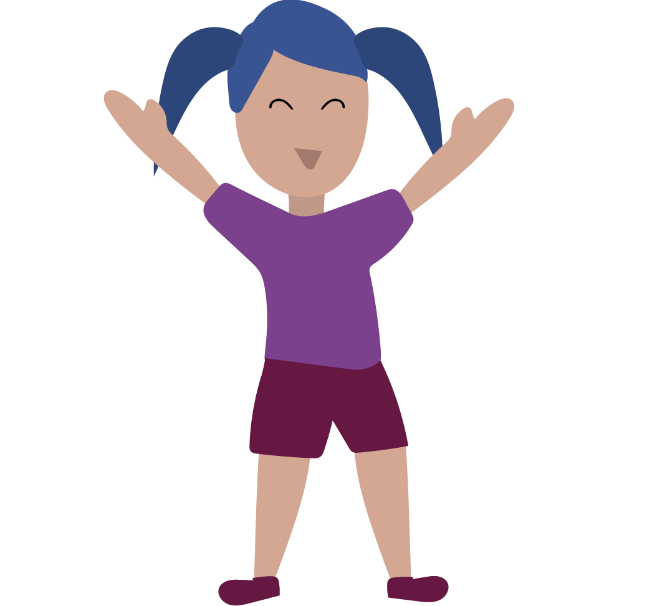
Lesson 1
Part 8
Call out the words that were most important in this lesson.
Make a sentence using at least two of these words.
Notes:
Notes for teachers
Changemaker Unit 3rd – 6th class: Lesson 1/Part 8 (No animation)
Read aloud and follow the steps outlined on the slide.
Depending on your class, you might like to write the words that they identify as the most important from the lesson in the remaining green space on the slide.
NB: In order to record the words suggested by pupils into the green space on the slide, you will have to come out of PowerPoint presentation mode into normal mode (alternatively, you could record their suggestions on a separate board/flipchart sheet).
Depending on your class and time remaining, you might like to invite a selection of pupils to share their sentences with the class.
Adaptation note: In the context of online learning, pupils could be asked to type their important words into chat.
If pupils are learning at home, this task could be done as a post-lesson individual reflection.

Slide 19
Lesson 2
Global problems,
Goal solutions
Learning intentions
We are learning to…
practice breathing as a way of feeling calm
identify some of the challenges facing people and the planet
recognise that the Global Goals are a plan to make our world a better place
Notes:
Notes for teachers
Changemaker Unit 3rd – 6th class: Lessons 2 (title slide with learning intentions) (No animation)
Depending on your class, you might like to share the learning intentions for Lesson 2 with pupils before starting. If this is the case, you could ask for volunteers to read the learning intentions on the slide aloud, clarifying/adapting language as required.

Slide 20
Lesson 2
Part 1
Do you feel calmer now?
Notes:
Notes for teachers
Changemaker Unit 3rd – 6th class: Lesson 2/Part 1 (1 animation at *)
Explain that one way to feel calmer or better is to breathe in and out, slowly and deeply.
Tell the class that they are going to practise breathing as a way of feeling calm. Sometimes it can help to imagine something at the same time as we breathe, to help us slow down our breath.
Depending on your class, you might like to demonstrate and invite the class to join in for a second or third practice breath.
To guide the breathing activity, you can either play the video provided, by clicking on the image of the butterfly (also available: https://youtu.be/BqGQoZTo3CY (English language version); https://youtu.be/WAd55dolYl4 (Irish language version); and/or use the instructions below:
Bring your hands together, palms touching. Imagine your hands are a butterfly whose wings are closed. As I count, we’re going to slowly open our wings and breath in.
Now, together 1, 2, 3, 4 and pause. Now, breathing out and closing, 1, 2, 3, 4.
Now, lets repeat this a few times.
Breathing in 1, 2, 3, 4 open - breathing out 1, 2, 3, 4 closed. [repeat this line twice more]
If using the video, you might decide to play it a second time. If your school is an Irish-medium school, you might like to firstly play the video in Irish, and then a second time in English. If your school is an English-medium school, you might like to firstly play the video in English, and then a second time in Irish.
* At the end of the breathing activity, animate in a question for pupils about whether they feel calmer now.
Background information
Grounding activities, like this breathing exercise, can be very useful at the start of Development Education/Global Citizenship Education lessons. They can help children to settle and connect with how they are feeling, before beginning to switch the focus outwards to our wider world.

Slide 21
Lesson 2
Part 3a
1
2
3
4
5
6
7
8
9
10
11
12
13
14
15
16
17
Notes:
Notes for teachers
Changemaker Unit 3rd – 6th class: Lesson 2/Part 3a (2 animations at * and ^)
NB: This is the first slide in an activity that runs over to 2 slides.
Invite pupils to pick the box with their favourite colour from the 17 boxes on the slide.
* Animate in the numbers on the boxes.
Invite pupils to write down the colour and number of the box they picked.
Ask them if they know what the colour/number represents.
^ Animate in the Global Goals logos.
Ask pupils to write down the text to match their Global Goal number/colour.
Move to the next slide for the 2nd part of this activity.

Slide 22
Lesson 2 - Part 3b
One third (⅓) of all food produced in our world every year goes to waste
One out of every five (_{⅕}) children in our world live in extreme poverty
Trees and forests are very important to humans, animals, plants and insects
In 2018, there were 820 million hungry people in our world
Measles vaccinations have prevented nearly 15.6 million deaths since 2000
Globally one fifth (_{⅕}) of young people are not in education, employment or training
Handwashing is one of the best ways to stop infections and disease from spreading
1.6 billion children were out of school worldwide in April 2020 during the global Covid19 shutdown
90% (^{9/10}) of people in our world who live in cities and towns are breathing unsafe air
3.8 billion people in our world’s population of 7.6 billion do not have access to the internet
Countries, businesses, scientists, schools – everyone - will need to work together to make the Goals happen
The country with the highest number of female members in national government is Rwanda (in Africa), but globally only 24% (just under ¼) of our governments are made up of women
Burning fossil fuel (coal, oil) & gas produces large amounts of greenhouse gases, which are harmful to people’s health and the environment
The 26 richest billionaires own as much as the 3.8 billion people who make up the poorest half (_{½}) of the planet’s population.
Beach clean ups and buying fewer plastic goods and goods with less plastic packaging can help with the problem of plastic pollution in our seas and oceans
Over 20 million people in our world are refugees (someone who must leave their country because of conflict, war or discrimination)
Our planet’s rising temperature has made our weather more extreme and unpredictable
Notes:
Notes for teachers
Changemaker Unit 3rd – 6th class: Lesson 2/Part 3b (17 animations at * one after the others)
NB: This is the second and final slide in an activity that runs over 2 slides.
Explain that you are going to show a series of statements, mostly with number data (including fractions), and all linked to the Global Goals.
Explain to the class that their job is to find the statement that relates to their Global Goal and write this beside their Goal colour, number and logo text (answers are given below).
* Animate in the 17 statements, pausing between each statement to allow time for pupils to think about the statement and write it down if they believe it applies to their Global Goal.
A = Goal 12 - Make sure we don’t buy too many things so that we do not use up the earth’s scarce resources
B = Goal 1 - End poverty - so that everyone can afford what they need to survive
C = Goal 15 - Look after forests, animals and the earth itself
D = Goal 2 - End hunger - so that everyone has enough good food to eat and stay healthy
E = Goal 3 - Make sure everyone can live healthy lives and can go to the doctor or to hospital if they need to
F = Goal 8 - Help countries to develop and provide good jobs in a way that benefits everyone
G = Goal 6 - Make sure that everyone has access to clean water and proper toilets
H = Goal 4 - Make sure everyone gets to go to school and gets a good education
I = Goal 11 - Make cities clean, friendly and safe places where all people can live well
J = Goal 9 - Build schools, hospitals and roads and help businesses and industries that make all people’s lives better
K = Goal 17 - Countries will work together as partners to achieve the Global Goals and make the world a better place for everyone
L = Goal 5 - Make sure that women and girls get the same chances as men and boys
M = Goal 13 - Act now to fight climate change
N = Goal 10 - Make sure that everyone is treated fairly, and that countries treat each other fairly
O = Goal 14 - Look after the life in our oceans and seas
P = Goal 16 - Work for peace and justice inside and between countries
Q = Goal 7 - Make sure that everyone has enough heat, light and power without damaging the environment (our world)
Background information:
The statements on these slides were devised using data from: https://www.un.org/sustainabledevelopment/sustainable-development-goals/ and https://worldslargestlesson.globalgoals.org/
For further information see https://www.goalglobal.org/changemakers/ - scroll down to ‘Other useful resources’ and click on each Global Goal for specific information about that Goal.

Slide 23
Lesson 2
Part 4
Notes:
Notes for teachers
Changemaker Unit 3rd – 6th class: Lesson 1/Part 4 (17 animations at * one after the others)
Ask the class if anyone can explain what a freezeframe is (a person freezing in a silent pose, as if someone else was taking their photograph). What about a mime (a person performing a short series of actions, also with no words). Please choose one of the following alternatives for this activity:
Alternative (a):
Explain to the class they are going to do a PowerPoint Presentation (like this one), but without a computer. One person will be the presenter. Everyone else will have a turn to do either a freezeframe or mime, as if they are a picture or a short, silent video playing on a PowerPoint slide. Each person doing a freezeframe/mime should be representing something that they know or feel about the Global Goal that they have they focused on in this lesson. They are allowed to use drawings and props, but they cannot write and show the number/title of their Goal or any text related to their Goal. As they perform, everyone else can try to guess which Global Goal they are representing. The presenter will have an invisible remote control and every time they pretend to click their remote, the ‘slide’ will change, and the next person will do their freezeframe/ mime.
Ask for a volunteer to take on the role of presenter.
Allow sufficient time for preparation, reminding pupils to look back at the notes they have about the Global Goal they have focused on in this lesson.
Depending on your class you might want to: (1) provide some prompts – see paragraph below this one; (2) prompt pupils to be respectful if representing people.
Identify the first child to perform the freezeframe/mime and ask the presenter to begin their ‘presentation’.
Every few ‘slides’, stop and invite the class to talk about anything that made them curious or they found interesting.
Alternative (b)
Explain to the class they are each going to make an image with their bodies, a freezeframe or mime, using no words or sounds, as if they are a picture or a short, silent video. Each person will represent something that they know or feel about the Global Goal that they have they focused on in this lesson. They can use drawings or props, but they cannot write and show the number/title of their Goal or any text.
Ask the class to get into a circle, or into small groups, whichever is appropriate or space-allowing. On your count, all students will perform/mime/act out their Goal or idea. When you say "freeze", everyone should stop in a pose. Ask a few members of the class to step into the circle and look around at their classmates and see if they can guess one other persons topic/Goal. (If working in small groups, ask them to take turns to look at one another's poses.
Allow sufficient time for preparation, reminding pupils to look back at the notes they have about the Global Goal they have focused on in this lesson.
Depending on your class you might want to: (1) provide some prompts – see paragraph below this one; (2) prompt pupils to be respectful if representing people.
Every now and again, stop and ask the class to talk about anything that made them curious or they found interesting
---------
Freeze frame prompts:
Global Goal 2 (Zero Hunger): “In 2018, 820 million people did not have enough food“ – drama idea: make the numbers 8, 2 and 0 with their hands/bodies; or, show drawing of an empty plate.
Global Goal 12 (Responsible consumption and production): “One third of all food produced in our world every year goes to waste” – drama idea: make an eating action, represent one third with hands, then act out throwing food in a bin.
Global Goal 14 (Life under water): “Beach clean ups and buying less plastic goods and goods with less plastic packaging can help with the problem of plastic pollution in our seas and oceans” – drama idea: Mime picking things up and putting them in the bin; freeze frame as a fish swimming.

Slide 24
Lesson 2
Optional 3rd-4th class activity
In our world bingo
1.6 billion
Question number:
1 in 3
Question number:
1/2
785 million
Question number: 1
Question number:
Question number:
Rwanda
Question number:
12%
Question number:
26
Question number:
90%
Question number:
17
Question number:
Climate change
Question number:
habitat
Question number:
820 million
Question number:
handwashing
Question number:
193
Question number:
internet
Question number:
1 degree Celsius
Question number:
Notes:
Notes for teachers
Changemaker Unit: Lesson 2/optional 3rd-4th class activity (Two animations at * and ^)
Invite pupils to draw a table in their copy, with 8 columns and 4 rows. They should copy the information on the slide into this table.
Explain to the class that they are going to play bingo. You will call out 16 different questions, about our world and how they are linked to what they have been learning about the Global Goals. As you call out each question, pupils should look at the answers on their bingo sheet (i.e. as per the numbers and words in the orange boxes on the slide).
To make sure everyone understands, read question 1, below.
* Animate in the question number (i.e. 1) beside the correct answer on the slide.
Explain that the aim is the get 4 correct matching questions/answers in a row – either vertically, horizontally or diagonally.
^ Animate in three possibilities for 4 in a row.
Tell the class, that if anyone thinks they have 4 in a row CORRECT question numbers beside the answers, they should call out bingo and wait for their copy to be checked.
Depending on your class, you might decide to share the prompts given below in brackets after each question.
The number of children who were out of school in April 2020. (answer = 1.6 billion) SAMPLE
The number of Global Goals. (answer = 17)
3.8 billion people in our world do not have _ _ _ _ _ _ _ _ access. (prompt = the answer has 8 letters; answer = internet)
The number of people in our world in 2018 who did not have enough food to eat and stay healthy. (prompt = the answer includes the number 8; answer = 820 million)
The fraction of our world’s population that get the medicine or healthcare that they need. (prompt = look for a fraction; answer = 1/2)
The first country in our world to elect a female prime minister. (prompt = a country name with two separate words; answer = Sri Lanka)
The country with the most female members of parliament. (prompt = a country on the African continent; answer = Rwanda)
The number of people in our world who do not have clean water or proper toilets. (prompt = the answer is in millions; answer = 785 million)
In our world, the % more money per hour that men earn than women. (prompt = the answer is just over 1/10; answer = 12% on average)
Animal can lose their _ _ _ _ _ _ _ when forests are cut down. (prompt = the answer means home or environment; answer = habitat)
The number of billionaires who own as much as the poorest half of our world’s population. (prompt = the answer is 20 something; answer = 26)
The percentage of people living in cities who breathe unsafe or polluted air. (prompt = another way to write this answer is 9/10; answer = 90%)
The amount the temperature of the earth has gone up since 1880. (prompt = a number followed by the word degree; answer = 1 degree Celsius)
One of the best ways to stop infections and disease from spreading is _ _ _ _ _ _ _ _ _ _ _. (prompt = involves soap and water; answer = handwashing)
The main issue that Greta Thunberg talks and campaigns about. (prompt = 2 words beginning with the same letter; answer = climate change)
The number of countries who in 2015 committed (promised) to working towards the Global Goals. (prompt = ends in the number 3; answer = 193)
Background information:
The information in the bingo activity were devised using data from: https://www.un.org/sustainabledevelopment/sustainable-development-goals/ and https://worldslargestlesson.globalgoals.org/

Slide 25
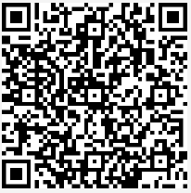
Lesson 2
Optional 5th – 6th class activity
Our World Quiz
Notes:
Notes for teachers
Changemaker Unit: Lesson 2/optional 5th - 6th class activity
Explain to the class that they are going to do an online quiz with questions about our world and linked to what they have been learning about the Global Goals. There are 18 question in the quiz, and they get one point for each correct answer. You can access the quiz via the QR code or the URL on the slide.
Adaptation note: This quiz can be done individually in school or at home, assuming all pupils have devices and internet access. Alternatively, you can access the quiz via the URL or QR code on the slide, reading the questions aloud as pupils write down their answers in their copies. Once you have read all 18 questions, you could go back to the start and ask students to call out their answers, ticking the most popular response. The class will be able to see the correct answer on the board and can check the answer in their copy at the same time.
Background information:
The information in the quiz were devised using data from: https://www.un.org/sustainabledevelopment/sustainable-development-goals/ and https://worldslargestlesson.globalgoals.org/

Slide 26
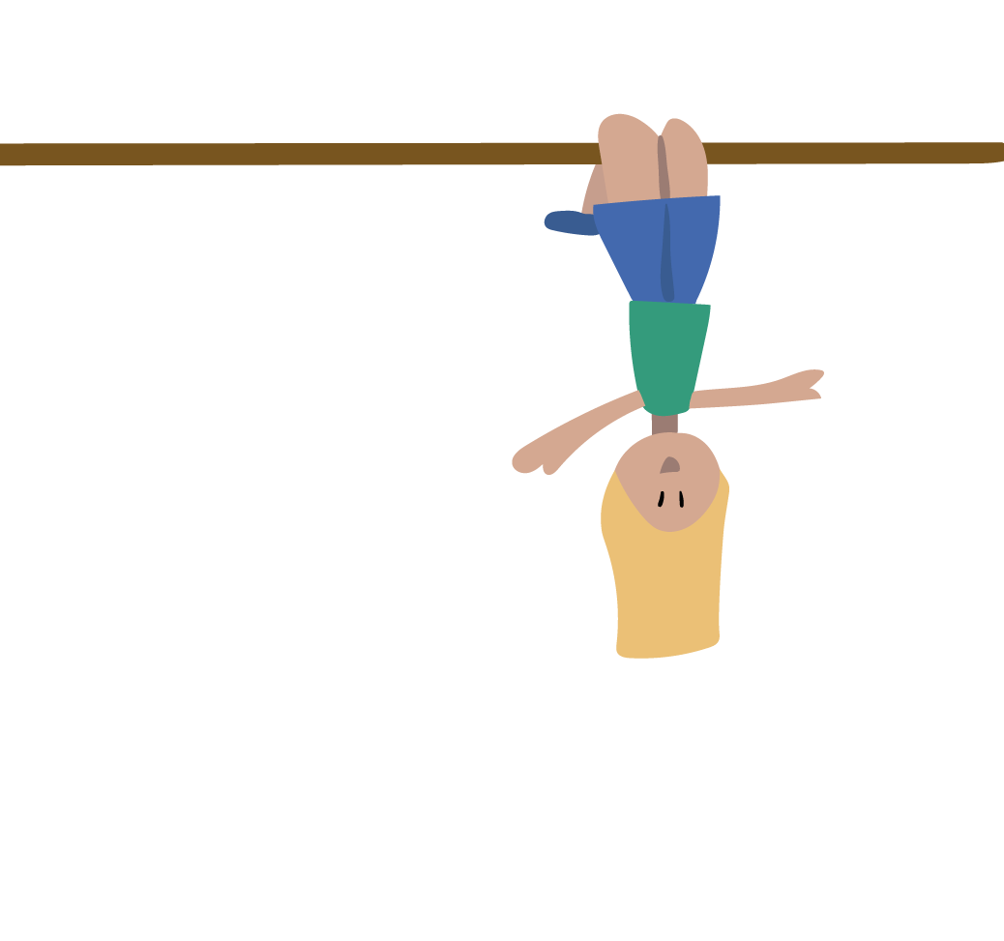
Lesson 2
Part 5
We have learned to…
practice breathing as a way of feeling calm
identify some of the challenges facing people and the planet
recognise that the Global Goals are a plan to make our world a better place
Notes:
Notes for teachers
Changemaker Unit 3rd – 6th class: Lesson 2/Part 5 (No animation)
Invite pupils to give thumbs up (for fully achieved or learned), thumb to the side (for somewhat achieved or learned); or thumbs down (for still some work to do), as you read through each of the Lesson 2 learning intentions on the slide.

Slide 27
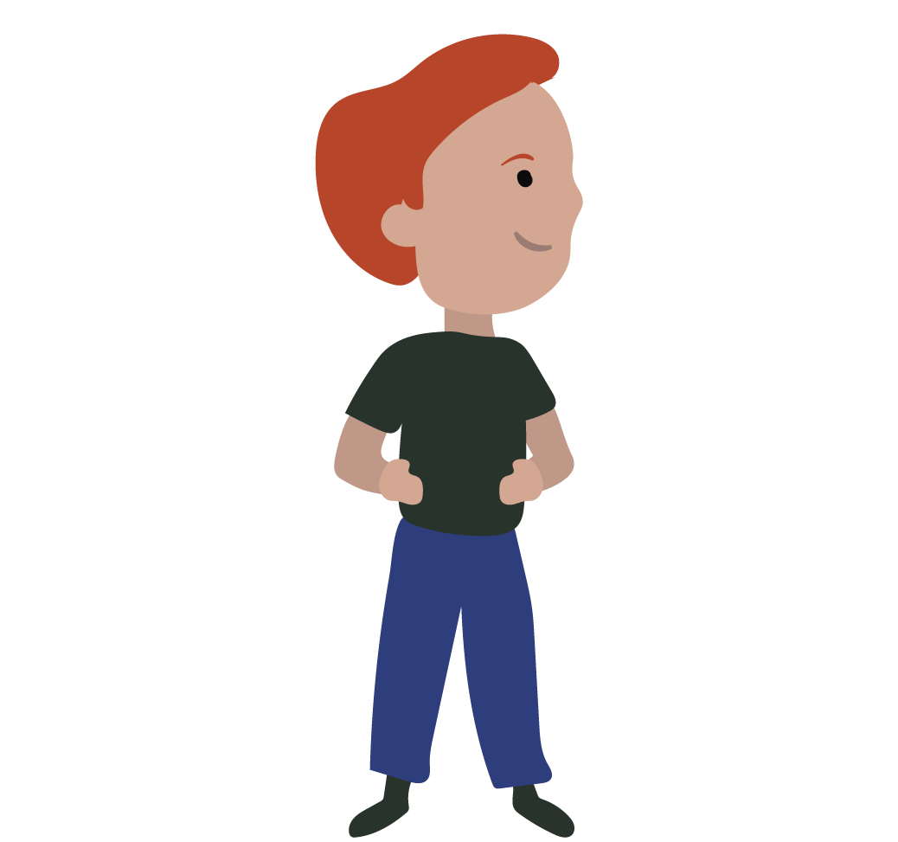
Lesson 3
Changemakers actions
Learning intentions
We are learning to…
practice breathing as a way of feeling calm
identify actions that have been and can be taken to contribute to the Global Goals
plan an action to promote the Global Goals or celebrate Changemakers
Materials
You will need…
Character cards
(one for each pupil)
available Slides 30-31
Notes:
Notes for teacher
Changemaker Unit 3rd – 6th class: Lessons 3 (title slide with learning intentions) (No animation)
NB: In advance of delivering this lesson, you will need to print and cut out the Character Cards (see Slides 30-31). There are ten different Character Cards available, each pupil will need one Card. Depending on the numbers in your class, two or more people will have the same card.
Depending on your class, you might like to share the learning intentions for Lesson 3 with pupils before starting. If this is the case, you could ask for volunteers to read the learning intentions on the slide aloud, clarifying/adapting language as required.

Slide 28
Lesson 3
Part 1
Do you feel calmer now?
Notes:
Notes for teachers
Changemaker Unit 3rd – 6th class: Lesson 3/Part 1 (1 animation at *)
Explain that one way to feel calmer or better is to breathe in and out, slowly and deeply.
Tell the class that they are going to practice breathing as a way of feeling calm. Sometimes it can help to imagine something at the same time as we breathe, to help us slow down our breath.
Depending on your class, you might like to demonstrate and invite the class to join in for a second or third practice breath.
To guide the breathing activity, you can either play the video provided, by clicking on the image of the butterfly (also available: https://youtu.be/BqGQoZTo3CY (English language version); https://youtu.be/WAd55dolYl4 (Irish language version); and/or use the instructions below:
Bring your hands together, palms touching. Imagine your hands are a butterfly whose wings are closed. As I count, we’re going to slowly open our wings and breath in.
Now, together 1, 2, 3, 4 and pause. Now, breathing out and closing, 1, 2, 3, 4.
Now, lets repeat this a few times.
Breathing in 1, 2, 3, 4 open - breathing out 1, 2, 3, 4 closed. [repeat this line twice more]
If using the video, you might decide to play it a second time. If your school is an Irish-medium school, you might like to firstly play the video in Irish, and then a second time in English. If your school is an English-medium school, you might like to firstly play the video in English, and then a second time in Irish.
* At the end of the breathing activity, animate in a question for pupils about whether they feel calmer now.
Background information
Grounding activities, like this breathing exercise, can be very useful at the start of Development Education/Global Citizenship Education lessons. They can help children to settle and connect with how they are feeling, before beginning to switch the focus outwards to our wider world.

Slide 29
Lesson 3
Part 2
The air is clean and fresh where I live.
It is easy for me to get clean drinking water.
I live in a safe place.
Pollution is not a problem where I live.
I will be able to finish school and go onto further study if I work hard.
If I get sick, it is easy for me to get medicine and see a doctor.
I never worry about where my next meal is coming from.
I can play and exercise regularly if I want.
We always have electricity in my home.
Traffic is not a problem where I live.
Notes:
Notes for teachers
Changemaker Unit 3rd – 6th class: Lesson 3/Part 2 (Animations at * (ten questions one after the other) and ^)
NB: It is recommended to read through the slide notes (below) and play this slide in presenter mode before class to understand how this activity works.
Explain to pupils that they are each going to get a Character Card (available on Slides 30-31). During the activity they will be asked to put themselves in the shoes of the person on their card. When they receive their card, they should read about their character, imagining the life of this person. They should not tell their friends about their character at this stage. Distribute the Character Cards (available on Slides 30-31), one for each pupil. There are ten different Character Cards available, and depending on the numbers in your class, two or more people will have the same card.
Give pupils a few minutes of silent reading, then invite them to close their eyes and, in character, imagine what they see when they wake up in the morning? What might they think about just before they go to sleep at night?
Invite pupils to take out their rulers and place a small piece of paper, paperclip or similar, representing their character, on zero centimetres.
Explain that you are going to read aloud a 10 statements that will appear on the board. As the statements appear, they should think about whether these statements are true or not for their character. If they are true (do apply) then they should move their ‘character’ one centimetre along their ruler. So for example, if first statement is true (does apply) to their ‘character’ they would move to 1cm. If the statement is not true (does not apply) or they are unsure whether it is true, they should not move their ‘character’ for that statement. So, in this example, if the first statement was not true for their character, they would still be at 0cm.
Depending on your class, you might want to do a practice run, checking in with a selection of pupils after the first statement to see why the did or did not move.
* Animate in the 10 statements one at a time, reading each statement aloud, and allowing sufficient time between statements for pupils to think and move their ‘character’.
After statement ten, facilitate a whole class discussion using the following prompt questions:
What statements did you move for?
Which statements did your ‘character’ stay still for?
What did it feel like to go ahead, knowing others were probably not able to move as much as your character?
What did it feel like to not move, knowing others were probably able to?
What could be done to improve things for anyone who could not move?
If more than one pupil had the same character and did different things, prompt them to compare their interpretation of their character’s response to the statements and discuss their choices.
^ Animate in the Global Goal logos image.
Invite pupils to talk about the Global Goal that is most important to their character.
Drama debrief:
Invite pupils to stand and shake off their characters. Shake out one arm, then the other. Shake out one leg, then the other. Shake their whole body. Shake it all out! Finish by taking three deep breaths.
Adaptation note:
In a context where physical distancing is not necessary and sufficient space is available, you might decide to revert to the original version of Giant Steps (i.e. pupils lined up one end of a room and the teacher at the other, reading the statements aloud; the pupils taking a giant step in response to statements that apply to their character).

Slide 30
My name is Ryan. I am 9 years old. I am from Ireland. I live in a hotel with my mam. I miss my old house – the owner sold it and then all the houses we looked at were too dear. My mam has the bottom bunk and I have the top bunk. My biggest wish is to have a home. Here there are a lot of rules, like “keep the noise down”. There isn’t anybody my own age to play with here. I do Lego, drawing and art. When I grow up, I want to be a Lego designer.
My name is Rohit. I am 16 years old. I live in a huge city, Bangalore in India. There is a lot of traffic in my city. Bangalore used to have a lot of lakes. They were drained to make way for roads and buildings. The remaining lakes are full of rubbish. Sometimes when I turn on the tap the water that comes out is very dirty and I can’t drink it. When I grow up, I would like to go to university to learn more about being an inventor.
My name is Elif. I live in Istanbul in Turkey. I am 16 years old. I want to be a doctor or a scientist when I grow up. I love school and reading. I live in a big house in a very nice part of Istanbul. My favourite food is kebab. Something I don’t like about my city is that the air is not clean.
My name is John. I am ten years old. I live in Peckham in London, England. I really want a fidget spinner, but Dad says we have too many bills to pay. We eat the same few things every day because Dad doesn’t have enough money to do much shopping. Dad and I go to a foodbank some days to get food. I don’t like people seeing me going in.
My name is Robert. I am 12 years old. I live in Philadelphia in the USA. My neighbourhood is a bit rundown and dangerous. It’s not very safe and doesn’t have a lot of green areas. I like organising fun things to do with my friend Daekwon. Philadelphia has really cool fireworks sometimes.
Notes:
Changemaker Unit 3rd – 6th class: Lesson 3/Materials for Part 2 (see notes on Slide 29)

Slide 31
My name is Sofia. I am 12 years old and I live in Galway in Ireland. Galway is a happy city beside the sea with lots to do. But I think there is too much traffic. A few times I have been late for school because there was so much traffic and we were all really stressed in the car. Now, I have to get up very early to make sure I am on time. Sometimes I feel like I haven’t slept enough. I want to be a physiotherapist when I grow up.
My name is Muzoon. I am originally from Syria, but I live in a refugee camp in Jordan because of the war in my country. There is no electricity here - in summer it gets very hot and in winter it gets really cold. I think school is important. In my refugee camp, many girls have to give up school to get married at a young age. I think that is a big mistake because getting a good education gives you better chances in life.
My name is William. I am 14 years old and I live in Malawi. I love fixing things and inventing. There is no electricity in my village. I can’t read late at night because there is no kerosene for the lamp. Sometimes I can’t go to school because my parents don’t have enough money for the fees. It is very windy here but doesn’t rain much and we don’t have enough water to grow our crops.
My name is Grace. I am 14-years old. I live in Nigeria, the country with one of the fastest growing populations in our world. I am very good with computers and I would love to work in technology. One thing I don’t like about where I live is that rubbish isn’t cleared up properly. Rubbish is smelly and insects and vermin that spread disease are attracted to rubbish. This makes the people who live nearby sick.
My name is Melati. I am 12 years old. I am from Bali, a very beautiful island in the Indian ocean. I love living here, but there are too many plastic bags in our ocean, and I worry that this is ruining the beach, polluting the water and killing the fish.
Notes:
Changemaker Unit 3rd – 6th class: Lesson 3/Materials for Part 2 (see notes on Slide 29)

Slide 32
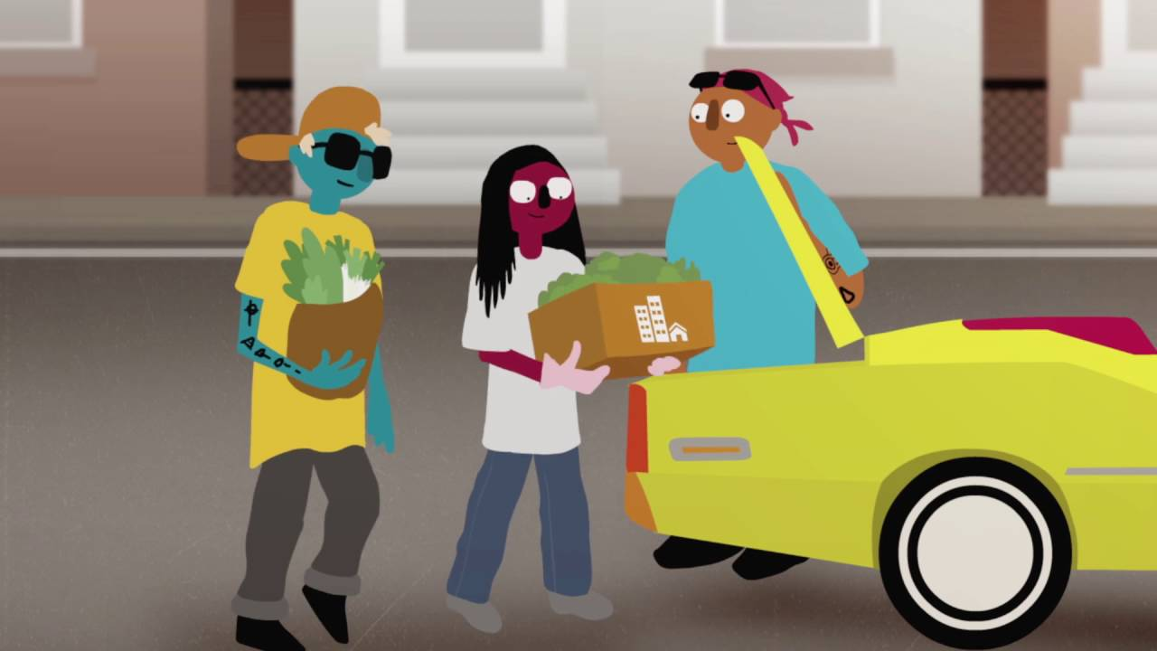
Name(s) | Place | Problem | Solution/Action
Elif | Istanbul, Turkey | dirty air (because of petroleum based plastics) | Elif invented a new plastic made from bananas that is easy to recycle
Rohit | Bangalore, India | More people, more toilet use, more water wasted because of toilet flushing | Rohit invented Vacuflush, which saves 50 % of water used in toilet flushing
Grace (from Team Charis) | Nigeria | Rubbish not cleared up properly, people getting sick | Team Charis invented the Discardious app – people can report waste and have it taken away safely
Isabelle and Melati | Bali | plastic in the ocean harming marine life | Isabelle & Melati organised petitions and beach clean ups with the result that plastic bags were banned
Muzoon | Syria | Early marriage means girls were not finishing school | Muzoon campaigned to convince parents to keep their girl children in school
Urban Creators | Philadelphia USA | The area was rundown and dirty | Urban Creators started a farm to grow food for the community, and worked to make the area safer
Lesson 3
Part 3
Where is your young Changemaker from?
What problem or challenge is your young Changemaker trying to solve?
What action or solution did your Changemaker come up with to solve this problem?
Notes:
Notes for teachers
Changemaker Unit 3rd – 6th class: Lesson 3/Part 3 (3 animations at *, ^ and +)
NB: It is recommended to read through the slide notes (below) and play this slide in presenter mode before class to understand how this activity works.
Explain to the class that they are going to watch a short video (5 mins 16 secs) about young Changemakers around our world.
Randomly allocate one of the following young Changemakers in the video to each pupil in your class: (1) Elif; (2) Rohif; (3) Grace; (4) Isabelle and Melati; (5) Muzoon; and, (6) Urban Creators.
As they watch the video, their job is to listen/look for the answers to the 3 questions on the board where their allocated Changemaker is concerned, writing their answer in their copy.
Play the video by clicking on the image of the animation on the slide. Also available: https://youtu.be/l3qT1gZLwMU (English language version); INSERT youtube link/hyperlink for Irish version of the video followed by (Irish language version).
Depending on your class, you might decide to play the video a second time. If your school is an Irish-medium school, you might like to firstly play the video in Irish, and then a second time in English. If your school is an English-medium school, you might like to first play the video in English, and then a second time in Irish.
* Click to animate in answers
Invite pupils to check their answers against the information in the table on the slide.
Extension activity:
Depending on your class, you might like to invite pupils to create a Changemakers ID card for their young Changemaker (ID card available on slide 17).

Slide 33
Lesson 3
Part 4a
VALERY
Valery speaks to politicians and policymakers making sure that they:
know what young people eat for breakfast
know what young people want and how young people see the world
know what young people do in their spare time
What do you think Valery means when she says that she started living the world she wanted to see?
DAIRE
Who did Daire talk to about global issues when he first learned about these?
Policymakers and politicians
Celebrities
Friends, teachers in school, and family at home
Media
Which Global Goal means the most to Daire?
FLOSSIE
Which two Global Goals are most important to Flossie?
According to Flossie, what can you save if you pick up one piece of plastic on the beach?
SANO
What Global Goal does Sano focus on?
Name one thing that Sano says she learned about herself when she got involved in Gender equality work?
Notes:
Notes for teachers
Changemaker Unit 3rd -6th class: Lesson 3/Part 4a (No animation)
Explain to the class that they are going to watch a short video (English version = 6 mins 32 secs; bilingual (English/Irish) version = 6 mins 34 secs), about young people in Ireland and Malawi who are Changemakers, working to contribute to one or more of the Global Goals. [The Changemakers video is embedded on the next slide]
This video includes four Changemakers – Daire, Valery, Flossie and Sano.
After watching, they will answer the questions on the slide.
Background information:
Daire Hennessy lives in Tallaght, Dublin and works in Citywise Education, a youth centre that helps young people with their education and encourages them to become Changemakers by talking about the United Nations Global Goals. Daire is studying for a Masters in Social Policy in Trinity College.
Flossie Donnelly is a secondary school student who lives by the sea in Dublin. Flossie started beach cleaning when she was ten years old and later set up a group called FlossieandtheBeachCleaners. Flossie and other members of the group do beach cleans once a week.
Valery Molay lives in Dublin and graduated from UCD with a Bachelors in Politics, International Relations, Philosophy and Social Justice and later with a Masters in Science, specialising in environmental policy. In 2019-20, Valery was one of two Irish Youth Delegates to the United Nations.
Sano Evelyn Kasamale lives in the city of Blantyre in Malawi. After completing her Bachelors degree at the University of London, Sano went on to read her Masters in Law at the University of Westminster. As a result of living in different countries, Sano learned about cultures around the world. This has helped her to appreciate the values of others and encouraged her to remain curious and open-minded. Being the only sister to for older brothers, Sano has been interested in gender equality since childhood. Earlier this year, she organised International Women’s Day events to take place in Malawi to celebrate the achievements of girls and women by highlighted the need to protect them. Its also important to remember that gender equality means we appreciate all people including the great boys and men. Equality means educating people to value and protect each and to do so without putting someone else down.

Slide 34
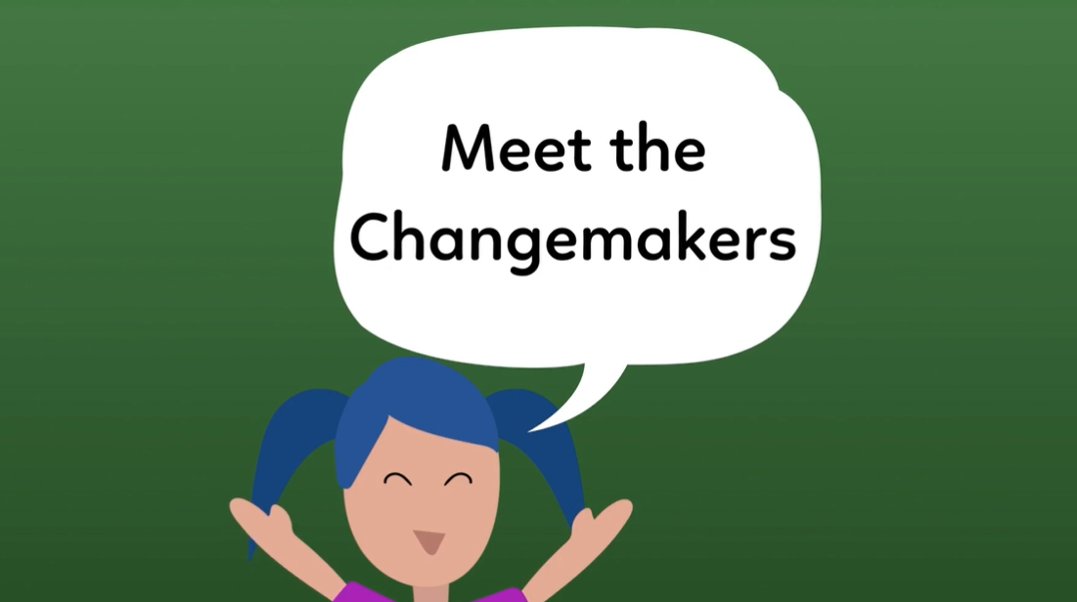
Lesson 3
Part 4b
VALERY
Valery speaks to politicians and policymakers making sure that they:
know what young people eat for breakfast
know what young people want and how young people see the world
know what young people do in their spare time
What do you think Valery means when she says that she started living the world she wanted to see?
DAIRE
Who did Daire talk to about global issues when he first learned about these?
Policymakers and politicians
Celebrities
Friends, teachers in school, and family at home
Media
Which Global Goal means the most to Daire?
FLOSSIE
Which two Global Goals are most important to Flossie?
According to Flossie, what can you save if you pick up one piece of plastic on the beach?
SANO
What Global Goal does Sano focus on?
Name one thing that Sano says she learned about herself when she got involved in Gender equality work?
Notes:
Notes for teachers
Changemaker Unit 3rd – 6th class: Lesson 3/Part 4 (4 animations – one for the questions for each of the four Changemakers in the video)
To play the video, click on the “Meet the Changemakers” image (also available: https://www.youtube.com/watch?v=K8FR90xbSjU (English language version); https://www.youtube.com/watch?v=wtCSfW9CjfE (bilingual version – start and finish ‘as Gaeilge’, clips with Changemakers in English).
Depending on your class, you might decide to:
play the video a second time, and then go through the Changemaker questions
or
pause the video after each Changemaker clip, and get the class to answer the questions about that Changemakers at that point.

Slide 35
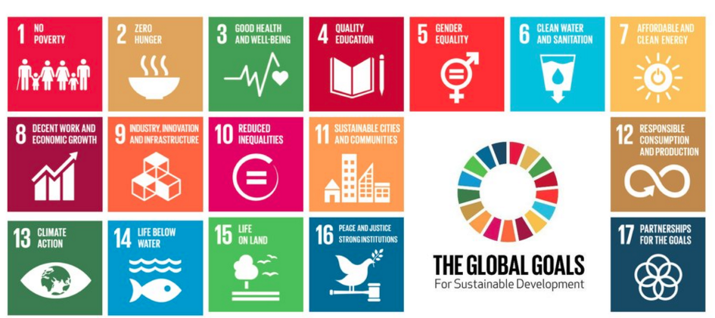
Lesson 3
Part 5
What can we do as a class to help the Global Goals?
Which Global Goal are you most interested in taking action on?
How can we tell other people about the Global Goals?
Notes:
Notes for teachers
Changemaker Unit 1st-2nd class: Lesson 3/Part 5 (No animation)
Question 1 prompt – Is there anything we could do as a class that might help achieve the Global Goals?
Question 2 prompt - Explain to pupils that they can choose the Goal they find most interesting as a class and take action on that Goal.
Depending on your class, you might like to remind them what each Goal is about (see child-friendly explanations in the notes on Slide 21); or focus on specific Goals that might be easier to grasp for their age/stage, e.g. Goals 1 to 7 and Goals 13, 14 and 16.
Question 3 prompt – Explain that the class could focus on telling other people about the Global Goals, so that more people know and get involved in making them happen.
Depending on your class, you might like to:
(1) prompt their thinking with the action ideas on the next slide.
(2) follow the steps below to help pupils come to a decision about which action to take:
Divide the class into small groups of 4 or 5.
Invite them to discuss the changes they would like to see happen in their school or community. What solution or action can they take to help make this change happen? Encourage pupils to think about how they could invent/innovate/campaign like the young Changemakers in the video.
Ask each group to write their ideas on pieces of paper and rank them from least doable to most doable.
Invite one pupil from each group to summarise their group discussion and their most doable action.
Note the most doable action from each group on the board.
Explain that they are now going to vote. They can only vote once and they cannot vote for their own group’s action.
Ask for a show of hands for each action option, recording votes for each.
Announce the action idea with the most votes.

Slide 36
Lesson 3
Part 6
Action ideas…
Each one…teach one campaign
Using the Changemaker PowerPoint template, develop a presentation to tell other people about all that you have learned. Encourage others to fill in a Changemaker I.D. card and to become Changemakers for the Global Goals.
Global Goals display
Capture the attention of passing people with a window/wall display including information (ie. up to date data from reliable sources) and images about one or more of the Global Goals.
Celebrating Changemakers
-make up a song, rap, poem or play
-draw a picture
or
-create a poster
…about yourselves and/or other Changemakers who are working to achieve the Global Goals today.
Notes:
Notes for teachers
Changemaker Unit 1st-2nd class: Lesson 3/Part 6 (No animation)
Remind the class that GOAL Changemakers is a programme that is run by an organization or charity called GOAL. GOAL is working to help achieve the Global Goals and make sure that people in poor countries have food, clean water, medicine and schools. GOAL wants to support us to work for the Global Goals, in solidarity with people who are in need.
Explain that these are ideas for action only. The class is free to pick a different GOAL Changemakers action.

Slide 37
Lesson 3
Part 7
Sit at your desk/table.
We are going to take turns saying one thing we liked or learned during our Changemaker lessons.
After the first person has taken their turn, say ‘Whoosh’ and do an action as if you are throwing something to friend nearby.
Then it is the 2nd person’s turn, and so on until everyone has had a turn.
WELL DONE CHANGEMAKERS!
Notes:
Notes for teachers
Changemaker Unit 3rd -6th class: Lesson 3/Part 7 (1 animation at *)
Follow the steps outlined on the slide.
Depending on your class, you might want to take the first turn and demonstrate how to do the ‘Whoosh’ and the throwing action.
* Animate in ‘well done Changemakers’ and image of boy jumping
Adaptation note: In the context of an online learning lesson using Zoom or similar, you could invite each pupil to say the name of the person they are giving the next turn to, before doing the ‘Whoosh’ and throwing action.

Slide 38
Let’s get going Changemakers!
Submission form available Here!
Notes:
Notes for teachers
As you and your class engage with the Changemaker lessons and/or undertake Changemaker related actions, we would love to hear how you are getting on. Tweet us your thoughts, pupils comments etc. @GoalNextGen using the hashtag #GOALchangemakers.
If you need additional support or have questions relating to the programme, phone or email Jessica Sargeant on 0863542491 or jsargeant@goal.ie, and one of our Changemakers team members will get back to you as soon as possible.
We want to celebrate your participation in the Changemakers programme, regardless of how small or big that participation is. If you would like to receive a Changemakers certificate of recognition and a large map of the world for classroom display, all you have to do is take a few minutes to fill out our simple submission form, available here: https://forms.office.com/Pages/ResponsePage.aspx?id=eyyiaeokR0aD1EiqjbjOd_QIHIdzOSZPsrCMcGlMmkFUN1RKSkFNRFJSNUc4WjJZUDA5S1NKWE5IRS4u

