Slide 1
1st-2nd class unit
2020/21
Notes:
Notes for teachers
Changemaker Unit 1st-2nd class: Title slide (No animation)
Acknowledgements:
This resource has been published by GOAL as part of GOAL’s Development Education programme in Primary schools 2020.
All artwork for this resource has been designed in house by GOAL’s Design team in Honduras.
© GOAL 2020
Background:
GOAL Global is a humanitarian aid agency founded in 1977. GOAL has responded to many of the world’s major humanitarian crises, working with vulnerable communities in over 60 countries. Today, GOAL is supporting vulnerable communities in 13 programme countries across Africa, the Middle East and Latin America. Currently GOAL is applying its unique expertise in Emergency Response to the Global Covid-19 crisis. In addition to emergency response, GOAL also works towards: food & nutrition security, resilient health & sustainable livelihoods, and fostering Global Citizenship by recognising that we all share responsibility for a better world. We all need to work together as we strive to achieve GOAL’s mission: A world without poverty.

Slide 2
Aim
To encourage pupils to understand and contribute to the United Nations Global Goals by taking part in learning activities and undertaking meaningful actions to bring about positive change.
Notes:
Notes for teachers
Changemaker unit 1st-2nd class: Aim slide (No animation)

Slide 3
Unit overview
3 curriculum-linked lessons
Visually attractive slides for 1st-2nd class pupils
Multi-media stimuli embedded in slides, meaning there is no need for internet access (but just in case, the links are all in the slide notes)
Step-by-step teacher support in the slide notes (including ideas for adapting to online learning contexts)
PowerPoint Contents | Section | Slide number
 | Curriculum links and unit learning intentions | 4-6
 | Lesson 1: We are Changemakers! | 8-16
 | Lesson 2: Global Goals Changemakers | 17-27
 | Lesson 3: Changemaker action | 28-35
Everything you need to teach for change right now – all in one PowerPoint!
Submission form available here
Notes:
Notes for teachers
Changemaker Unit 1st-2nd class: Overview slide, including contents (No animation)
Dear teacher
Welcome to GOALs Changemakers programme. We’re delighted that you and your class have decided to take part!
Here are a few things that might be helpful to know to make sure Changemakers runs smoothly in your class.
This Changemaker unit is made up of 3 lessons. All lesson activities have been designed as suitable for use with 1st-2nd class pupils.
It is recommended that you play the slides and read the slide notes in advance of class. A thumbnail of each slide, with the associated notes can be printed to a single page, using the PRINT – SETTINGS - NOTES PAGE facility.
There is very little preparation required. The first time you use this resource, you will need to print and cut cards for one activity (Lesson 1 – approx. 10 pages). But, if you collect these cards after use, you will not have to do this again.
During the lessons, show the slides in presenter mode to maximise animation. On the very few occasions you will need to come out of presenter mode (e.g. to type feedback from pupils on a slide), this is flagged in the slide notes.
As you and your class engage with the Changemaker lessons and/or undertake Changemaker related actions, we would love to hear how you are getting on. Tweet us your thoughts, pupils comments etc. @GoalNextGen using the hashtag #GOALchangemakers.
If you need additional support or have questions relating to the programme, you can call or email Jessica Sargeant on 0863542491 or jsargeant@goal.ie and one of our Changemakers team members will get back to you as soon as possible.
We want to celebrate your participation in the Changemakers programme, regardless of how small or big that participation is. If you would like to receive a Changemakers certificate of recognition and a large map of the world for classroom display, all you have to do is take a few minutes to fill out our simple submission form, available in the slide above.
Jessica Sargeant – [Development Education Officer]

Slide 4
Curriculum links & unit learning intentions
Slides 4-6
Notes:
Notes for teachers
Changemaker Unit 1st-2nd class: Curriculum links & unit learning intentions (title slide) (No animation)

Slide 5
Curriculum links
Drama | Strand | Strand unit
 | Drama to explore feelings, knowledge and ideas leading to understanding | Exploring and making drama Reflecting on drama Co-operating and communicating in making drama
Languages | Element | Learning outcome
 | Communication | Engagement, listening and attention Social conventions and awareness of others
 | Understanding | Demonstrate understanding through the ability to give and follow instructions, comprehend texts and clearly state a case
 | Exploring and using | Retelling and elaboration Playful and creative use of language Description, prediction and reflection
SPHE | Strand | Strand unit
 | Myself | Self-identity Growing and changing (feelings and emotions)
 | Myself and the wider world | Developing citizenship
Notes:
Notes for teachers
Changemaker Unit 1st-2nd class: Curriculum links slide (No animation)

Slide 6
Learning intentions
Lessons 1 - 3
We are learning to…
practise breathing as a way of feeling calm
discuss what it means to be a Changemaker
tell the difference between needs and wants
recognise that the United Nations Global Goals are a plan to make our world a better place
use our own words to explain what solidarity means
talk about and role play characters in a story
plan a changemaker action to show solidarity / tell others about the Global Goals
Notes:
Notes for teachers
Changemaker Unit 1st-2nd class: Learning intentions for the 3 lessons in the unit (No animation)
Depending on your class, you might like to share the unit learning intentions before starting the first lesson. If this is the case, you could ask for volunteers to read the learning intentions on the slide aloud, clarifying/adapting language as required.

Slide 7
Lessons 1-3
Slides 8-39
Notes:
Notes for teachers
Changemaker Unit 1st-2nd class: Lessons 1-3 (title slide) (No animation)

Slide 8
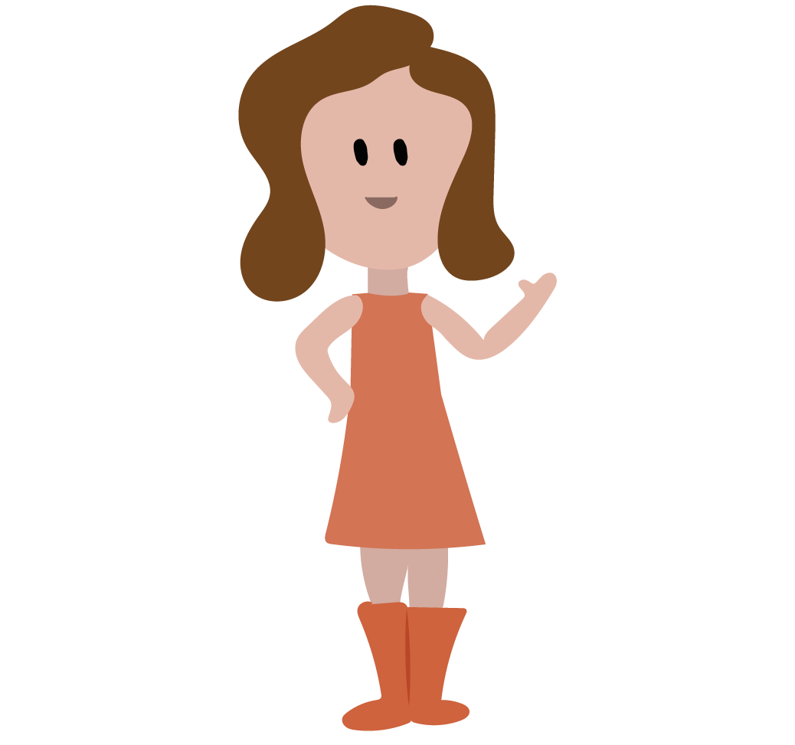
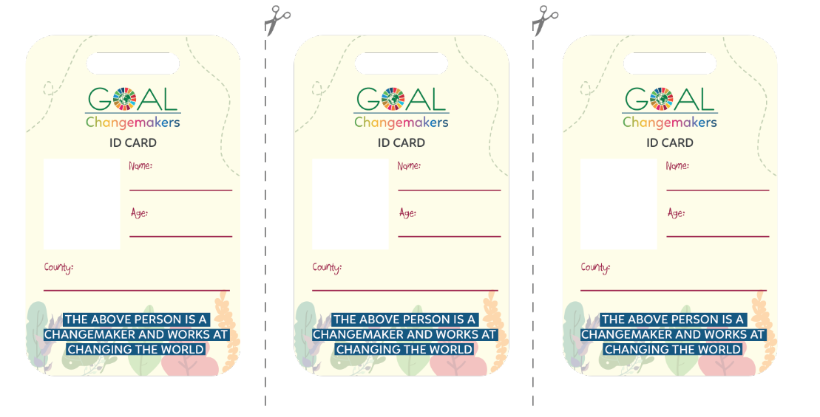
Lesson 1
We are Changemakers!
Learning intentions
We are learning to…
practise breathing as a way of feeling calm
discuss what it means to be a Changemaker
Materials
You will need…
Changemaker ID card
(one for each pupil)
available Slide 15
Notes:
Notes for teachers
Changemaker Unit 1st-2nd class: Lessons 1 (title slide with learning intentions and note re materials) (No animation)
NB: In advance of delivering this lesson, you will need to print and cut one Changemaker ID card for each pupil in your class (see Slide 15). This is the only lesson where advance preparation of materials is needed.
Depending on your class, you might like to share the learning intentions for Lesson 3 with pupils before starting, clarifying/adapting language as required.

Slide 9
Lesson 1
Part 2
Can you name these different emotions or feelings?
Do you think it is normal to feel all these emotions at different times?
Do you think that it is possible to be happy all the time?
Which feelings can be tricky?
If a feeling gets too strong, what can we do to calm down or feel better?
Do we need other people to help or can we get calmer or feel better by ourselves?
Notes:
Notes for teachers
Changemaker Unit 1st-2nd class: Lesson 1/Part 1 (6 animations at * – questions animate in one by one)
* Animate in six questions, one by one
Read these questions aloud, clarifying/adapting language when necessary.
Encourage as many different children as possible to respond.
Question 1: There is a visual prompt immediately after question 1, which may assist children to name emotions/feelings.
Question 2: Answer = yes
Question 3: Answer = no

Slide 10
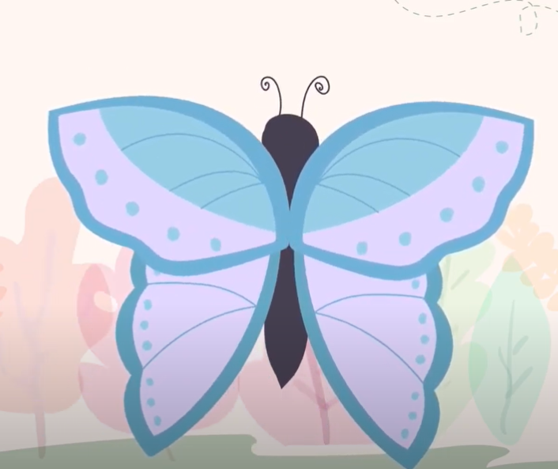
Lesson 1
Part 2
Do you feel calmer now?
Notes:
Notes for teachers
Changemaker Unit 1st-2nd class: Lesson 1/Part 2 (1 animation at *)
Explain that one way to feel calmer or better is to breathe in and out, slowly and deeply.
Tell the class that they are going to practice breathing as a way of feeling calm. Sometimes it can help to imagine something at the same time as we breathe, to help us slow down our breath.
Depending on your class, you might like to demonstrate and invite the class to join in for a second or third practice breath.
To guide the breathing activity, you can either play the video provided, by clicking on the image of the butterfly. Also available: https://youtu.be/BqGQoZTo3CY (English language version);
https://youtu.be/WAd55dolYl4 (Irish language version); and/or use the instructions below:
Bring your hands together, palms touching. Imagine your hands are a butterfly whose wings are closed. As I count, we’re going to slowly open our wings and breath in.
Now, together 1, 2, 3, 4 and pause. Now, breathing out and closing, 1, 2, 3, 4.
Now, lets repeat this a few times.
Breathing in 1, 2, 3, 4 open - breathing out 1, 2, 3, 4 closed. [repeat this line twice more]
If using the video, you might decide to play it a second time. If your school is an Irish-medium school, you might like to firstly play the video in Irish, and then a second time in English. If your school is an English-medium school, you might like to firstly play the video in English, and then a second time in Irish.
NOTE: In presenter mode, you can click into the butterfly video directly, without leaving the presentation. The slide is animated so once you finish the video, click once again for the prompting question before moving on. (The other slides in the resource that are animated are marked with an *)
* At the end of the breathing activity, click again to animate in a question for pupils about whether they feel calmer now.
Background information
Grounding activities, like this breathing exercise, can be very useful at the start of Development Education/Global Citizenship Education lessons. They can help children to settle and connect with how they are feeling, before beginning to switch the focus outwards to our wider world.

Slide 11
Lesson 1
Part 3
What do you think a Changemaker is?
Can you think of any people who are Changemakers?
Have you ever been a Changemaker?
Notes:
Notes for teachers
Changemaker Unit 1st-2nd class: Lesson 1/Part 3 (3 animations one after another at *)
Explain that the class is going to take part in a programme called GOAL Changemakers.
* Three questions animate in one by one.
Read these questions aloud, clarifying/adapting language as required.
Encourage as many children as possible to respond.
Question 1: Prompt - A Changemaker could be someone who sees a problem or a gap, thinks of a way of solving the problem, improving things or changing things for the better, and decides to do something about it.
Question 2: Prompt – is there someone in this school, at home, or someone that you’ve met or seen on TV that has done something to solve a problem in our world?
Question 3: Prompt – think about times that you have fixed a problem/ helped someone else/ been kind to a friend who was upset/ cared for our environment.

Slide 12
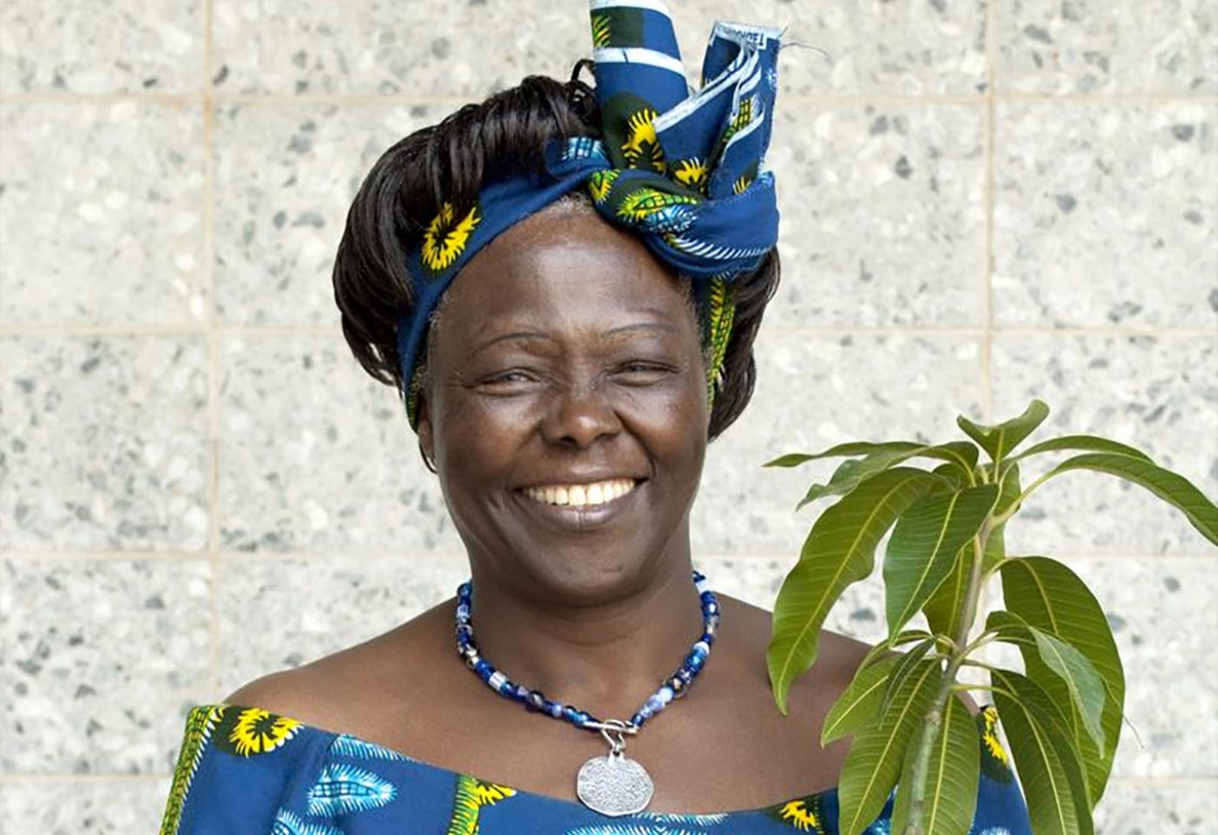
Lesson 1
Part 4
Who is the Changemaker in the video?
What problem does this Changemaker see?
What action do they take?
What do the other animals do?
What does the Hummingbird say to the other animals?
Notes:
Notes for teachers
Changemaker Unit 1st-2nd class: Lesson 1/Part 4 (1 animation at *)
Explain to the class that they are going to watch a short video (2 mins).
As they watch, their job is to listen/look for the answers to questions about the video.
Read the questions on the slide aloud, clarifying/adapting language as required.
Play the video by clicking on the hummingbird image. Also available: https://youtu.be/f3sCATyn_e0 (English language version); https://youtu.be/Qb8SUEgeGQ8 (Irish language version).
Depending on your class, you might decide to play the video a second time. If your school is an Irish-medium school, you might like to firstly play the video in Irish, and then a second time in English. If your school is an English-medium school, you might like to firstly play the video in English, and then a second time in Irish.
Discuss the video using the questions on the slide as prompts.
* Animate in a picture of Wangari Maathai
Explain that the lady in the video is Wangari Maathai (1940-2011). She was a Kenyan lady and an inspiring Changemaker, who helped other women and girls, and planted a lot of trees to help all people and our planet.
Background information
Wangari Maathai (1940-2011) was a Kenyan social, environmental and political activist. She overcame gender and ethnic minority discrimination to become an inspiring leader and changemaker. When she was 20 years old, she won a scholarship to study in the United States of America, and later completed a PHD in the University of Nairobi. In 1977, she founded the Green Belt Movement, an environmental NGO focused on the planting of trees, environmental conservation and women’s rights. She was elected to Kenyan parliament in 2002. She was the first African woman to win the Nobel Peace Prize (in 2004). In 2005, she was elected as first president of the African Union’s Economic, Social and Cultural Council.
We all need to work hard to make a difference in our neighbourhoods, regions, and countries, and in the world as a whole. That means making sure we work hard, collaborate with each other, and make ourselves better agents for change.
(Wangari Maathai (2010), Replenishing the Earth: Spiritual Values for Healing Ourselves and the World)

Slide 13
Lesson 1
Part 5
To become GOAL Changemakers, we need to think up a magic transforming or changing movement.
Let’s think…
What magic movements might be good?
On the count of three, let’s stand up, wave our magic wands and shout “CHANGEMAKERS!” and at the same time do our magic changemakers movement.
One…Two…Three…
Well done! You’re a GOAL Changemaker!
Notes:
Notes for teachers
Changemaker Unit 1st-2nd class: Lesson 1/Part 5 (1 animation at *)
GOAL Changemakers is a programme that is run by an organization or charity called GOAL. GOAL is working to help achieve the Global Goals and make sure that all people, and especially people in poor countries, have food, clean water, medicine and schools.
Read through points on slide, clarifying/adapting language as required.
If children need some prompts when it comes to ideas for magic movements, ask 2-3 children to demonstrate their magic movements and the rest of the class can copy or adapt these.
* Click again to Animate in the congratulations message
Invite pupils to sit down.

Slide 14
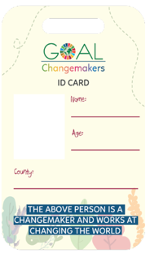
Lesson 1
Part 5
As Changemakers, you will need an official identity card (I.D.) so that everyone knows who you are.
Here’s a blank I.D. card.
Fill in your name, age, county (where your school is). You can draw or stick a picture of yourself in the box beside your name/age.
Notes:
Notes for teachers
Changemaker Unit 1st-2nd class: Lesson 1/Part 5 (No animation)
Read through points on slide, clarifying/adapting language as required.
In the space beside ‘county’, explain that pupils should write the county where the school is located.
Distribute one copy of the blank Changemaker I.D. card to each pupil. The I.D. cards are available on the next slide (#15). 3 x I.D. cards can be printed on each A4 sheet of paper. You could ask pupils to stick their I.D. card onto card for extra durability.
Depending on your class, you might like to invite pupils to write and decorate the word CHANGEMAKER on the reverse of their I.D. card.
NB: Changemaker I.D. cards will be needed in lesson 2. Depending on your class, you might like to collect the cards after each class.
Adaptation note:
Depending on time, this activity could be completed as homework.
In the context of online learning, you could make the Changemaker I.D. card available via the school’s preferred platform or ask pupils to design and fill in their own Changemaker I.D. card.

Slide 15
Lesson 1
Materials for Part 5
Notes:
Notes for teachers
Changemaker Unit 1st-2nd class: Lesson 1/Materials for Part 5 (see previous slide)

Slide 16
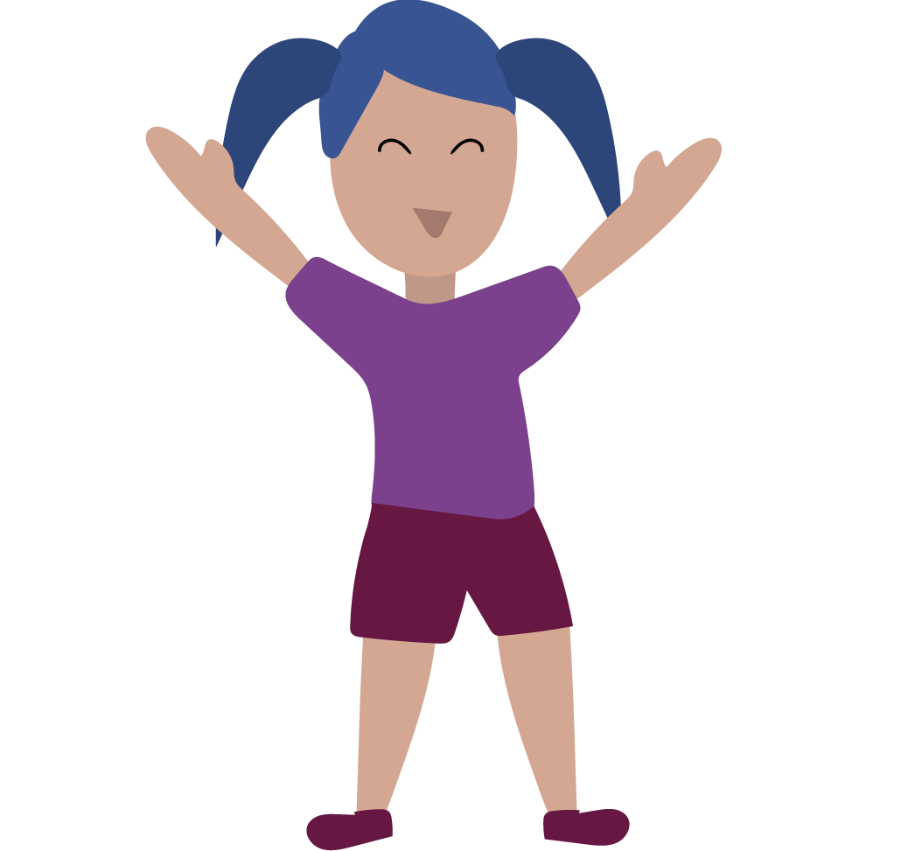
Lesson 1
Part 6
Stand up in your place.
We are going to take turns bowing, one after the other, until we have all taken a bow.
Once you have taken your bow, start to clap and keep clapping until everyone has bowed.
When we have all had our turn, we’ll shout out:
WELL DONE CHANGEMAKERS!
Notes:
Notes for teachers
Changemaker Unit 1st-2nd class: Lesson 1/Part 7 (No animation)
Read aloud and follow the steps outlined on the slide.

Slide 17
Lesson 2
Global Goals Changemakers
Learning intentions
We are learning to…
practice breathing as a way of feeling calm
tell the difference between needs and wants
recognise that the United Nations Global Goals are a plan to make our world a better place
use our own words to explain what solidarity means
talk about and role play characters in a story
Notes:
Notes for teachers
Changemaker Unit 1st-2nd class: Lessons 2 (title slide with learning intentions) (No animation)
Depending on your class, you might like to share the learning intentions for Lesson 3 with pupils before starting, clarifying/adapting language as required.

Slide 18
Lesson 2
Part 1
FOR JESSICA: Insert visual of the butterfly from GOALs breathing activity vid. Embed link (to the clip in Irish for Gaeilge slides and English clip for English slides) so teachers can click and watch without leaving PowerPoint
Do you feel calmer now?
Notes:
Notes for teachers
Changemaker Unit 1st-2nd class: Lesson 2/Part 1 (1 animation at *)
Explain that one way to feel calmer or better is to breathe in and out, slowly and deeply.
Tell the class that they are going to practise breathing as a way of feeling calm. Sometimes it can help to imagine something at the same time as we breathe, to help us slow down our breath.
Depending on your class, you might like to demonstrate and invite the class to join in for a second or third practice breath.
To guide the breathing activity, you can either play the video provided, by clicking on the image of the butterfly. Also available: https://youtu.be/BqGQoZTo3CY (English language version);
https://youtu.be/WAd55dolYl4 (Irish language version) ; and/or use the instructions below:
Bring your hands together, palms touching. Imagine your hands are a butterfly whose wings are closed. As I count, we’re going to slowly open our wings and breath in.
Now, together 1, 2, 3, 4 and pause. Now, breathing out and closing, 1, 2, 3, 4.
Now, lets repeat this a few times.
Breathing in 1, 2, 3, 4 open - breathing out 1, 2, 3, 4 closed. [repeat this line twice more]
If using the video, you might decide to play it a second time. If your school is an Irish-medium school, you might like to firstly play the video in Irish, and then a second time in English. If your school is an English-medium school, you might like to firstly play the video in English, and then a second time in Irish.
* At the end of the breathing activity, click to animate in a question for pupils about whether they feel calmer now.
Background information
Grounding activities, like this breathing exercise, can be very useful at the start of Development Education/Global Citizenship Education lessons. They can help children to settle and connect with how they are feeling, before beginning to switch the focus outwards to our wider world.

Slide 19
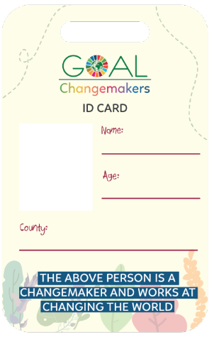
Let’s transform into Changemakers!
Lesson 2
Part 2
Let’s transform into GOAL Changemakers.
You can use the same magic transforming or changing movement as last time or think up a new magic movement.
On the count of three, let’s stand up, wave our magic wands and shout “CHANGEMAKERS!” and at the same time do our magic Changemakers movement.
One…Two…Three…
Well done! You’re a GOAL Changemaker!
Notes:
Notes for teachers
Changemaker Unit 1st-2nd class: Lesson 2/Part 2 (1 animation at * )
Read through points on slide, clarifying/adapting language as required.
If pupils need prompting when it comes to ideas for magic movements, you could suggest that they shake their whole body, turn around on the spot, wave their arms etc.
* Click to animate in congratulations
Invite pupils to sit down and display their Changemaker I.D. card.

Slide 20
Lesson 2
Part 3
Phone
Needs | Wants
Water
Car
Food
Nintendo
Healthcare
Television
Shelter
Trampoline
Education
Notes:
Notes for teachers
Changemaker Unit 1st-2nd class: Lesson 2/Part 3 (3 animations at *, ^ and +. Before presenting this slide, read through the NB text below as you will need to move between presentation and normal mode)
Read through the word boxes on the slide, clarifying/adapting language when required (e.g. what does healthcare mean? What happens when someone is sick? Do they check their temperature and take medicine if they need it? Do they go to the doctor to get some medicine or go to hospital if they are feeling bad enough? Healthcare means that if you are sick enough you go to the doctor or hospital to get the help you need. It means that there is care for your health. Is healthcare something that is really important to stay alive?)
* Click to Animate in the Needs/Wants table.
Explain that a need is something that you must have to live or survive, for example, water.
^ Animate the ‘Water’ text box to the first row under Needs.
Explain that a want is something we may like to have, but we can live without it, for example, a trampoline.
+ Animate the ‘Trampoline’ text box to the first row under Wants.
Invite pupils to say whether the items in the remaining text boxes belong under Needs or Wants.
NB: In order to move the boxes on the left, you will have to come out of PowerPoint presentation mode into normal mode (alternatively you could replicate the Needs/Wants table on the board, and write the text box words under the heading indicated by pupils).
Point to the words in the Needs column (likely to be water, food, healthcare, shelter, education).
Invite the pupils to agree a movement they can do with their bodies in response to each Need, for example, miming opening a book or writing for education.
Call out or point to each Need in turn and invite pupils to mime their corresponding movement.

Slide 21
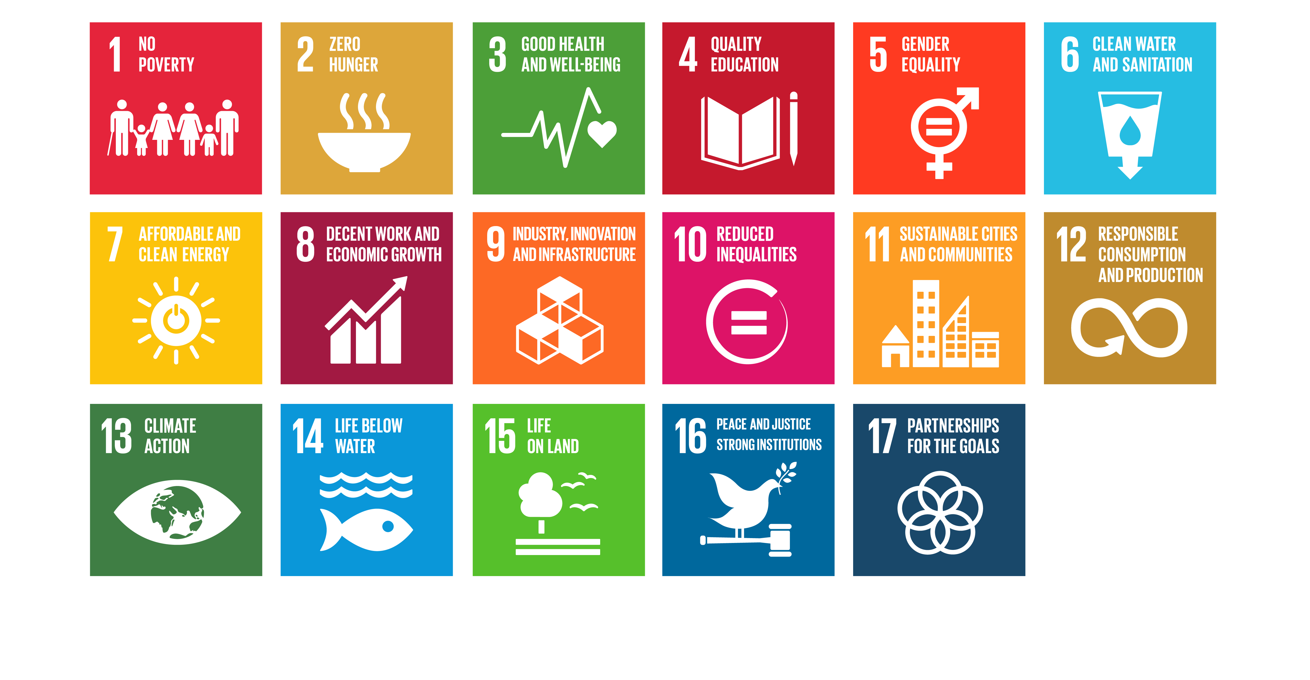
Global Goals
Lesson 2
Part 4
Notes:
Notes for teachers
Changemaker Unit 1st-2nd class: Lesson 2/Part 4 (No animations)
Explain that there are many people in every country in our world who do not have all the things that they need – some people do not have enough food, some don’t have clean water to drink, others do not get a chance to stay in school; or, maybe they haven’t got a home; or, can’t afford to go to a hospital when they are sick. Because of this, all the countries in our world, including Ireland, came together to work on a plan to try to make our world a better place where everyone has what they need to survive and be safe.
This plan, which countries have been working on since 2015, is called the Global Goals.
Briefly explain what each Global Goal means (you might find the following child-friendly text for the Global Goals useful).
1. End poverty - so that everyone can afford what they need to survive
2. End hunger - so that everyone has enough good food to eat and stay healthy
3. Make sure everyone can live healthy lives and can go to the doctor or to hospital if they need to
4. Make sure everyone gets to go to school and gets a good education
5. Make sure that women and girls get the same chances as men and boys
6. Make sure that everyone has access to clean water and proper toilets
7. Make sure that everyone has enough heat, light and power without damaging the environment (our world)
8. Help countries to develop and provide good jobs in a way that benefits everyone
9. Build schools, hospitals and roads and help businesses and industries that make all people’s lives better
10. Make sure that everyone is treated fairly, and that countries treat each other fairly
11. Make cities clean, friendly and safe places where all people can live well
12. Make sure we don’t buy too many things so that we do not use up the earth’s scarce resources
13. Act now to fight climate change
14. Look after the life in our oceans and seas
15. Look after forests, animals and the earth itself
16. Work for peace and justice inside and between countries
17. Countries will work together as partners to achieve the Global Goals and make the world a better place for everyone
When you have finished explaining the 17 Goals, ask the class which Global Goals they can link to needs such as food, water, shelter, healthcare and education.

Slide 22
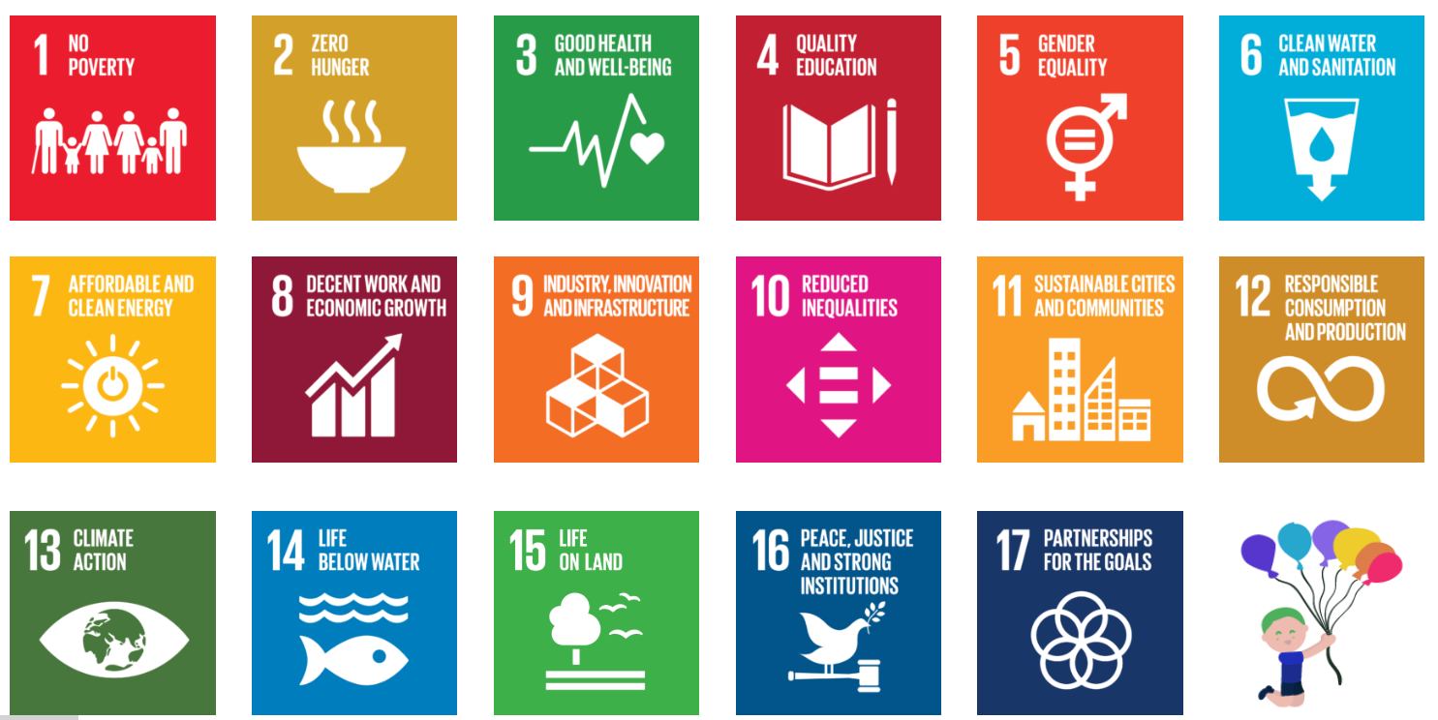
Lesson 2
Part 5
What 2 problems, that are making life hard for people in our world, are talked about in the video?
Notes:
Notes for teachers
Changemaker Unit 1st-2nd class: Lesson 2/Part 5 (No animation)
Depending on your class, you might like to check the transcript for the Global Goals video (available here), and pre-teach any tricky words/phrases (e.g. climate change and inequality). You might also like to play the video more than once to make the task outlined below manageable for the diversity of learners in the class.
Explain to the class that you are going to watch a short video about the Global Goals (3 mins).
As they watch, their job is to listen/look for the two problems that are talked about in the video. (Answer = climate change and inequality).
Play the video (available in both English and Irish) by clicking on the image of the Global Goals (also available: https://youtu.be/cDQrJ4BLoDY (English language version); https://youtu.be/LNrQblTzTg4 (Irish language version).
Depending on your class, you might decide to play the video a second time. If your school is an Irish-medium school, you might like to firstly play the video in Irish, and then a second time in English. If your school is an English-medium school, you might like to firstly play the video in English, and then a second time in Irish.

Slide 23
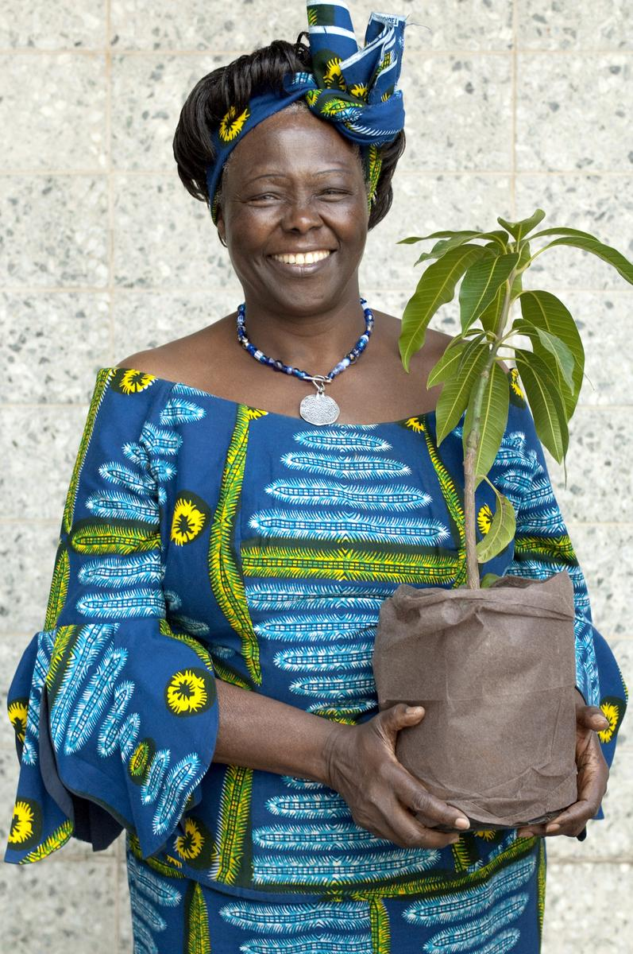
Lesson 2
Part 6
Notes:
Notes for teachers
Changemaker Unit 1st-2nd class: Lesson 2/Part 6 (No animation)
Ask for a volunteer to tell the story of the Hummingbird from the first Changemaker lesson.
Depending on your class, you might like to show the video again. To play the video, click on the image of the hummingbird. Also available: https://youtu.be/f3sCATyn_e0 (English language version); https://youtu.be/Qb8SUEgeGQ8 (Irish language version).
You might also like to remind pupils that the lady in the video is Wangari Maathai (1940-2011). She was a Kenyan lady and an inspiring Changemaker, who helped other women and girls, and planted a lot of trees to help all people and our planet.

Slide 24
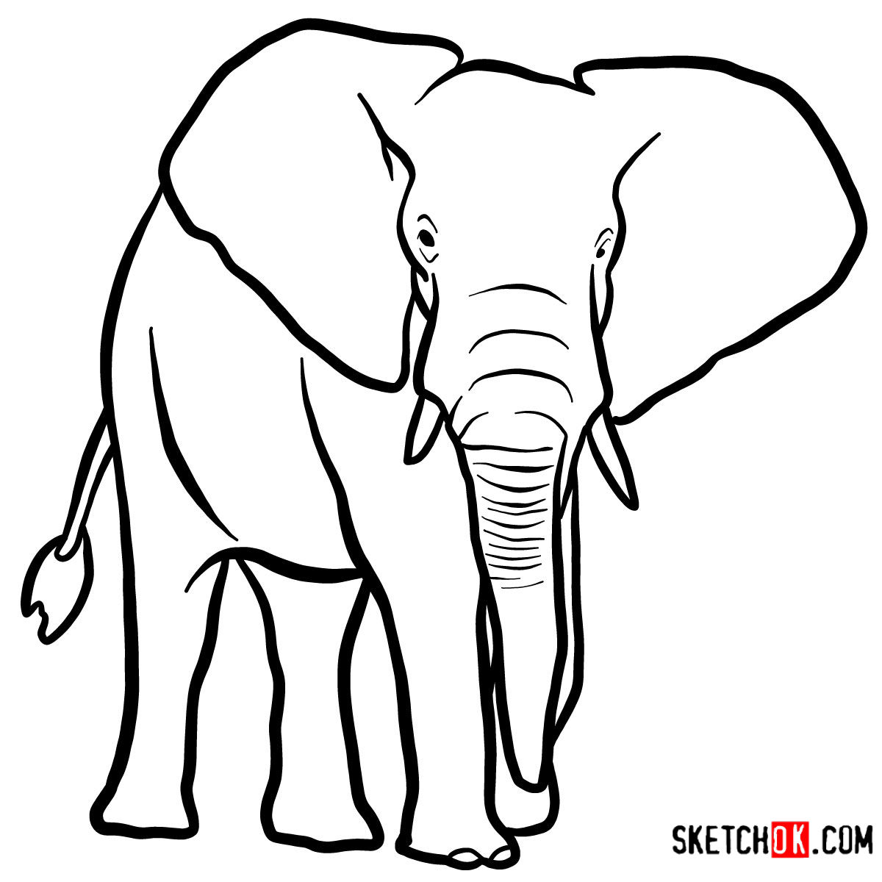
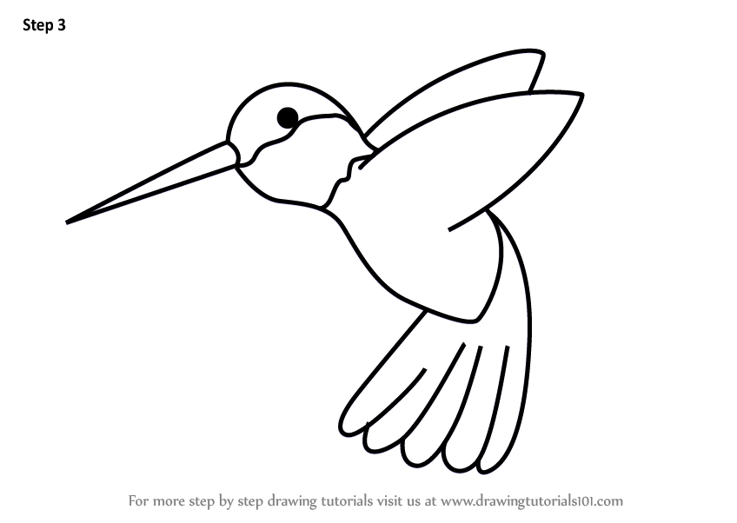
Lesson 2
Part 7
Notes:
Notes for teachers
Changemaker Unit 1st-2nd class: Lesson 2/Part 7 (2 animations, both sound files at *)
Invite neighbouring pairs of pupils to stand at their desk/table.
In each pair, one person is the Hummingbird and the other is the Elephant.
* Animate in the sound file for the Hummingbird (first), then the Elephant (mp3 files available: https://www.hummingbird-guide.com/hummingbird-sounds.html and http://www.orangefreesounds.com/elephant-sound/)
Invite the pupils who are role playing the Elephants to wave their trunks and make elephant noises; and, the Hummingbirds to flap their wings and say ‘humm ’.
Ask all pupils to stand quietly for a minute.
Tell the Hummingbirds to imagine two spots on the ground, 1-2 steps apart. Spot A is water and Spot B is the fire.
Explain that when you say ”Go” the Hummingbirds should mime quickly scooping up water at Spot A and dropping it on the fire at Spot B.
Tell the Elephants that when you say “Go” they should stand still with a disapproving look on their faces, shaking their heads and saying “tch tch” or another sound that they think an Elephant would make if it didn’t approve or wasn’t happy with something or someone.
Explain to the class that they should stop acting when you say “Freeze”.
Call out “Go” and allow the drama to progress for a minute or two, then call out “Freeze”.
Invite the Hummingbirds to politely ask their Elephant partner ”Why are you saying ‘tch tch’?”
Allow for a short conversation between pairs, then invite everyone to sit back down.
Ask the class how they felt when they were the Elephant and the Hummingbird.
Adaptation note: In the context of an online learning lesson with Zoom or similar, ask 2 children to volunteer take on the Elephant/Hummingbird roles while the others watch.

Slide 25
Lesson 2
Part 8
Solidarity
Notes:
Notes for teachers
Changemaker Unit 1st-2nd class: Lesson 2/Part 8 (2 animations at * and ^)
Invite the class to imagine another version of this story where the Elephant acted differently. What do they think the Elephant should have done?
NB: If no one mentions that the Elephant should have helped the Hummingbird to put out the fire, offer this suggestion yourself.
*Animate in the word “solidarity”.
Explain that if the Elephant helps the Hummingbird deal with the fire, he would be acting in “solidarity” with the Hummingbird.
Invite pupils to explain what the word “solidarity” means.
Acknowledge their ideas and add your own if needed (e.g. thinking about others if they have problems or difficulties, working together with other people to make something good happen or to help stop something bad from happening, behaving in a way that doesn’t harm others etc).
NB: The explanation in the paragraph below (text in bold) uses the example of solidarity during the COVID-19 lockdown from March 2020. Your knowledge of your class, and of the experiences of individual pupils, will be important in deciding whether or not to use this example.
Explain that during the COVID-19 lockdown, lots of people acted in solidarity with others. They stayed home, they didn’t see their friends, they didn’t visit their grandparents because they were told this would help make sure that people did not get sick. Children drew pictures, people clapped and turned on their lights to show their support and solidarity for nurses, doctors, shop workers, cleaners and rubbish collectors. This was done because these are the people who kept things going for everyone else. Others checked in on elderly neighbours and shopped for elderly relatives. Around our world, countries worked together in solidarity to try to deal with COVID-19. They told each other what was happening in their countries, sent masks and hospital equipment to countries that did not have enough etc.

Slide 26
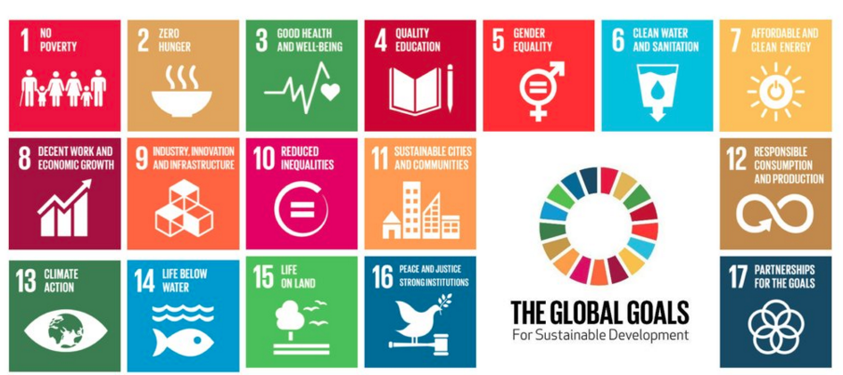
Lesson 2
Part 9
Notes:
Notes for teachers
Changemaker Unit 1st-2nd class: Lesson 2/Part 9 (1 animation at *)
Explain that it is really important that everyone in our world works together in solidarity. We need to do this to make the Global Goals happen and to create a better world where all people have what they need to live and be safe.
Remind the class that they are Changemakers.
*Animate in the Global Goal logos
As Changemakers, they can be like the Elephant they imagined, and act in solidarity with people who do not have what they need to survive. They can be Changemakers who work with others (families, schools, leaders in our country and our world) to make the Global Goals come true for everyone.

Slide 27
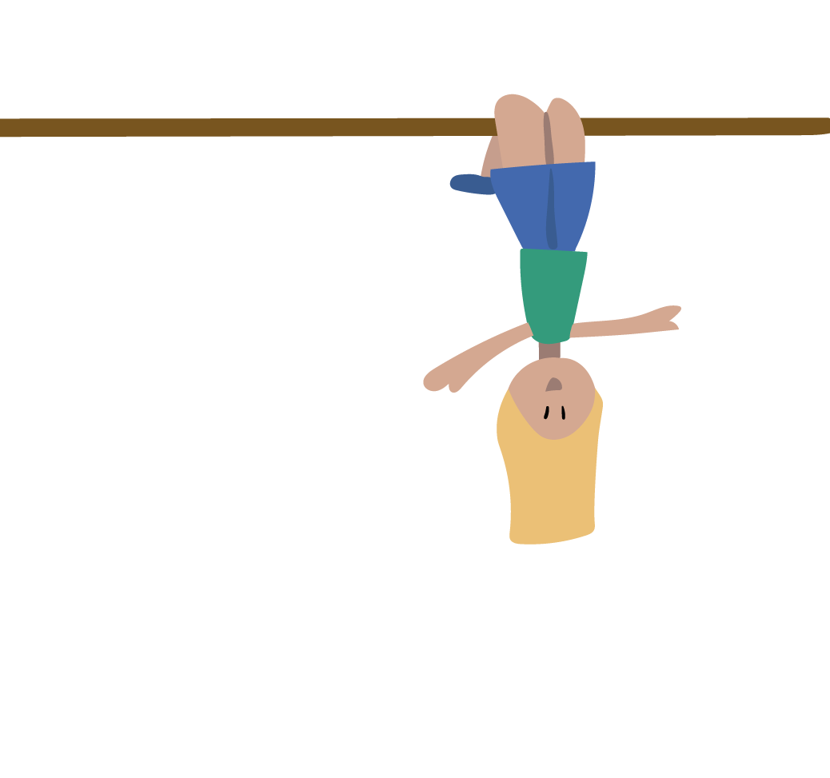
Lesson 2
Part 10
We have learned to…
practice breathing as a way of feeling calm
tell the difference between needs and wants
recognise that the United Nations Global Goals are a plan to make our world a better place
use our own words to explain what solidarity means
talk about and role play characters in a story
Notes:
Notes for teachers
Changemaker Unit 1st-2nd class: Lesson 2/Part 10 (No animation)
Invite pupils to give thumbs up (for fully achieved or learned), thumb to the side (for somewhat achieved or learned); or thumbs down (for still some work to do), as you read through each of the learning intentions for Lesson 2.

Slide 28
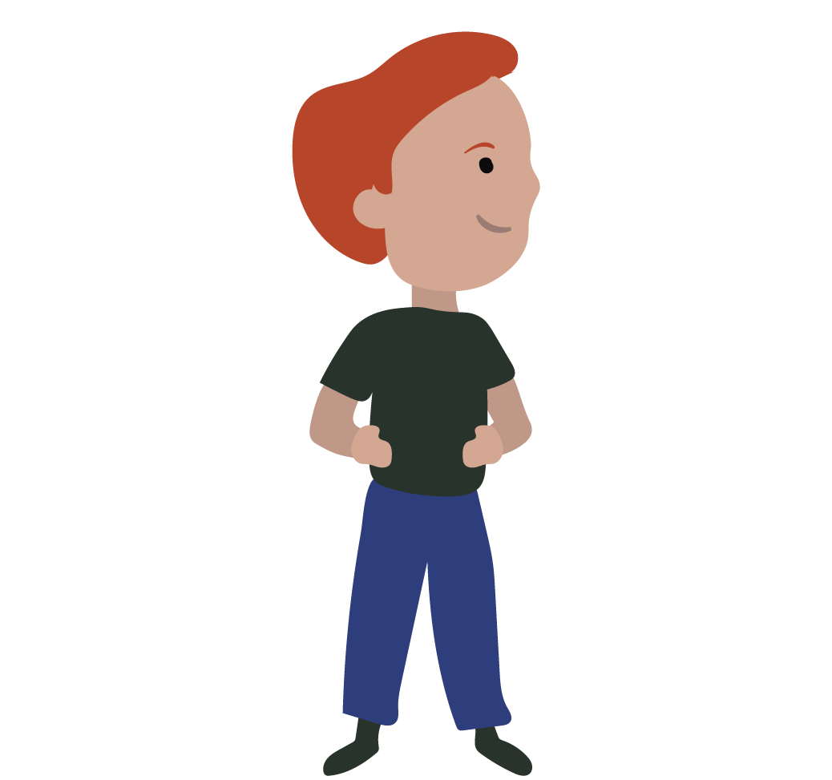
Lesson 3
Changemakers actions
Learning intentions
We are learning to…
practice breathing as a way of feeling calm
plan a changemaker action to show solidarity/ tell others about the Global Goals
Notes:
Notes for teacher
Changemaker Unit 1st-2nd class: Lessons 3 (title slide with learning intentions) (No animation)
Depending on your class, you might like to share the learning intentions for Lesson 3 with pupils before starting, clarifying/adapting language as required.

Slide 29
Lesson 3
Part 1
FOR JESSICA: Insert visual of the butterfly from GOALs breathing activity vid. Embed link (to the clip in Irish for Gaeilge slides and English clip for English slides) so teachers can click and watch without leaving PowerPoint
Do you feel calmer now?
Notes:
Notes for teachers
Changemaker Unit 1st-2nd class: Lesson 3/Part 1 (1 animation at *)
Explain that one way to feel calmer or better is to breathe in and out, slowly and deeply.
Tell the class that they are going to practice breathing as a way of feeling calm. Sometimes it can help to imagine something at the same time as we breathe, to help us slow down our breath.
Depending on your class, you might like to demonstrate and invite the class to join in for a second or third practice breath.
To guide the breathing activity, you can either play the video provided, by clicking on the image of the butterfly. Also available: https://youtu.be/BqGQoZTo3CY (English language version);
https://youtu.be/WAd55dolYl4 (Irish language version) ; and/or use the instructions below:
Bring your hands together, palms touching. Imagine your hands are a butterfly whose wings are closed. As I count, we’re going to slowly open our wings and breath in.
Now, together 1, 2, 3, 4 and pause. Now, breathing out and closing, 1, 2, 3, 4.
Now, lets repeat this a few times.
Breathing in 1, 2, 3, 4 open - breathing out 1, 2, 3, 4 closed. [repeat this line twice more]
If using the video, you might decide to play it a second time. If your school is an Irish-medium school, you might like to firstly play the video in Irish, and then a second time in English. If your school is an English-medium school, you might like to firstly play the video in English, and then a second time in Irish.
* At the end of the breathing activity, animate in a question for pupils about whether they feel calmer now.
Background information
Grounding activities, like this breathing exercise, can be very useful at the start of Development Education/Global Citizenship Education lessons. They can help children to settle and connect with how they are feeling, before beginning to switch the focus outwards to our wider world.

Slide 30
Lesson 3
Part 2
Notes:
Notes for teachers
Changemaker Unit 1st-2nd class: Lesson 3/Part 2 (No animation)
Remind the class about the story of the Hummingbird video that the class watched in their first Changemaker lesson.
Depending on your class, you might like to show the video again. To play the video, click on the image of the hummingbird. Also available: https://youtu.be/f3sCATyn_e0 (English language version); https://youtu.be/Qb8SUEgeGQ8 (Irish language version).
You might also like to remind pupils that the lady in the video is Wangari Maathai (1940-2011). She was a Kenyan lady and an inspiring Changemaker, who helped other women and girls, and planted a lot of trees to help all people and our planet.

Slide 31
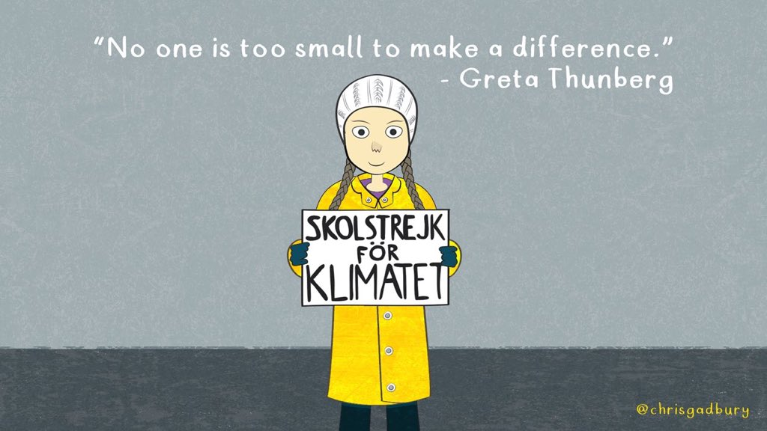
Lesson 3
Part 3
Do you know of any children or young people who are trying to make good changes in our world and be Changemakers?
Do you know who Greta Thunberg is?
What is Greta trying to change?
Don’t forget that you are a Changemaker too! Have you got our Changemaker I.D. with you?
Notes:
Notes for teachers
Changemaker Unit 1st-2nd class: Lesson 3/Part 3 (1 animations at *)
Read the question on the slide aloud, encouraging different pupils to respond.
* Animate in two questions and an image related to Greta Thunberg.
Read the question on the slide aloud, encouraging different pupils to respond.
Teacher background information
Greta Thunberg (2003 - ), is Swedish Changemaker and environmental activist who works to address the problem of climate change. Climate change is when there is a big difference in normal climate patterns over a long amount of time. The Earth's climate is changing very fast, in a way that hasn’t happened before. Scientists say that these changes are because of an increase in ‘greenhouse gases’, invisible gases (like steam when water is boiling) from burning coal and oil in factories to make our food, machines, clothes and toys, when we drive cars and fly in aeroplanes. These gases go into the atmosphere (a blanket of air and gases that surrounds our world) and trap the heat, which changes the climate.
Greta was so concerned that changes in the climate that she decided not to go to school until the leaders in her country, Sweden, took notice and did something about this problem. She has inspired other children, young people and adults all around our world to join her in a movement or community known as Fridays for Future (because she agreed with her parents that she would strike from school on Fridays instead of every day of the week). In everything she says, Greta encourages people to stop ignoring unfairness and injustice and to stand in solidarity with those who are in need or worse off. Her work around climate change helps to achieve Global Goal 13: Climate Action.

Slide 32
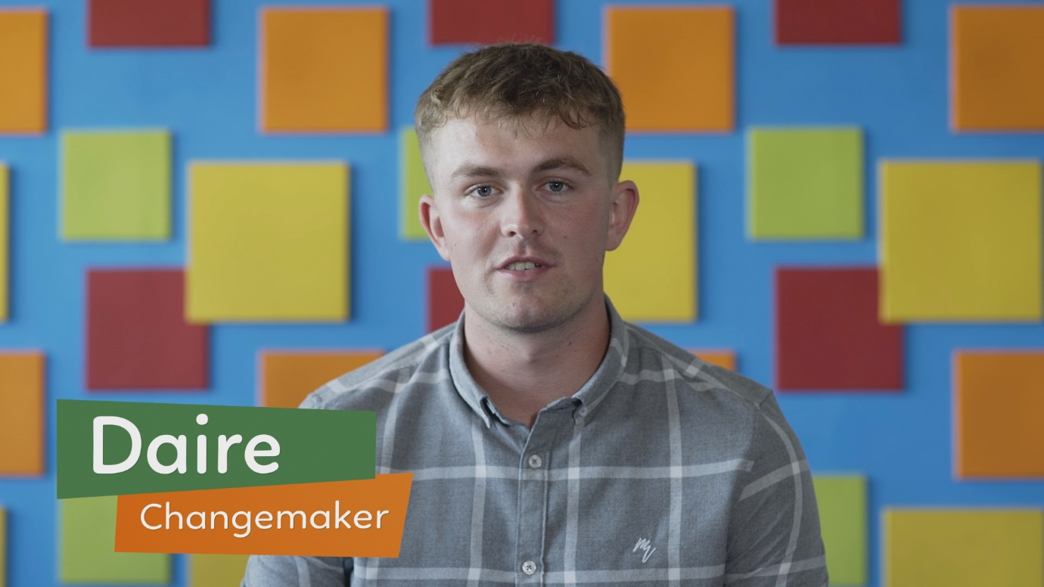
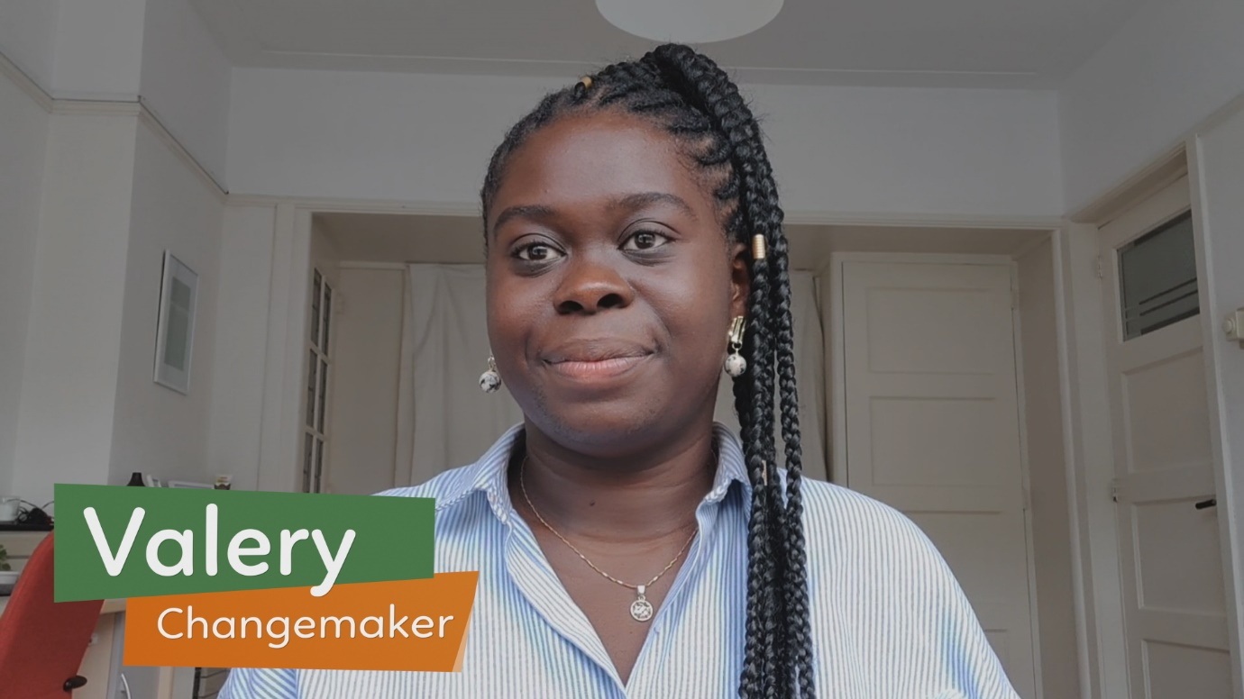
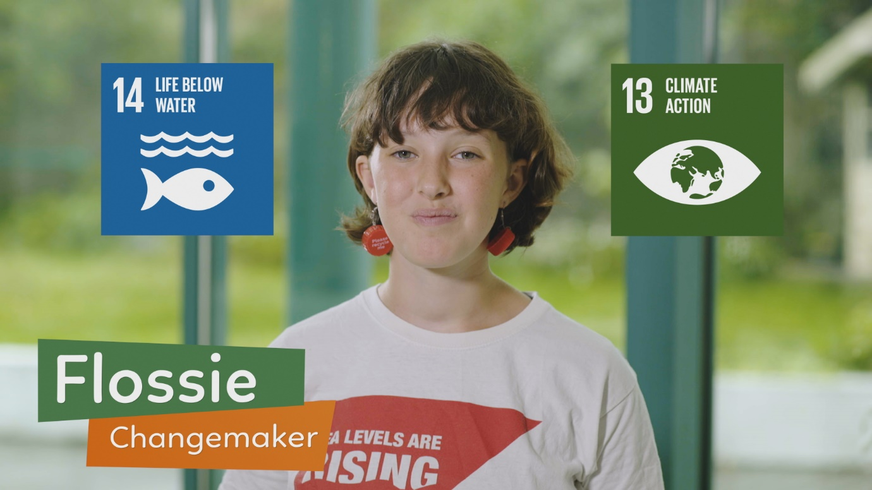
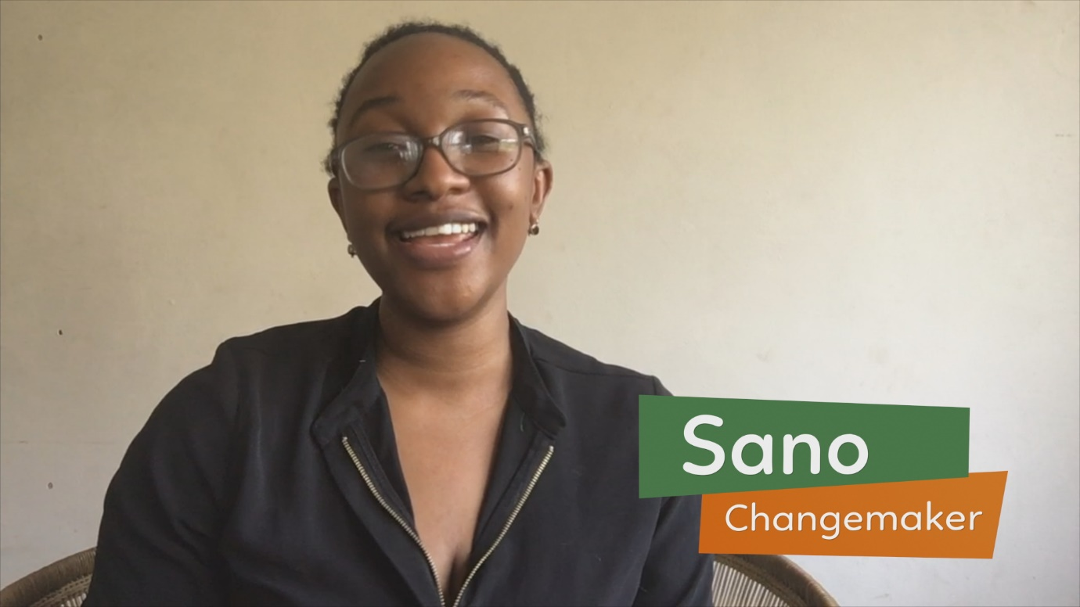
Lesson 3
Part 4a
Write or draw:
one thing that Daire says that you like
or
one question you would like to ask Daire
Write or draw:
one thing that Valery says that you like
or
one question you would like to ask Valery
Write or draw:
one thing that Flossie says that you like
or
one question you would like to ask Flossie
Write or draw:
one thing that Sano says that you like
or
one question you would like to ask Sano
Notes:
Notes for teachers
Changemaker Unit 1st-2nd class: Lesson 3/Part 4a (No animation)
Explain to the class that they are going to watch a short video (English version = 6.32 mins; bilingual (English/Irish) version = 6.34 mins), about young people in Ireland and Malawi who are Changemakers, working to contribute to one of more of the Global Goals. [The Changemakers video is embedded on the next slide]
Tell the class that you are going to divide them into four groups, one for each of the four Changemakers in the video – so their groups will be Daire, Valery, Flossie or Sano.
As they watch the video, their job is to listen out for and pay lots of attention to what their own Changemaker says.
After watching, they are going to either: (a) write or draw one thing that their Changemaker said that they liked (this can be because they found it interesting or something they would like to get involved in, or any other reason) OR they can come up with one question that they would like to ask their specific Changemaker.
Background information:
Daire Hennessy lives in Tallaght, Dublin and works in Citywise Education, a youth centre that helps young people with their education and encourages them to become Changemakers by talking about the United Nations Global Goals. Daire is studying for a Masters in Social Policy in Trinity College.
Flossie Donnelly is a secondary school student who lives by the sea in Dublin. Flossie started beach cleaning when she was ten years old and later set up a group called FlossieandtheBeachCleaners. Flossie and other members of the group do beach cleans once a week.
Valery Molay lives in Dublin and graduated from UCD with a Bachelors in Politics, International Relations, Philosophy and Social Justice, and later with a Masters in Science, specialising in environmental policy. In 2019-20, Valery was one of two Irish Youth Delegates to the United Nations.
Sano Evelyn Kasamale lives in the city of Blantyre in Malawi. After completing her Bachelors degree at the University of London, Sano went on to read her Masters in Law at the University of Westminster. As a result of living in different countries, Sano learned about cultures around the world. This has helped her to appreciate the values of others and encouraged her to remain curious and open-minded. Being the only sister to for older brothers, Sano has been interested in gender equality since childhood. Earlier this year, she organised International Women’s Day events to take place in Malawi to celebrate the achievements of girls and women by highlighting the need to protect them. Its also important to remember that gender equality means we appreciate all people including great boys and men. Equality means educating people to value and protect each and to do so without putting someone else down.

Slide 33
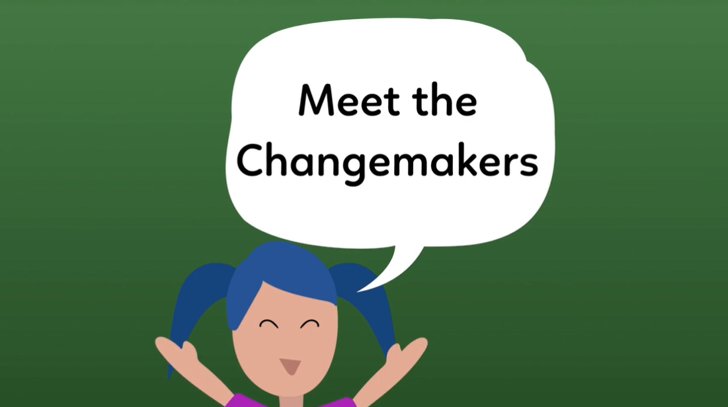
Lesson 3
Part 4b
Write or draw:
one thing that your Changemaker says that you like
or
one question you would like to ask your Changemaker
Notes:
Notes for teachers
Changemaker Unit 1st-2nd class: Lesson 3/Part 4 (No animation)
To play the video, click on the “Meet the Changemakers” image (also available: INSERT youtube link/hyperlink for English version of the video followed by (English language version); INSERT youtube link/hyperlink for the bilingual version of the video followed by (bilingual version – start and finish ‘as Gaeilge’, clips with Changemakers in English).
Depending on your class, you might decide to play the video a second time.

Slide 34
Lesson 3
Part 5
What can we do as a class to help the Global Goals?
Which Global Goal are you most interested in taking action on?
How can we tell other people about the Global Goals or the importance of acting in solidarity with other people in our world?
Notes:
Notes for teachers
Changemaker Unit 1st-2nd class: Lesson 3/Part 5 (No animation)
Question 1 prompt – Is there anything we could do as a class that might help achieve the Global Goals?
Question 2 prompt - Explain that they can choose the Goal they find most interesting as a class and take action on that Goal. Depending on your class, you might like to remind them what each Goal is about (see child-friendly explanations in the notes on Slide 21); or focus on specific Goals that might be easier to grasp for their age/stage, e.g. Goals 1 to 7 and Goals 13, 14 and 16.
Question 3 prompt – Explain that the class could focus on telling other people about the Global Goals, so that more people know and get involved in making them happen. Another thing they could do is tell people about Solidarity and how important it is to stand with those who are in need of our help or support.
Depending on your class, you might like to prompt their thinking with the action ideas on the next slide.

Slide 35
Lesson 3
Part 6
Action ideas…
Each one…teach one campaign
Give Changemaker ID cards to other people in our families, school or community, for celebrities/sportspeople/politicians to encourage them to become Changemakers for the Global Goals.
Hummingbird display
Make a window/wall display about one (or all) of the Global Goals to capture the attention of people passing by.
Something in solidarity
-make up a song, rap, poem or play
-draw a picture
or
-create a poster
…about someone who was kind or who acted in solidarity with others.
Notes:
Notes for teachers
Changemaker Unit 1st-2nd class: Lesson 3/Part 6 (No animation)
Remind the class that GOAL Changemakers is a programme that is run by an organization or charity called GOAL. GOAL is working to help achieve the Global Goals and make sure that people in poor countries have food, clean water, medicine and schools. GOAL wants to support us to work for the Global Goals, in solidarity with people who are in need.
Here are some ideas for actions that we can take as GOAL Changemakers.

Slide 36
Lesson 3
Part 7
Sit at your desk/table.
We are going to take turns saying one thing we liked or learned during our Changemaker lessons.
After the first person has taken their turn, say ‘Whoosh’ and do an action as if they are throwing something to friend nearby.
Then it is the 2nd person’s turn, and so on until everyone has had a turn.
WELL DONE CHANGEMAKERS!
Notes:
Notes for teachers
Changemaker Unit 1st-2nd class: Lesson 3/Part 6 (1 animation at *)
Follow the steps outlined on the slide.
Depending on your class, you might want to take the first turn and demonstrate how to do the ‘Whoosh’ and the throwing action.
* Animate in ‘well done Changemakers’ and image of boy jumping
Adaptation note: In the context of an online learning lesson with Zoom or similar, you could ask each person to say the name of the person they are giving the next turn to, before doing the ‘Whoosh’ and throwing action.

Slide 37
Let’s get going Changemakers!
Submission form available here
Notes:
Notes for teachers
As you and your class engage with the Changemaker lessons and/or undertake Changemaker related actions, we would love to hear how you are getting on. Tweet us your thoughts, pupils comments etc. to @GoalNextGen using the hashtag #GOALchangemakers.
If you need additional support or have questions relating to the programme, phone or email Jessica Sargeant on 0863542491 or jsargeant@goal.ie, and one of our Changemakers team members will get back to you as soon as possible.
We want to celebrate your participation in the Changemakers programme, regardless of how small or big that participation is. If you would like to receive a Changemakers certificate of recognition and a large map of the world for classroom display, all you have to do is take a few minutes to fill out our simple submission form, available via this link and in the above slide: https://forms.office.com/Pages/ResponsePage.aspx?id=eyyiaeokR0aD1EiqjbjOd_QIHIdzOSZPsrCMcGlMmkFUNTJVUTlVUlhWUTM2QVdNNFpUQ04zWjFVTy4u

